Slide 1



Gifted and Talented Assessment Program for Grade 2 Students
Fall 2025 DTC Pretest Workshop-
Online Administration

Slide 2

Disclaimer on the Use of Artificial Intelligence
The content presented is the intellectual property of the South Carolina Department of Education (SCDE) or Riverside Insights. By participating in this event, attendees agree they will not record, capture, or share its contents without permission. Attendees agree they will not use artificial intelligence (AI) to capture or summarize the contents of the event. The SCDE reserves the right to remove attendees using these services.
Notes:
The SCDE has provided permission to use this presentation for training purposes.

Slide 3

Who to Contact
Riverside Insights- South
Carolina Team
South Carolina Department of Education Staff
For information on the administration of the CogAT and Iowa Assessments.
For questions regarding accommodations, testing procedures, or test security.
Celia Ortiz
  Sr. Project Manager celia.ortiz@riversideinsights.com
  Phone: 630-760-4419
Sierra Scott
  Assessment Consultant
  sierra.scott@riversideinsights.com
  Phone: 407-362-8204
David Trombly
  Office of Assessment and Standards, SCDE
  dctrombly@ed.sc.gov
  Phone: 803-734-8274

Slide 4

Schedule of Important Dates- Fall 2025
Milestone, Task, or Deliverable | Date
Test Administration Manuals arrive at the schools and districts | Monday, September 8
Pretest Workshops via Webinar Paper Administration Online Administration | Tuesday, September 9 Thursday, September 11
DataManager Live Proctor Trainings *OnDemand Proctor training now available | Monday, Sept 15 at 9 AM Wednesday, Sept 17 at 2 PM Thursday, Sept 18 at 2 PM
Gr 2 GT Testing Fall 2025 Roster | September 22
Online Test Events Open | September 22
Test administration window | October 6 – 28
Online Test Events Close | October 28
Post test Webinar for District Test Coordinators | November 6
Reports arrive in districts if returned by October 31 , 2025 | December 4
Notes:
(TAM page iii)

Slide 5
SC Gr 2 Gifted & Talented
Assessment Program
The Gifted and Talented Grade 2 Assessment is a statewide assessment used to identify students for district gifted and talented programs. Students are identified for this program by demonstrating high performance ability or potential in academic and/or artistic areas.
All students in Grade 2, including students with disabilities and multilingual learners (MLs), must be administered CogAT® (the Cognitive Abilities Test™) and the Iowa Assessments™ except those students who qualify for the alternate test as determined by their IEPs (Individualized Education Plans).
Notes:
State Board of Education regulation 43-220 requires the administration of assessments measuring cognitive, academic, and/or artistic abilities to identify students for district gifted and talented programs. The South Carolina Department of Education (SCDE) provides an aptitude and an achievement assessment for this purpose.
South Carolina law requires districts to screen all students at the elementary and secondary levels for district Gifted and Talented services. Districts are required to provide services for all gifted and talented students.
Although the primary purpose of these assessments is to identify students for the Gifted and Talented programs, student results can be useful to teachers as they examine their instructional practices and can help them identify teaching strategies for all students.

Slide 6
Criteria for Gifted & Talented Selection
Students may qualify for placement in the district’s Gifted & Talented program based on aptitude alone.
Eligibility includes a CogAT® composite score:
  Grades 1–2: at or above the 98th national age percentile
  Grades 3–12: at or above the 96th national age percentile
Qualifying aptitude scores remain valid for five years.
Students may also qualify by meeting high performance in two of the following dimensions:
Dimension A: Aptitude (CogAT®)
93rd percentile or higher on one or more subtests:
Verbal/Linguistic
Quantitative/Math
Nonverbal
Composite
Dimension B: Achievement
94th percentile or higher in Reading and/or Mathematics
Dimension C: Intellectual/Academic
Score of 16 (for Grade 3 placement) on the verbal or nonverbal section of the Performance Task Assessments

Slide 7
Administration of CogAT and IA
New this year…
CogAT Shortened Directions- Online testing
Release Date: March 2025
What is it?
  More succinct wording for directions
  Students can now self-pace through directions, creating a smoother testing experience and cutting ~10 minutes from test administration.
2024 Normative Update for CogAT and Iowa Assessments
Release Date: August 2025
What is it?
  Updated national norms using a representative collection of more than 1 million data points
  Available for both online and paper versions
  The SCDE has decided to adopt the new norms for the grade 2 testing program, as well as for districts administering CogAT and/or Iowa Assessments in other grades for GT identification purposes.
  The 2024 norms are now available for selection when creating online test events and when completing the OSS for off-grade districts using paper-based testing.
  Supplemental white papers and ancillaries will be available to help with norm interpretation and use.

Slide 8
Administration of CogAT and IA
New this year…
CogAT Practice Activities
Release Date: September 2025
What is it?
  Teacher- and student-friendly practice activities built into PowerPoint slides that can be used to help prepare students for CogAT testing.
  Currently, levels 5/6 and 8 are available in the Resources section in DataManager.

Slide 9

Administration of CogAT and IA
CogAT and Iowa Assessments are group-administered by classroom teachers.
It is best for tests to be administered by someone who is familiar to the students.
Tests at the second-grade level are not timed.
Adjust pacing to fit your students’ needs. CogAT tests focus on assessing how well, not how quickly, students solve reasoning problems.
Teachers must be trained before administering these assessments.
Each test starts with a practice item to help students get accustomed to the format. Review practice questions with students. Make sure students fully understand the instructions before beginning the subtest.

Slide 10

Administration of CogAT and IA cont’
Monitor students – it is important to monitor the students to ensure they are working on the correct questions and are marking their answers correctly in the online test.
Color blindness- CogAT can be used for students who are colorblind without disadvantaging their performance on the assessment. Students do not have to be able to see or name colors to be successful in answering the questions on CogAT.
Usage of Scratch paper during CogAT test (Paper Folding) is not allowed. Scratch paper is allowed for Iowa Assessments Math, but pretty much nowhere else.
Notes:
Color blindness-
CogAT can be used for students who are colorblind without disadvantaging their performance on the assessment. All informational graphics went through a composition check to ensure coherency to a color-deficient student. Art was processed through a color blindness simulator which renders images as they would appear to individuals with Protanopia, Deuteranopia and Tritanopia. Using these simulations as a guide, any art requiring modification was addressed by choosing patterns and/or color contrast that was acceptable for colorblindness. The revised art was resubmitted for validation and retested using the color-blindness simulator to ensure viability. Students do not have to be able to see or name colors to be successful in answering the questions on CogAT.
Usage of Scratch paper- There is supposed to be NO SCRATCH PAPER during the Paper Folding test. Scratch paper is allowed for Iowa Assessments Math, but pretty much nowhere else

Slide 11
Administration of CogAT and IA cont’
There are two methods for online test administration: proctor-led and audio-led.
In proctor-led administration, classroom teachers read the test aloud, word for word. Teachers must speak clearly, maintain a steady pace, and use appropriate vocal inflection.
In audio-led administration, students wear headphones to listen to the test instructions and questions.
Teachers are not allowed to preview the test before administration. However, audio directions can be found in the TAM (pages 81–83).
Each test starts with a practice item to familiarize students with the format. Review practice questions with students. Make sure students fully understand the instructions before beginning the subtest.
Notes:
Subtest directions- TAM pages 81-83
Practice items- the students are prompted to try again if they answer incorrectly. This is only for the practice items, not the actual test.

Slide 12
Cognitive Ability Test (CogAT®)
All of the following CogAT tests must be administered:
Required Sections of Each Test | Number of Items | Estimated Time (minutes) | Minimum No. of attempts
Verbal Battery Picture Analogies Sentence Competition Picture Classification | 18 18 18 | 13 14 13 | 9 9 9
Quantitative Battery Number Analogies Number Puzzles Number Series | 18 14 18 | 15 15 15 | 9 7 9
Nonverbal Battery Figure Matrices Paper Folding Figure Classification | 18 16 18 | 13 11 13 | 9 8 9
All nine tests are combined to obtain a Composite Aptitude score.

Slide 13
Iowa Assessments™
All the following subtests in the IA level 7 tests must be administered:
IA Form G, Level 7 Core Battery | Number of Items | Estimated Time (minutes)
Reading: Part 1* | 17 | 20
Reading: Part 2* | 18 | 25
Reading Totals | 35 | 45
Mathematics: Part 1** | 26 | 25
Mathematics: Part 2** | 15 | 25
Mathematics Totals | 41 | 50
*Both Reading Parts 1 and 2 must be completed to obtain a Reading score.
**Mathematics Parts 1 and 2 must be completed to receive a Total Math score
Notes:
Online Reading
Part 1 includes Picture Stories and Sentences
Part 2 includes Stories

Slide 14
Testing Students with Documented Disabilities and ML Students
  Definition of a Student with Disabilities
  Students with IEP and 504 Plans must participate in the screening
  The student’s IEP team determines whether the student will participate in the assessment in the same manner as other students, or with accommodations
  South Carolina-Allowed Accommodations
Notes:
A student with a documented disability is either a student who has been evaluated and found to meet the eligibility criteria for enrollment in special education as defined by the Individuals with Disabilities Education Act (IDEA 97) and South Carolina State Board of Education Regulation 43-243.1 or a student who has a disability covered under Section 504 of the Rehabilitation Act of 1973.
Students with a current Individualized Education Program (IEP) or 504 Accommodations Plan must participate in screening for identification for the academic gifted and talented program. Students should participate in CogAT and Iowa Assessments testing, as appropriate, or in an alternative screening process that includes a documented review of existing data from a norm-referenced aptitude and norm-referenced mathematics and reading comprehension assessment.
The student’s IEP team determines whether the student will participate in the assessment in the same manner as other students, or with accommodations. Students cannot be excluded from screening because of a disability.
SC Allowed Accommodations- Some accommodations listed in the Directions for Administration (DFA) for both CogAT and Iowa Assessments are not approved for use in South Carolina. Make sure that Test Administrators (TAs) are aware that the accommodations listed in the TAM pages 8-14 are the only approved accommodations for the South Carolina Grade 2 Gifted and Talented Assessment program.

Slide 15
State-Allowed Accommodations
Setting – individual or small group
Timing – frequent and extended breaks
Scheduling - multiple sessions or days
Presentation –read aloud to self, repeating or signing the directions, repeated directions, signed administration
Response – nonverbal indication of answer choices or dictation of responses
Bilingual Dictionary – word-to-word dictionary only with no pictures, definitions, etc.
Translate Directions – only general test directions may be translated
Notes:
Setting-
The small-group size should be consistent with the group size used for routine classroom assessments.
Preferential seating
Separate location
Timing- Frequent and Extended Breaks – This accommodation is used if additional time is needed beyond the break structure of the assessment. These breaks may occur:
In the classroom/separate location, with no contact between students; or
Outside of the classroom/separate location, with contact between students monitored to ensure there is no discussion of the assessment.
Scheduling- Multiple Test Sessions/Days – The student may take portions of CogAT or the Iowa Assessments over several days, as long as all testing is completed by the last day of the testing window. Students must begin testing on the regularly scheduled testing date and may not go back to previously completed sections of the test.
Presentation- Highlighting and Cueing are not available with online testing
Read Aloud to Self – All items on CogAT are pictorial. For the Iowa Assessments, the student may read the test questions aloud to himself or herself. This accommodation requires an individual administration.
Repeated Directions- Only test directions may be read aloud as many times as necessary to inform students of the proper procedures to follow in responding. This accommodation applies only to the general test directions prior to the first test item for each subtest. Additionally, any student may have the general directions repeated or clarified to ensure the student understands the proper procedures to follow in responding.
Notice that there are differences between the test administration directions for the CogAT and Iowa Assessments tests. These administration directions apply to all students. CogAT- you may repeat the directions as many times necessary. Iowa- Read the directions for each question only once. Do not repeat the directions. This applies to the entire test, even for students with “repeated directions” in their IEP, because repeating the directions changes the construct of the test.
Signing the Directions – The student may need to repeat/sign the directions to the Test Administrator for clarification or to demonstrate his or her understanding.
Signed Administration (Communication Assistance) – The online system does not have the capability of signing the test, so a Test Administrator or Interpreter may sign the entire administration to a student. The TA/Interpreter must sign exactly as written in the Proctor screen and may not interpret test item content beyond what is allowed by the subject. Care must be taken not to use signs that might convey answers to any test questions.
Bilingual Dictionary- Students may use a word-to-word bilingual dictionary. However, the dictionary must not include any examples, pictures, or definitions..
Translate Directions- The general test directions may be translated into the student’s native language. This translation cannot go beyond the scope and meaning of the directions. Test questions/individual test question directions may not be translated. Practice items also may not be translated as they are embedded in the test.
In DataManager, the directions and item prompts may be administered in the student’s native language using audio proctoring. Seven additional languages are available including Spanish, Arabic, Chinese-Mandarin, Chinese-Cantonese, Russian, Somali, and Vietnamese. If your student’s native language is not available, then the general test directions may be translated into the student’s native language. This translation cannot go beyond the scope and meaning of the directions. Test questions/individual test question directions may not be translated. Practice items also may not be translated as they are embedded in the test

Slide 16
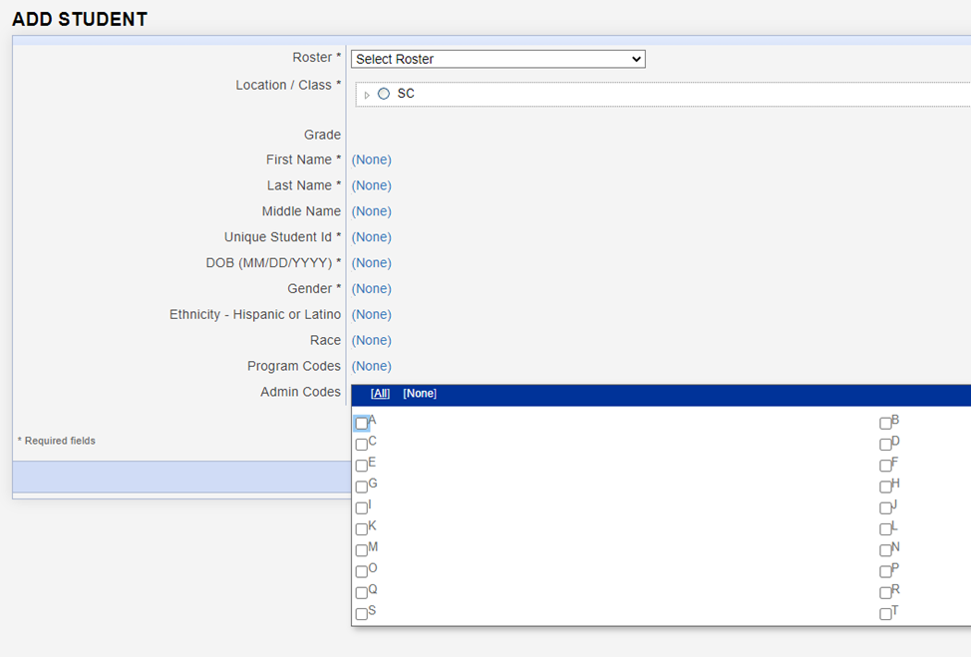
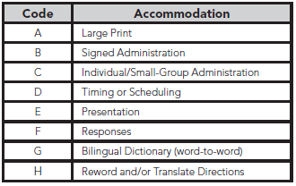
Coding Accommodations for Students with Documented Disabilities and ML Students
Notes:
The types of accommodations provided to students can be recorded in the student record in DataManager.
Even though more accommodations are allowed for testing, the codes listed on page 15 of the TAM are the only accommodations that can be recorded.

Slide 17
Large Print Materials
Braille test booklets are NOT available for CogAT or the Iowa Assessment at the second-grade level.
Large-print test books are available for both the Iowa Assessments and CogAT. Student responses must be transcribed to the student’s barcoded test booklet.
To order the Large Print books, please contact Celia Ortiz. We will begin to fulfill requests starting on Monday, 9/22.
Please order these materials no later than Tuesday, October 21, 2025.
Notes:
Why isn’t CogAT offered in Braille? The visual nature of the majority of CogAT items makes them impossible to convert into Braille.
Students may mark directly in the large print booklet with a pencil, pen, or crayon. Later, the test administrator can transfer the responses to the student’s barcoded test booklet.
If a student’s visual impairment is such that the large print booklet is insufficient, you may work with a clinician or school psychologist in your district to administer an appropriate individually administered assessment, such as the Woodcock-Johnson IV. Both the standard WJ IV kits from Riverside and the Braille kit from the American Printing House for the Blind (APH) will need to be ordered. Please contact David Trombly for more information.

Slide 18
What is CogAT Alt-V Scoring for Grades K-2?
CogAT is designed to be accessible for English Learners (ELs), minimizing the effect that limited English proficiency may have on measuring reasoning skills. An Alternative-Verbal version is available, which is not a separate test, but it involves the elimination of the Sentence Completion subtest from the Verbal battery. If the correct subtests are administered, students will receive a composite score and an Ability Profile that can be used for instructional grouping.
Who?
SCDE states only ML students are eligible for Alt-V scoring where they have the option to omit the Sentence Completion subtest.
Consideration for Alt-V Scoring should be determined for each individual ML student. ML students receiving an ACCESS for ELL’s composite score between 1.0-3.9 may be coded for Alt-V Scoring.
How?
Teachers will administer only the ALT/VERBAL/Picture Analogies and ALT VERBAL/Picture Classification subtests. The Sentence Completion subtest will be skipped. Students will complete the full Quantitative and Nonverbal batteries.
Administering the ALT/VERBAL subtests triggers a system flag that designates the test as Alt-V.
Notes:
Alt-V scoring involves the elimination of the Sentence Completion subtest from the Verbal battery.
SCDE states only ML students are eligible for Alt-V scoring where they have the option to omit the Sentence Completion subtest.
Consideration for Alt-V Scoring should be determined for each individual ML student. ML students receiving an ACCESS for ELL’s composite score between 1.0-3.9 may be coded for Alt-V Scoring (TAM page 16). ML students without an ACCESS score may have their screener score used; 1.0–4.5 may be considered.

Slide 19
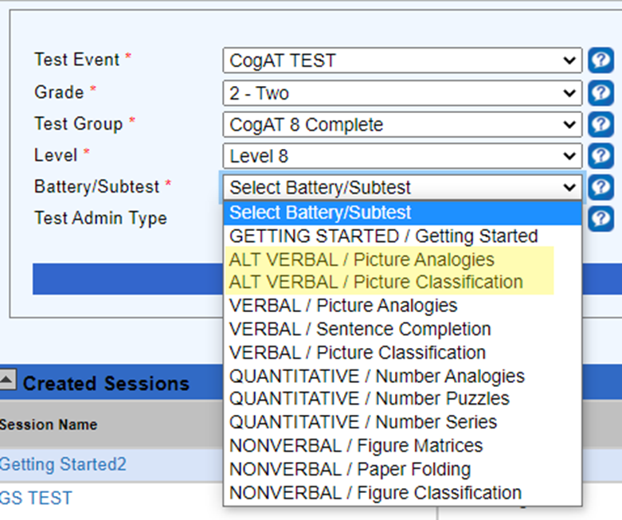

Administering the Alt-V Online
  Alt-V Required subtests:
  ALT-V/ Picture Analogies
  ALT-V/ Picture Classification
  Number Analogies (Q)
  Number Puzzles (Q)
  Number Series (Q)
  Figure Matrices (NV)
  Paper Folding (NV)
  Figure Classification (NV)

Slide 20


Slide 21



Preparing Students for Testing
Informing parents
Testing environment
TEST ADMINISTRATION
Notes:
Keeping parents informed before testing helps testing run smoothly and allows students to perform at their best.
Parents should be informed about the purpose of the tests and how the results will be used. It's important to clarify that there is no opt-out option—all second-grade students must be given the opportunity to participate in testing.
The grade 2 parent and student brochure that can be sent home to inform parents about the test. A Spanish-translated digital version is now available for districts to use if needed.
Parent permission is not required for these tests, but all parents should be notified in advance of the dates and times for each test and/or subtest at their child's school. Be sure to send them the testing schedule.
Testing Environment:
Students should be tested in well-lit and well-ventilated classrooms.
There should be adequate spacing between students to enhance test security.
The classrooms should be quiet, free from distractions, and any content related to grade 2 standards in reading and math should be covered or removed.
Test Administration:
Determine how the test will be administered and who will oversee it. This include proctor mode of administration.
Monitor students to ensure they understand the test instructions.
Adjust the pacing of the test to suit the students' needs. For classes where some students may take significantly longer than others, consider administering the test in two separate groups.

Slide 22

Suggested Testing Schedule
Day | Test | Estimated Time (minutes)
Day 1 | Verbal Picture Analogies Sentence Completion Picture Classification | 13 14 13
Day 2 | Quantitative Number Analogies Number Puzzles Number Series | 15 15 15
Day 3 | Nonverbal Figure Matrices Paper Folding Figure Classification | 13 11 13
Day 4 | Iowa Reading: Part 1 Reading: Part 2 | 20 25
Day 5 | Iowa Mathematics: Part 1 Mathematics: Part 2 | 25 25
Notes:
Sample test schedule on page 19 of the TAM.

Slide 23

Online Testing Roadmap
Tech Readiness
DataManager Training
Test Preparations
Materials Needed for testing
Check system and network requirements
Install the Riverside App or create a desktop shortcut to the student login page on all student devices.
Ensure student devices are ready for testing.
STCs and TAs to attend the DataManager training.
Live Training Sessions:
  Monday 9/15 at 9 AM EST
  Wednesday 9/17 at 2 PM EST
  Thursday 9/18 at 2 PM EST
Self-paced, blended learning Proctor Training now available
Ensure that all STCs, and TAs have access to the DataManager Platform.
Gr 2 Roster will be available on 9/22. STCs to confirm student are rostered correctly.
Gr 2 Test Events will be opened on 9/22. STCs to decide who will create test sessions
Student devices
Scratch Paper and pencils for the Math subtests.
Student login Information: Student ID and session code
Ready to test

Slide 24
Pretesting Activities for Online Testing
Review System/Network Requirements
System/Network Requirements and DataManager Domain and Port Listing.
Considerations:
  If schools are testing with wireless devices, do you have access points (APs) in each room or another setup.
  If possible, postpone scheduled network scans and updates to devices during testing window.
  How many students are testing simultaneously? If their testing schedules allow plan on staggered start times.
While TAs are performing live proctoring it is nevertheless still important to minimize local network processes and programs that compete for bandwidth.

Slide 25
Pretesting Activities for Online Testing
Prepare student devices for testing
Make sure the Riverside App is installed on all devices or create a desktop shortcut to the student login page at www.riversideonlinetest.com.
Verify that student devices are completely charged.
Confirm the functionality of the volume.
Provide headphones for audio proctoring.
Have additional devices on standby.
Close all active applications, including additional browser windows or tabs, on both student and proctor devices.

Slide 26
Pretesting Activities for Online Testing
Rostering
Student Roster
The SCDE will be submitting a student roster to be used by ALL districts for the grade 2 administration of CogAT and the Iowa Assessments during the main and make-up test windows. Roster will be available in DataManager by Monday 9/22, 2025.
Roster name- SCDE Gr 2 GT Testing- Fall 2025
School Test Coordinators can download the roster to confirm that all students in their schools are included.
Please Do not rename the roster
Districts do not need to submit or create separate rosters for the grade 2 GT testing.
Notes:
Sharing PII Information: When emailing me student information for issue descriptions or student relocation requests, kindly provide only the student's 10-digit state ID (and building/class if applicable). Please refrain from including any other student identifiable information.
If you get a message indicating that a student ID already exists when adding a student, please contact me as it may signify that the student is already rostered in another SC district and requires an update. Simply provide me with the 10-digit student ID and the school/class where the student should be moved.

Slide 27
Pretesting Activities for Online Testing
Rostering
Staff file
DTCs need to ensure that anyone administering the CogAT and Iowa Assessments online have access to DataManager.
Step 1- Export a list of staff users using the Manage Staff functionality in DataManager
Step 2- Update the users as necessary and add new staff if needed.
Step 3- Submit the file to Celia Ortiz for upload
*Manual entry of new staff or edits to existing staff is also available

Slide 28
Pretesting Activities for Online Testing
Test Events
The SCDE will create the Test Events that will be used by ALL districts for the grade 2 administration of CogAT and Iowa Assessment during the Fall 2025 testing window. These test events are scheduled to open on Monday, September 22.
  Important reminders:
  Districts are not required to create separate Test Events for grade 2 GT testing.
  Please refrain from closing the Test Events that have been set up for grade 2 GT testing.
  Avoid reopening a Test Event once it has been closed.
  After the Test Events have been closed, no additional testing will be permitted.

Slide 29
DTC Checklist- Before Testing
Participate in the pretest workshops.
Ensure that adequate training is given to all persons who will be administering or monitoring the Gifted and Talented assessments.
Conduct training sessions for all STCs.
DTCs and/or STCs must hold training sessions for all Test Administrators (TAs) and monitors.
DTCs, STCs, TAs and monitors to complete the appropriate “Agreement to Maintain Test Security and Confidentiality” forms found on pages 63-68 of the Online TAM.

Slide 30
DTC Checklist- Before Testing cont’
Develop a test administration schedule for the district- see page 19 of the TAM for a sample testing schedule
Ensure that each school has sufficient Test Administration Manuals (TAM).
If paper materials are needed to support accommodations, use the Request for Additional Test Materials form posted on the SC microsite and email your request to me.

Slide 31
STC Checklist- Before Testing
  Ensure that adequate training is given to all persons who will be administering or monitoring the CogAT and Iowa Assessments.
  Inform teachers of the testing schedule.
  Confirm that all grade 2 students are rostered correctly
  Ensure that arrangements have been made for any student who requires accommodations to respond to the tests.
  Determine who will create Test Sessions in preparations for testing.

Slide 32

SUNS and Power School ID Numbers
Student Identification Number (State ID)
  The 10-digit State ID number assigned to each student is used for testing online.
Student Power School Number
  The 5–12-digit Power School Number is not unique across the entire state and will likely cause problems if used for online testing.

Slide 33
Checklist- During & After Testing
District Test Coordinators
School Test Coordinators
Ensure that schools are on track to complete all required subtests during the test window.
Provide ongoing support to schools
Return any paper materials used for accommodations
Ensure that STCs have validated score results. Contact Celia with discrepancies
Ensure that TAs are on track to complete all required subtests during the test window.
Provide ongoing support to TAs
Return any paper materials used for accommodations to the DTC
Validate score results. Contact DTC with discrepancies.

Slide 34

Testing Recommendations
Why are we making recommendations?
Optimize your testing experience
Standard browser vs kiosk mode browser
Audio proctoring vs Proctor led
Interval testing start times between classes

Slide 35
Testing Recommendations cont’
Standard browser vs kiosk mode browser
Using the Standard browser…
Every year 2.1 million tests are delivered using the standard browser
The same student data privacy and security considerations still apply (COPPA and FERPA compliance)
Students simply connect to the test via the URL www.riversideonlinetest.com instead of clicking on an app; but the login process and testing experience is the same from that point on.
Proctors are still in control of the testing environment in the classroom or lab.
Proctors retain the same abilities to monitor students’ progress and watch for irregularities via the DataManager Proctor Session screens, just as before.
The primary purpose of the kiosk mode browser (app) is to lock a student’s device into a full screen mode, which prevents students from easily exiting the app on their own.
The kiosk mode browser also runs a continuous process on a student’s computer or device to check for ‘blacklisted’ applications running in the background, and blocks use of these applications during testing. Some clients find that this process can slow the performance of the student test taking experience.

Slide 36
Testing Recommendations cont’
Audio proctoring vs Proctor led
Benefits of audio proctoring…
Proctor led mode requires a lot of internet “chatter” for successful communication between proctor commands and the student devices receiving those commands (i.e. navigate to the next question, give me a checkmark on my screen when the student has answered the question, etc.) Audio led testing reduces the probability of devices getting out of sync with proctor screens.
Students use headphones during testing, as opposed to a live proctor pacing the entire group through the test.
Frees up the proctor to have better visibility of the room; improved ability to actively monitor students.
Students have a little more autonomy to work at their own pace within a test, reducing student stress, frustration or boredom while waiting for others to answer a test question or have a proctor led technical difficulty/out of synch issue addressed.
Proctors still retain the control to pace the group to the next test.

Slide 37
Testing Recommendations cont’
Staggered testing start times between classes
Staggered test start times at least 10-15 minutes apart. This helps reduce the possibility of bottlenecking occurring from large numbers of students logging in at the exact same time (once students are past the login screens and into the test questions, there is less stress on networks from load).
STC to take in consideration when creating the testing schedule

Slide 39

Scoring and
Reporting
DataManager Reporting is a dynamic online reporting tool that allows you to perform the following tasks:
Create customized reports using the options available for your account
View and edit reports online
Save, edit, and re-use report criteria
Print reports
Export reports to PDF, RTF, or Microsoft Excel® format
Notes:
*The schools will also receive 2 copies of the Student Profile Narrative and the Student Score Labels- 1 for Iowa, 1 for CogAT
Step-by-step instructions on how to generate the data export is be posted on the SC Microsite as well as a live demo during the Posttest Workshop.

Slide 40

Scoring and Reporting
In addition, the schools will receive the following reports in paper form
Two (2) copies of the Student Profile Narrative
Student Score Labels- 1 for Iowa, 1 for CogAT
*Packing List and box labeling for ease of unpacking your reports and distributing to the schools.
Notes:
*The schools will also receive 2 copies of the Student Profile Narrative and the Student Score Labels- 1 for Iowa, 1 for CogAT
Step-by-step instructions on how to generate the data export is be posted on the SC Microsite as well as a live demo during the Posttest Workshop.

Slide 41
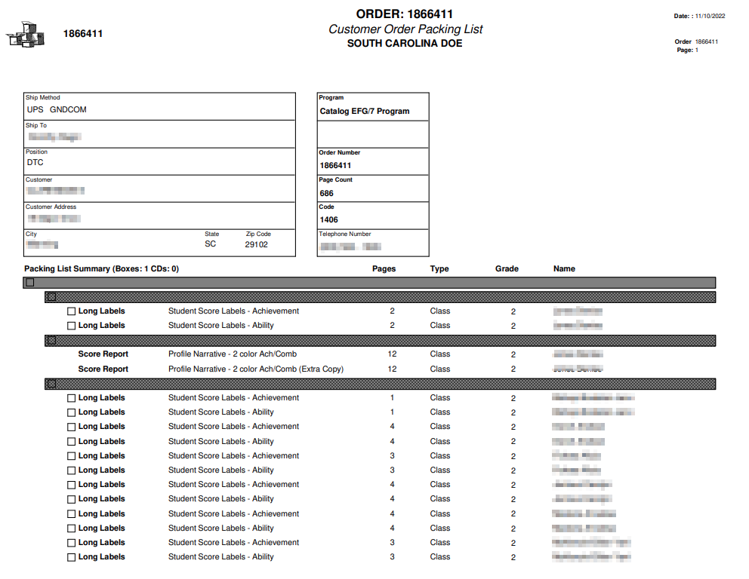
Packing List & Box Labeling
South Carolina Grade 2 Gifted and Talented Assessment Program
Score Paper Reports
Box _____of_____
1
1
Green folders- Score Labels
White folders- Profile Narrative

Slide 42
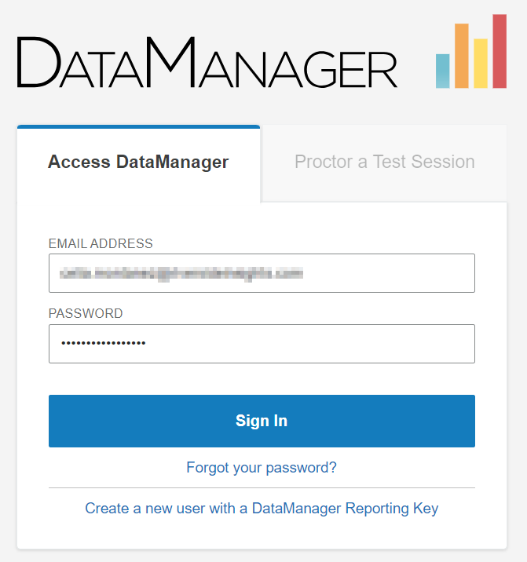
DataManager Platform Demo
https://www.riversidedatamanager.com

Slide 43

SC Assessment
Consultants
Contact your Assessment Consultant with any questions about pricing, Quotes, and to submit orders for off-grade-level testing.
Sierra Scott
Assessment Consultant sierra.scott@riversideinsights.com
Phone: 407-362-8204
I’d like to introduce Jillian Brown, Riverside Partnership Specialist, who will be working closely with Sierra. From time to time, you may also receive responses from her at jillian.brown@riversideinsights.com.

Slide 44
Ordering Off-Grade-Level Materials
Contact Sierra Scott with any questions about pricing, Quotes, and to submit orders for off-grade-level materials.
Do NOT ship off-grade-level test materials with the on-grade-level test materials for this program.
Do NOT use the orange scorable and blue nonscorable return labels when shipping off-grade-level test materials.

Slide 45

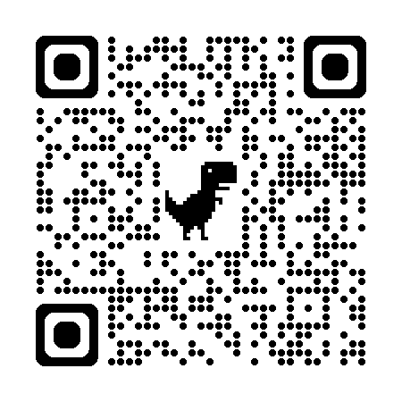
SCDoE Grade 2 Gifted and Talented Assessment Website
Follow the following link to access the website: https://info.riversideinsights.com/scdoe
You can find digital resources to support the Fall 2025 Testing Administration:
  Required tests
  Test Administration Manuals
  Pretest Workshop PowerPoint presentation
  Test security affidavit for DTC’s and STC’s
  Test security affidavit for TA’s
  Test Security Violation Forms
  Links to DataManager Proctor training
  Gr 2 Brochure for Parents and Students

Slide 46


Slide 47
THANK YOU
For attending!

