Slide 1


Gifted and Talented Assessment Program for Grade 2 Students
Fall 2026 DTC Pretest Workshop-
Online Administration
Thursday, September 10,2026

Slide 2
Who to Contact
Riverside Insights- South
Carolina Team
South Carolina Department of Education Staff
For information on the administration of the CogAT and Iowa Assessments.
For questions regarding accommodations, testing procedures, or test security.
Celia Ortiz
  Sr. Project Manager celia.ortiz@riversideinsights.com
  Phone: 630-760-4419
Sierra Scott
  Assessment Consultant
  sierra.scott@riversideinsights.com
  Phone: 407-362-8204
David Trombly
  Office of Assessment and Standards, SCDE
  dctrombly@ed.sc.gov
  Phone: 803-734-8274

Slide 3
SC Gr 2 Gifted & Talented
Assessment Program
The Gifted and Talented Grade 2 Assessment is a statewide assessment used to identify students for district gifted and talented programs. Students are identified for this program by demonstrating high performance ability or potential in academic and/or artistic areas.
South Carolina law requires districts to screen all students at the elementary and secondary levels for district Gifted and Talented services. This includes students with an IEP or 504 Plan, and Multilingual (ML) students.
Notes:
State Board of Education regulation 43-220 requires the administration of assessments measuring cognitive, academic, and/or artistic abilities to identify students for district gifted and talented programs. The South Carolina Department of Education (SCDE) provides an aptitude and an achievement assessment for this purpose.
South Carolina law requires districts to screen all students at the elementary and secondary levels for district Gifted and Talented services. Districts are required to provide services for all gifted and talented students.
Although the primary purpose of these assessments is to identify students for the Gifted and Talented programs, student results can be useful to teachers as they examine their instructional practices and can help them identify teaching strategies for all students.

Slide 4
Criteria for Gifted & Talented Selection
Students may qualify for the academically gifted and talented program solely based on their composite aptitude scores.
Eligibility includes a CogAT® composite score:
  Grades 1–2: at or above the 98th national age percentile
  Grades 3–12: at or above the 96th national age percentile
Qualifying aptitude scores remain valid for five years.
Students may also qualify by meeting high performance in two of the following dimensions:
Dimension A: Aptitude (CogAT®)
93rd percentile or higher on one or more subtests:
Verbal/Linguistic
Quantitative/Math
Nonverbal
Composite
Dimension B: Achievement
94th percentile or higher in Reading and/or Mathematics
Dimension C: Intellectual/Academic
Score of 16 (for Grade 3 placement) on the verbal or nonverbal section of the Performance Task Assessments
Notes:
Regulation for using Composite Aptitude Score for placement into GT:
Students may qualify for the academically gifted and talented program solely based on their composite aptitude scores.
Students who meet or exceed the 96th national age percentile composite score (placement into grades three through twelve) or the 98th national age percentile score or higher (placement into grades one through two) are not required to meet any other criteria.

Slide 5

Back to school 2026
Platform readiness
Stability approach
Performance testing
Technical investments
Next-gen CogAT
Special Guest Presenter:
Anna Houseman| Senior Director of Product, Riverside Insights

Slide 6
DataManager (DM)
Performance Update
What happened in SY2025-26, how we fixed it, and the results
What Happened Last Year?
2024-25 was stable but DM was operating on old infrastructure
Focus on shipping 2024 Norms meant load testing was delayed
Upgrades introduced problems that weren’t identified until late load tests (no time to fix)
As a result:
Students faced latency and disruptions
Testing windows restricted and disrupted
How We Fixed the Problem
Made DM Performance our #1 priority for 2026-27
Began performance remediation and load testing planning in December
Rebuilt our load testing process from the ground up – better approximation of reality; more frequent
Set performance targets and deadlines
The Results:
A Performant DM
Hit our performance targets in load testing:
Simulated a full peak day - 43,000 students logging in within 15 minutes
Response times held under 1 second, even under added stress with fewer servers than we’ll use when live
We're ready for this fall.
What This Means For You
We’re confident you’ll experience smoother, more reliable testing on DM this fall.
This isn’t a one-time improvement – we’ve set up infrastructure to continuously maintain performance

Slide 7
DataManager (DM)
Performance Update
Visual Comparison – First Test to Final Test
Need this to go UP
Need this to go DOWN
What This Means For You
We’re confident you’ll experience smoother, more reliable testing on DM this fall.
This isn’t a one-time improvement – we’ve set up infrastructure to continuously maintain performance

Slide 8
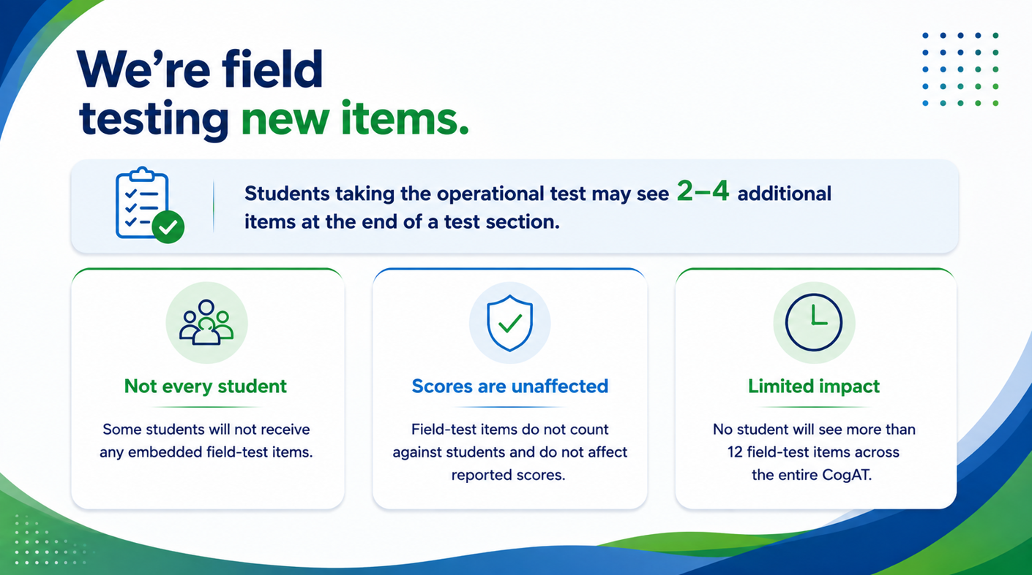

Slide 9
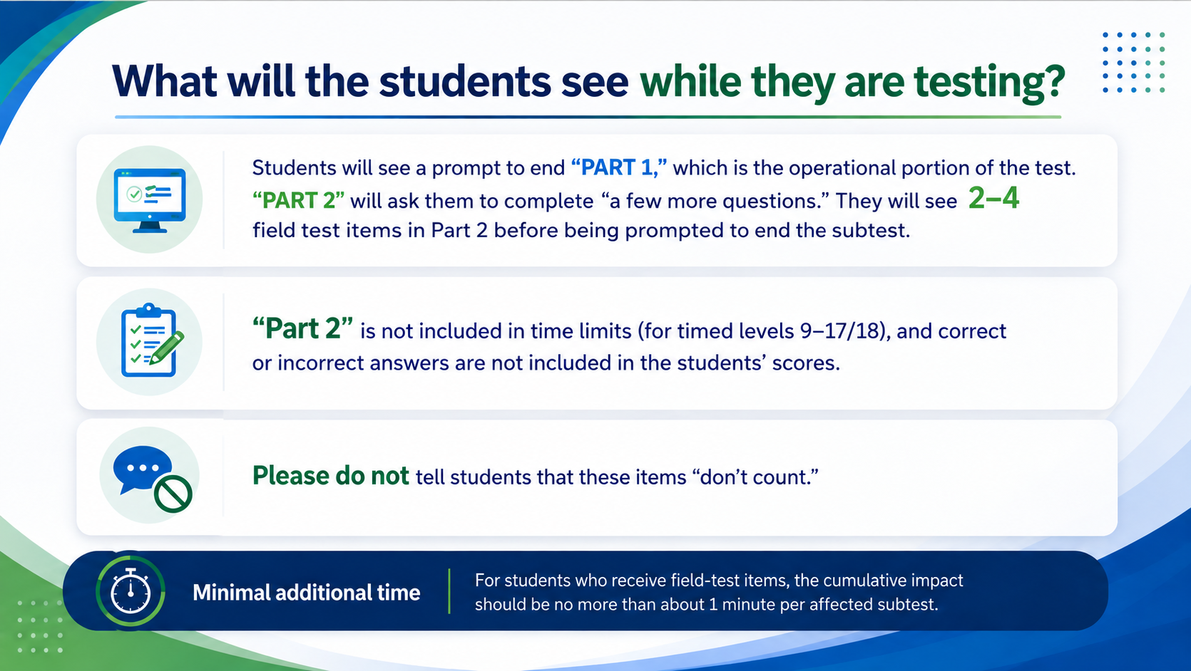

Slide 10
Pause
Questions welcome

Slide 11

Schedule of Important Dates- Fall 2026
Milestone, Task, or Deliverable | Date
Test Administration Manuals arrive at the schools and districts | Tuesday, September 8
Pretest Workshops via Webinar Paper Administration Online Administration | Tuesday, September 8 Thursday, September 110
DataManager Live Proctor Trainings *OnDemand Proctor training now available | Monday, Sept 14 at 9 AM Wednesday, Sept 16 at 3 PM Thursday, Sept 17 at 2 PM
Gr 2 GT Testing Fall 2026 Roster | September 21
Online Test Events Open | September 21
Test administration window | October 5 – 27
Online Test Events Close | October 27
Post test Webinar for District Test Coordinators | November 5
Reports arrive in districts if returned by October 30 , 2026 | December 4
Notes:
(TAM page iii)

Slide 12


Administration of CogAT and Iowa Assessments
🧑‍🏫 General Administration Guidelines
📋Prior to Each Subtest
CogAT and Iowa Assessments are group-administered by classroom teachers or other certified staff members who are familiar to students.
Second-grade tests are not timed.
Adjust pacing to meet students' needs. CogAT measures how well students solve reasoning problems, not how quickly they complete them.
Teachers must be trained before administering these assessments.
Each subtest begins with practice items to familiarize students with the format.
Review the practice items with students.
Ensure students fully understand the directions before beginning the subtest.
👀 During Testing
Monitor students throughout testing.
Verify that students are working on the correct questions.
Ensure students are recording their answers correctly in the online test.

Slide 13

Administration of CogAT and IA cont’
Online Administration Methods
🗣️ Proctor-Led Administration
The classroom teacher reads the test aloud, word for word.
Read clearly, maintain a steady pace, and use appropriate vocal inflection.
🎧 Audio-Led Administration
Students wear headphones and listen to prerecorded test directions and questions.
📌 Important to note
Teachers may not preview the test before administration.
Audio directions are available in the TAM (pages 81-83).
Each subtest begins with practice items.
Review practice items with students and ensure they understand the directions before beginning the subtest.
Notes:
Subtest directions- TAM pages 81-83
Practice items- the students are prompted to try again if they answer incorrectly. This is only for the practice items, not the actual test.

Slide 14
Cognitive Ability Test (CogAT®)
All of the following CogAT tests must be administered:
Required Sections of Each Test | Number of Items | Estimated Time (minutes) | Minimum No. of attempts
Verbal Battery Picture Analogies Sentence Competition Picture Classification | 18 18 18 | 13 14 13 | 9 9 9
Quantitative Battery Number Analogies Number Puzzles Number Series | 18 14 18 | 15 15 15 | 9 7 9
Nonverbal Battery Figure Matrices Paper Folding Figure Classification | 18 16 18 | 13 11 13 | 9 8 9
📌 All nine tests are combined to obtain a Composite Aptitude score.

Slide 15
Iowa Assessments™
All the following subtests in the IA level 7 tests must be administered:
IA Form G, Level 7 Core Battery | Number of Items | Estimated Time (minutes)
Reading: Part 1* | 17 | 20
Reading: Part 2* | 18 | 25
Reading Totals | 35 | 45
Mathematics: Part 1** | 26 | 25
Mathematics: Part 2** | 15 | 25
Mathematics Totals | 41 | 50
📌 *Both Reading Parts 1 and 2 must be completed to obtain a Reading score.
**Mathematics Parts 1 and 2 must be completed to receive a Total Math score
Notes:
Online Reading
Part 1 includes Picture Stories and Sentences
Part 2 includes Stories

Slide 16
Testing Students with Documented Disabilities and ML Students
  Students with IEP and 504 Plans must participate in the screening
  The student’s IEP team determines whether the student will participate in the assessment in the same manner as other students, or with accommodations
  South Carolina-Allowed Accommodations
Notes:
A student with a documented disability is either a student who has been evaluated and found to meet the eligibility criteria for enrollment in special education as defined by the Individuals with Disabilities Education Act (IDEA 97) and South Carolina State Board of Education Regulation 43-243.1 or a student who has a disability covered under Section 504 of the Rehabilitation Act of 1973
Key Point: Students receiving services through either an IEP or a Section 504 Plan are considered students with documented disabilities and may be eligible for approved testing accommodations.
Students with a current Individualized Education Program (IEP) or 504 Accommodations Plan must participate in screening for identification for the academic gifted and talented program. Students should participate in CogAT and Iowa Assessments testing, as appropriate, or in an alternative screening process that includes a documented review of existing data from a norm-referenced aptitude and norm-referenced mathematics and reading comprehension assessment.
The student’s IEP team determines whether the student will participate in the assessment in the same manner as other students, or with accommodations. Students cannot be excluded from screening because of a disability.
SC Allowed Accommodations- Some accommodations listed in the Directions for Administration (DFA) for both CogAT and Iowa Assessments are not approved for use in South Carolina. Make sure that Test Administrators (TAs) are aware that the accommodations listed in the TAM pages 8-14 are the only approved accommodations for the South Carolina Grade 2 Gifted and Talented Assessment program.

Slide 17
State-Allowed Accommodations
Setting – individual or small group
Timing – frequent and extended breaks
Scheduling - multiple sessions or days
Presentation –read aloud to self, repeating or signing the directions, repeated directions, signed administration
Response – nonverbal indication of answer choices or dictation of responses
Bilingual Dictionary – word-to-word dictionary only with no pictures, definitions, etc.
Translate Directions – only general test directions may be translated
Notes:
Setting-
The small-group size should be consistent with the group size used for routine classroom assessments.
Preferential seating
Separate location
Timing- Frequent and Extended Breaks – This accommodation is used if additional time is needed beyond the break structure of the assessment. These breaks may occur:
In the classroom/separate location, with no contact between students; or
Outside of the classroom/separate location, with contact between students monitored to ensure there is no discussion of the assessment.
Scheduling- Multiple Test Sessions/Days – The student may take portions of CogAT or the Iowa Assessments over several days, as long as all testing is completed by the last day of the testing window. Students must begin testing on the regularly scheduled testing date and may not go back to previously completed sections of the test.
Presentation- Highlighting and Cueing are not available with online testing
Read Aloud to Self – All items on CogAT are pictorial. For the Iowa Assessments, the student may read the test questions aloud to himself or herself. This accommodation requires an individual administration.
Repeated Directions- Only test directions may be read aloud as many times as necessary to inform students of the proper procedures to follow in responding. This accommodation applies only to the general test directions prior to the first test item for each subtest. Additionally, any student may have the general directions repeated or clarified to ensure the student understands the proper procedures to follow in responding.
Notice that there are differences between the test administration directions for the CogAT and Iowa Assessments tests. These administration directions apply to all students. CogAT- you may repeat the directions as many times necessary. Iowa- Read the directions for each question only once. Do not repeat the directions. This applies to the entire test, even for students with “repeated directions” in their IEP, because repeating the directions changes the construct of the test.
Signing the Directions – The student may need to repeat/sign the directions to the Test Administrator for clarification or to demonstrate his or her understanding.
Signed Administration (Communication Assistance) – The online system does not have the capability of signing the test, so a Test Administrator or Interpreter may sign the entire administration to a student. The TA/Interpreter must sign exactly as written in the Proctor screen and may not interpret test item content beyond what is allowed by the subject. Care must be taken not to use signs that might convey answers to any test questions.
Bilingual Dictionary- Students may use a word-to-word bilingual dictionary. However, the dictionary must not include any examples, pictures, or definitions..
Translate Directions- The general test directions may be translated into the student’s native language. This translation cannot go beyond the scope and meaning of the directions. Test questions/individual test question directions may not be translated. Practice items also may not be translated as they are embedded in the test.
In DataManager, the directions and item prompts may be administered in the student’s native language using audio proctoring. Seven additional languages are available including Spanish, Arabic, Chinese-Mandarin, Chinese-Cantonese, Russian, Somali, and Vietnamese. If your student’s native language is not available, then the general test directions may be translated into the student’s native language. This translation cannot go beyond the scope and meaning of the directions. Test questions/individual test question directions may not be translated. Practice items also may not be translated as they are embedded in the test

Slide 18
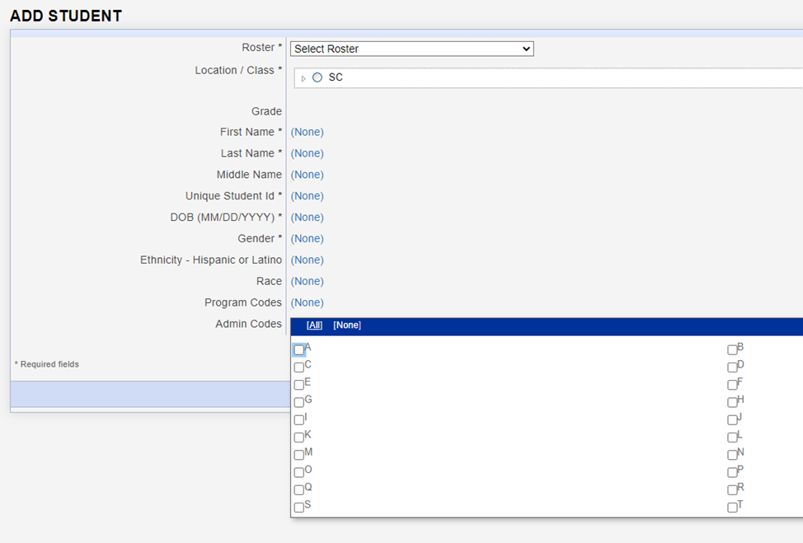
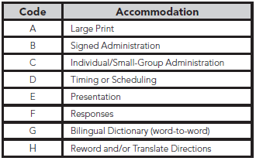
Coding Accommodations for Students with Documented Disabilities and ML Students
🔍 TAM Page 15
Notes:
The types of accommodations provided to students can be recorded in the student record in DataManager.
Even though more accommodations are allowed for testing, the codes listed on page 15 of the TAM are the only accommodations that can be recorded.

Slide 19
Large Print Materials
Braille test booklets are NOT available for CogAT or the Iowa Assessment at the second-grade level.
Large-print test books are available for both the Iowa Assessments and CogAT. Student responses must be transcribed to the student’s barcoded test booklet.
To order the Large Print books, please contact Celia Ortiz. We will begin to fulfill requests starting on Monday, 9/21.
Please order these materials no later than Tuesday, October 20, 2026.
Notes:
Why isn’t CogAT offered in Braille? The visual nature of the majority of CogAT items makes them impossible to convert into Braille.
Students may mark directly in the large print booklet with a pencil, pen, or crayon. Later, the test administrator can transfer the responses to the student’s barcoded test booklet.
If a student’s visual impairment is such that the large print booklet is insufficient, you may work with a clinician or school psychologist in your district to administer an appropriate individually administered assessment, such as the Woodcock-Johnson IV. Both the standard WJ IV kits from Riverside and the Braille kit from the American Printing House for the Blind (APH) will need to be ordered. Please contact David Trombly for more information.

Slide 20

CogAT Alt-V (Alternative Verbal) for ML Students
Alt-V is not a separate test—it’s a modified way of administering the CogAT Verbal Battery to reduce the impact of limited English proficiency on ML students’ scores. It does this by skipping the Sentence Completion subtest, which relies most heavily on English language proficiency.
What Alt-V students will take:
Who is eligible for Alt-V
Only Multilingual Learner (ML) students are eligible for Alt-V Scoring.
Alt-V Scoring allows the Sentence Completion subtest to be omitted.
Eligibility should be determined individually for each ML student.
ML students with an ACCESS for ELLs composite score of 1.0-3.9 may be considered for Alt-V Scoring.
Notes:
Alt-V scoring involves the elimination of the Sentence Completion subtest from the Verbal battery.
SCDE states only ML students are eligible for Alt-V scoring where they have the option to omit the Sentence Completion subtest.
Consideration for Alt-V Scoring should be determined for each individual ML student. ML students receiving an ACCESS for ELL’s composite score between 1.0-4.9 may be coded for Alt-V Scoring (TAM page 14). ML students without an ACCESS score may have their screener score used; 1.0–4.5 may be considered.
How to Administer Alt-V Online
In the online testing platform, select only the two ALT VERBAL subtests:
ALT VERBAL / Picture Analogies
ALT VERBAL / Picture Classification
Do not administer the standard VERBAL subtests (including Sentence Completion) Once the ALT VERBAL subtests are complete, the Verbal battery is done for that student.
Administer the full Quantitative battery.
Administer the full Nonverbal battery.

Slide 21
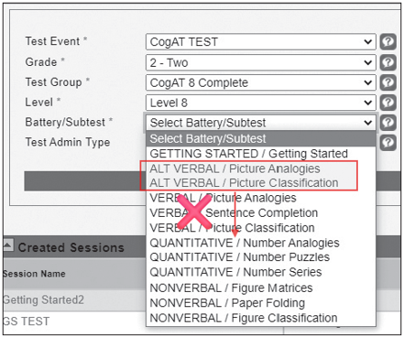
CogAT Alt-V (Alternative Verbal) for ML Students
Alt-V is not a separate test—it’s a modified way of administering the CogAT Verbal Battery to reduce the impact of limited English proficiency on ML students’ scores. It does this by skipping the Sentence Completion subtest, which relies most heavily on English language proficiency.
How to Administer Alt-V Online
Select only ALT VERBAL: Picture Analogies and Picture Classification.
Do not administer standard Verbal subtests, including Sentence Completion.
After ALT VERBAL is complete, the Verbal battery is complete for that student.
Administer the full Quantitative and full Nonverbal batteries.
Notes:
Alt-V scoring involves the elimination of the Sentence Completion subtest from the Verbal battery.
SCDE states only ML students are eligible for Alt-V scoring where they have the option to omit the Sentence Completion subtest.
Consideration for Alt-V Scoring should be determined for each individual ML student. ML students receiving an ACCESS for ELL’s composite score between 1.0-4.9 may be coded for Alt-V Scoring (TAM page 14). ML students without an ACCESS score may have their screener score used; 1.0–4.5 may be considered.
How to Administer Alt-V Online
In the online testing platform, select only the two ALT VERBAL subtests:
ALT VERBAL / Picture Analogies
ALT VERBAL / Picture Classification
Do not administer the standard VERBAL subtests (including Sentence Completion) Once the ALT VERBAL subtests are complete, the Verbal battery is done for that student.
Administer the full Quantitative battery.
Administer the full Nonverbal battery.

Slide 22
Pause
Questions welcome

Slide 23
Preparing Students for Testing
Informing parents
Testing environment
TEST ADMINISTRATION
Notes:
Keeping parents informed before testing helps testing run smoothly and allows students to perform at their best.
Parents should be informed about the purpose of the tests and how the results will be used. It's important to clarify that there is no opt-out option—all second-grade students must be given the opportunity to participate in testing.
The grade 2 parent and student brochure that can be sent home to inform parents about the test. A Spanish-translated digital version is now available for districts to use if needed.
Parent permission is not required for these tests, but all parents should be notified in advance of the dates and times for each test and/or subtest at their child's school. Be sure to send them the testing schedule.
Testing Environment:
Students should be tested in well-lit and well-ventilated classrooms.
There should be adequate spacing between students to enhance test security.
The classrooms should be quiet, free from distractions, and any content related to grade 2 standards in reading and math should be covered or removed.
Test Administration:
Determine how the test will be administered and who will oversee it.
Monitor students to ensure they understand the test instructions.
Adjust the pacing of the test to suit the students' needs. For classes where some students may take significantly longer than others, consider administering the test in two separate groups.

Slide 24

Suggested Testing Schedule
Day | Test | Estimated Time (minutes)
Day 1 | Verbal Picture Analogies Sentence Completion Picture Classification | 13 14 13
Day 2 | Quantitative Number Analogies Number Puzzles Number Series | 15 15 15
Day 3 | Nonverbal Figure Matrices Paper Folding Figure Classification | 13 11 13
Day 4 | Iowa Reading: Part 1 Reading: Part 2 | 20 25
Day 5 | Iowa Mathematics: Part 1 Mathematics: Part 2 | 25 25
Notes:
Sample test schedule on page 19 of the TAM.

Slide 25

Online Testing Roadmap
Tech Readiness
DataManager Training
Test Preparations
Materials Needed for testing
Check system and network requirements
Install the Riverside App or create a desktop shortcut to the student login page on all student devices.
Ensure student devices are ready for testing.
STCs and TAs to attend the DataManager training.
Live Training Sessions:
  Monday 9/14 at 9 AM EST
  Wednesday 9/16 at 3 PM EST
  Thursday 9/17 at 2 PM EST
OnDemand Proctor training now available on the microsite
Ensure that all STCs, and TAs have access to the DataManager Platform.
Gr 2 Roster will be available on 9/21. STCs to confirm student are rostered correctly.
Gr 2 Test Events will be opened on 9/21. STCs to decide who will create test sessions
Student devices
Scratch Paper and pencils for the Math subtests.
Student login Information: Student ID and session code
Ready to test

Slide 26

Pretesting Activities for Online Testing
Review System/Network Requirements
System/Network Requirements and DataManager Domain and Port Listing.
Considerations:
  If schools are testing with wireless devices, do you have access points (APs) in each room or another setup.
  If possible, postpone scheduled network scans and updates to devices during testing window.
  How many students are testing simultaneously? If their testing schedules allow plan on staggered start times.
While TAs are performing live proctoring it is nevertheless still important to minimize local network processes and programs that compete for bandwidth.

Slide 27
Pretesting Activities for Online Testing
Prepare student devices for testing
Make sure the Riverside App is installed on all devices or create a desktop shortcut to the student login page at www.riversideonlinetest.com.
Verify that student devices are completely charged.
Confirm the functionality of the volume.
Provide headphones for audio proctoring.
Have additional devices on standby.
Close all active applications, including additional browser windows or tabs, on both student and proctor devices.

Slide 28
Pretesting Activities for Online Testing
Rostering
Student Roster
The SCDE will be submitting a student roster to be used by ALL districts for the grade 2 administration of CogAT and the Iowa Assessments during the main and make-up test windows. Roster will be available in DataManager by Monday 9/21.
Roster name- SCDE Gr 2 GT Testing- Fall 2026
School Test Coordinators can download the roster to confirm that all students in their schools are included.
Please Do not rename the roster
Districts do not need to submit or create separate rosters for the grade 2 GT testing.
Notes:
Sharing PII Information: When emailing me student information for issue descriptions or student relocation requests, kindly provide only the student's 10-digit state ID (and building/class if applicable). Please refrain from including any other student identifiable information.
If you get a message indicating that a student ID already exists when adding a student, please contact me as it may signify that the student is already rostered in another SC district and requires an update. Simply provide me with the 10-digit student ID and the school/class where the student should be moved.

Slide 29
Pretesting Activities for Online Testing
Rostering
Staff file
DTCs must provide DataManager access to all staff administering online CogAT and Iowa Assessments.
Step 1- Export a list of staff users using the Manage Staff functionality in DataManager
Step 2- Update the users as necessary and add new staff if needed.
Step 3- Submit the file to Celia Ortiz for upload
📌Manual entry of new staff or edits to existing staff is also available

Slide 30
Pretesting Activities for Online Testing
Test Events
The SCDE will create the Test Events that will be used by ALL districts for the grade 2 administration of CogAT and Iowa Assessment during the Fall 2025 testing window. These test events are scheduled to open on Monday, September 21.
  🚨Important reminders:
  Districts are not required to create separate Test Events for grade 2 GT testing.
  Please refrain from closing the Test Events that have been set up for grade 2 GT testing.
  Avoid reopening a Test Event once it has been closed.
  After the Test Events have been closed, no additional testing will be permitted.

Slide 31
✅ DTC Checklist- Before Testing
Participate in all required DTC pretest training sessions.
Ensure all personnel involved in administering or monitoring Gifted & Talented assessments receive proper training, including STCs, Test Administrators (TAs), and monitors.
Ensure DTCs, STCs, Test Administrators (TAs), and monitors complete the Agreement to Maintain Test Security and Confidentiality forms (Paper TAM, pages 66-71).
Develop a district testing schedule. Refer to page 17 of the TAM for a sample schedule.
Ensure each school has an adequate supply of Test Administration Manuals (TAMs).
Request paper materials, if needed, using the Request for Additional Test Materials form included with your shipment.
Notes:
(TAM page 34)

Slide 32
✅ STC Checklist- Before Testing
Ensure that adequate training is given to all persons who will be administering or monitoring the CogAT and Iowa Assessments.
Inform teachers of the testing schedule.
Confirm that all grade 2 students are rostered correctly.
Arrange accommodations for students who need them.
Determine who will create Test Sessions in preparations for testing
Communicate teacher responsibilities.
Teacher responsibilities:
Ensure student devices and headphones are ready for testing.
Create and manage test sessions.
Provide scratch paper and pencils for Mathematics subtests.
Distribute student login information (Student ID and session code).Administer approved accommodations as needed.
Verify all students have completed their tests.

Slide 33

SUNS and Power School ID Numbers
Student Identification Number (State ID)
  The 10-digit State ID number assigned to each student is used for testing online.
Student Power School Number
  The 5–12-digit Power School Number is not unique across the entire state and will likely cause problems if used for online testing.

Slide 34
Checklist- During & After Testing
District Test Coordinators
School Test Coordinators
Ensure that schools are on track to complete all required subtests during the test window.
Provide ongoing support to schools
Return any paper materials used for accommodations
Ensure that STCs have validated score results. Contact Celia with discrepancies
Ensure that TAs are on track to complete all required subtests during the test window.
Provide ongoing support to TAs
Return any paper materials used for accommodations to the DTC
Validate score results. Contact DTC with discrepancies.

Slide 35

After the Test Administration
Testing ends October 27, 2026.
Test Events close COB October 27.
No additional testing is permitted after closure.

Slide 36
Pause
Questions welcome

Slide 37
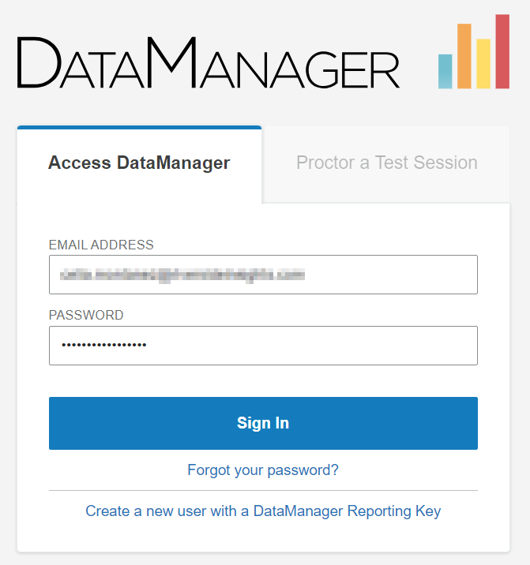
DataManager Platform Demo
https://www.riversidedatamanager.com

Slide 38
Scoring and Reporting
DataManager Reporting is a dynamic online reporting tool that allows you to perform the following tasks:
Create customized reports using the options available for your account
View and edit reports online
Save, edit, and re-use report criteria
Print reports
Export reports to PDF, RTF, or Microsoft Excel® format
Notes:
DataManager Reporting is a dynamic online reporting tool that allows you to perform the following tasks:
Create customized reports using the options available for your account
View and edit reports online
Save, edit, and re-use report criteria
Print reports
Export reports to PDF, RTF, or Microsoft Excel® format
From DataManager, you can locally download and/or print the following reports and more.
List Report of Student Scores
Classroom Summaries
School Summaries
District Summary
Student data file
*The schools will also receive 2 copies of the Student Profile Narrative and the Student Score Labels- 1 for Iowa, 1 for CogAT
Step-by-step instructions on how to generate the reports above is be posted on the SC Microsite as well as a live demo during the Posttest Workshop.

Slide 39
Scoring and Reporting
In addition, the schools will receive the following reports in paper form-
Two (2) copies of the Student Profile Narrative
Student Score Labels- 1 for Iowa, 1 for CogAT
*Packing List and box labeling for ease of unpacking your reports and distributing to the schools.
Notes:
DataManager Reporting is a dynamic online reporting tool that allows you to perform the following tasks:
Create customized reports using the options available for your account
View and edit reports online
Save, edit, and re-use report criteria
Print reports
Export reports to PDF, RTF, or Microsoft Excel® format
From DataManager, you can locally download and/or print the following reports and more.
List Report of Student Scores
Classroom Summaries
School Summaries
District Summary
Student data file
*The schools will also receive 2 copies of the Student Profile Narrative and the Student Score Labels- 1 for Iowa, 1 for CogAT
Step-by-step instructions on how to generate the reports above is be posted on the SC Microsite as well as a live demo during the Posttest Workshop.

Slide 40
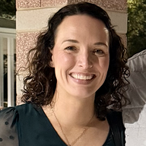
SC Assessment Consultant
Contact your Assessment Consultant with any questions about pricing, Quotes, and to submit orders for off-grade-level testing.
Sierra Scott
Assessment Consultant sierra.scott@riversideinsights.com
Phone: 407-362-8204

Slide 41

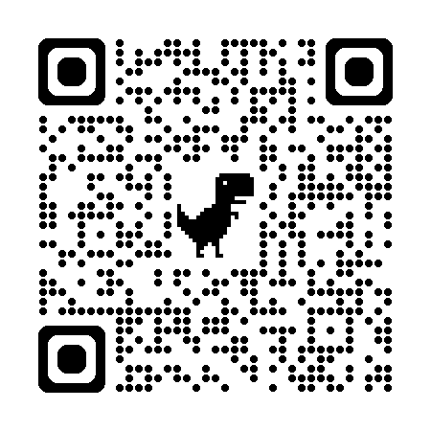
SCDoE Grade 2 Gifted and Talented Assessment Website
You can find digital resources to support the Fall 2026 Testing Administration:
  Required tests
  Test Administration Manuals
  Pretest Workshop PowerPoint presentation
  Test security affidavit for DTC’s and STC’s
  Test security affidavit for TA’s
  Test Security Violation Forms
  Links to DataManager Proctor training
  Gr 2 Brochure for Parents and Students
Follow the following link to access the website: https://info.riversideinsights.com/scdoe

Slide 42


Slide 43
THANK YOU
For attending!
Disclaimer on the Use of Artificial Intelligence
The content presented is the intellectual property of the South Carolina Department of Education (SCDE) or Riverside Insights. By participating in this event, attendees agree they will not record, capture, or share its contents without permission. Attendees agree they will not use artificial intelligence (AI) to capture or summarize the contents of the event. The SCDE reserves the right to remove attendees using these services.

