Slide 1



Gifted and Talented Assessment Program for Grade 2 Students
Fall 2024 DTC Pretest Workshop-
Paper Administration

Slide 2

Who to Contact
Riverside Insights South
Carolina Team
South Carolina Department of Education Staff
Celia Ortiz
  Sr. Project Manager celia.ortiz@riversideinsights.com
  Phone: 630-760-4419
Sierra Scott
  Assessment Consultant
  sierra.scott@riversideinsights.com
  Phone: 407-362-8204
David Trombly
  Office of Assessment and Standards, SCDE
  dctrombly@ed.sc.gov
  Phone: 803-734-8274
Dr. Susan Creighton
  Office of Assessment and Standards, SCDE
  screight@ed.sc.gov
  Phone: 803-734-8535

Slide 3
Schedule of Important Dates- Fall 2024
Milestone, Task, or Deliverable | Date
Test Administration Manuals arrive at the schools and districts | Tuesday, September 10
Pretest Workshops via Webinar Paper Administration Online Administration | Wednesday, September 11 Thursday, September 12
Schools and districts receive precoded test materials | Monday, September 23
Last day to order additional test materials or large print test booklets | October 21
Test administration window | October 7 – 29
Last day to ship back to Riverside for scoring | November 1
Post test Webinar for District Test Coordinators | November 6
Reports arrive in districts if returned by November 1, 2024 | December 4
Notes:
(TAM page iii)

Slide 4
SC Gr 2 Gifted & Talented Assessment Program
The Gifted and Talented Grade 2 Assessment is a statewide assessment used to identify students for district gifted and talented programs. Students are identified for this program by demonstrating high performance ability or potential in academic and/or artistic areas.
Notes:
State Board of Education regulation 43-220 requires the administration of assessments measuring cognitive, academic, and/or artistic abilities to identify students for district gifted and talented programs. The South Carolina Department of Education (SCDE) provides an aptitude and an achievement assessment for this purpose.
South Carolina law requires districts to screen all students at the elementary and secondary levels for district Gifted and Talented services.
Districts are required to provide services for all gifted and talented students.
Although the primary purpose of these assessments is to identify students for the Gifted and Talented programs, student results can be useful to teachers as they examine their instructional practices and can help them identify teaching strategies for all students.

Slide 5

Criteria for Gifted & Talented Selection
Students may be eligible for placement into the district Gifted and Talented program based on their aptitude score alone.
A composite score on the CogAT® at or above the 98th national age percentile for grades 1-2, or at or above the 96th national age percentile for grades 3-12.
Qualifying aptitude scores are good for 5 years.

Slide 6
Criteria for Gifted & Talented Selection
Students are also identified for services by demonstrating high performance in two of the following dimensions:
Dimension A: CogAT - 93rd national age percentile or higher on one or more subtests:
Verbal/linguistic
Quantitative/math
Nonverbal
Composite
Dimension B (High Achievement in Reading and/or Mathematics)- achievement (94th percentile and above)
Dimension C (Intellectual/Academics)- score of 16 (for 3rd Grade Placement) on either the verbal or nonverbal component of the Performance Task Assessments
Notes:
For placement into the Gifted and Talented grade 2 program, students must meet the criteria for two out of the three dimensions outlined in the regulation.
Dimension A (Reasoning Abilities) requires students to demonstrate high aptitude (93rd national age percentile) in one or more of these areas: verbal/linguistic, quantitative/mathematical, nonverbal, and/or a composite of the three. Scores on CogAT may be used for this purpose. Students who meet the 96th or higher national age percentile composite score on CogAT are automatically eligible for placement into a district gifted and talented program.
Dimension B (High Achievement in Reading and/or Mathematical Areas) of the regulation requires that students demonstrate high achievement in reading and/or mathematical areas (94th national percentile and above) as measured by a nationally normed or statewide assessment.
Students who meet the eligibility requirements of either Dimension A (aptitude) or Dimension B (achievement), but not both dimensions, must take the Performance Task Assessments (Dimension C).
Dimension C (Intellectual/Academic Performance) requires students to demonstrate a high degree of interest in and commitment to academic and/or intellectual pursuits or demonstrate intellectual characteristics such as curiosity/inquiry, reflection, persistence/tenacity in the face of challenge, and creative productive thinking. One of the methods by which these characteristics may be demonstrated is with a score of 16 on either the verbal or nonverbal component of the Performance Task Assessments for grade 3 placement.
If a student meets the criteria for Dimensions A and B, the student qualifies for Gifted & Talented services without taking the Performance Tasks Assessment.
If a student meets the criteria for Dimensions A or B, but not both, the student will take the Performance Tasks Assessment

Slide 7

Who to Test
SCDE provides these assessments for all grade 2 students. This includes:
Students with an IEP or 504 Plan
Multilingual (ML) students

Slide 8
Administration of CogAT and IA
CogAT and Iowa Assessments are group-administered by classroom teachers.
It is best for tests to be administered by someone who is familiar to the students.
Teachers must be trained before administering these assessments.
Tests at the second-grade level are not timed.
The pace at which test questions are presented should be adjusted to suit the characteristics of the students being tested. CogAT tests focus on assessing how well, not how quickly, students solve reasoning problems.

Slide 9
Administration of CogAT and IA
For paper-based tests, classroom teachers are responsible for reading the questions aloud verbatim.
Teachers must follow a prepared script from the Directions for Administration (DFA) manual for each test.
To ensure familiarity with the content, teachers should review and take notes on these directions before administering the test.
When reading the questions, articulate clearly and maintain a consistent pace, avoiding any changes in vocal inflection.

Slide 10
Administration of CogAT and IA
Each test starts with a practice item to help students get accustomed to the format. Review practice questions with students. Make sure students fully understand the instructions before beginning the subtest.
Monitor Students – It is important to monitor the students to ensure they are working on the correct questions and are marking their answers correctly in the test booklet.

Slide 11
Administration of CogAT and IA
Color blindness- CogAT can be used for students who are colorblind without disadvantaging their performance on the assessment. Students do not have to be able to see or name colors to be successful in answering the questions on CogAT.
Usage of Scratch paper during CogAT test (Paper Folding) is not allowed. Scratch paper is allowed for Iowa Assessments Math, but pretty much nowhere else.
Plans for a Normative Update for Fall 2025
Notes:
A few inquiries received last fall that are worth sharing with DTCs in preparation for this next administration:
Color blindness-
CogAT can be used for students who are colorblind without disadvantaging their performance on the assessment. All informational graphics went through a composition check to ensure coherency to a color-deficient student. Art was processed through a color blindness simulator which renders images as they would appear to individuals with Protanopia, Deuteranopia and Tritanopia. Using these simulations as a guide, any art requiring modification was addressed by choosing patterns and/or color contrast that was acceptable for colorblindness. The revised art was resubmitted for validation and retested using the color-blindness simulator to ensure viability. Students do not have to be able to see or name colors to be successful in answering the questions on CogAT.
Usage of Scratch paper- There is supposed to be NO SCRATCH PAPER during the Paper Folding test. Scratch paper is allowed for Iowa Assessments Math, but pretty much nowhere else
Normative Update-
At the time we would have been planning the next normative update, the COVID-19 pandemic occurred. Due to the resulting disruptions and impact to the standard K-12 education setting, there was a conscious effort on our part to delay any type of normative update until the pandemic stabilized and there was a return to more typical in-person learning environments with minimal disruptions.
Continuing to test and compare students against the 2017 norms represents a stable comparison for evaluating students longitudinally and determining recovery from the impact of the pandemic. This type of analysis and resulting interpretation would be more complicated if the ‘yardstick’ or comparison changed and was representative a non-normal situation.
We are currently in the process of planning the next normative update for CogAT and Iowa. We will investigate changes in student performance for the COVID-19 timeframe, but with the exclusion of those few years, we are within range of the next normative update.

Slide 12
Cognitive Ability Test (CogAT®)
All the following CogAT tests must be administered:
CogAT Form 8, Level 8 | Test Booklet Page Numbers | Directions for Administration Page Numbers
Verbal Battery Picture Analogies Sentence Competition Picture Classification | Practice items on inside of front cover Pages 1-7 Pages 9-14 Pages 15-24 | Pages 16-18 Pages 19-23 Pages 24-27 Pages 28-32
Quantitative Battery Number Analogies Number Puzzles Number Series | Pages 25-31 Pages 33-38 Pages 39-45 | Pages 33-37 Pages 38-41 Pages 42-46
Nonverbal Battery Figure Matrices Paper Folding Figure Classification | Pages 47-53 Pages 55-63 Pages 65-70 | Pages 47-51 Pages 52-56 Pages 57-60
All nine tests are combined to obtain a Composite Aptitude score.

Slide 13
Iowa Assessments™
All the following subtests in the IA level 7 tests must be administered:
IA Form G, Level 7 Core Battery | Test Booklet Page Numbers | Directions for Administration Page Numbers
Reading: Picture Stories* | Pages 12-14 | Page 22
Reading: Sentences* | Page 15 | Page 23
Reading: Stories* | Page 16-20 | Pages 24-25
Mathematics: Part 1** | Pages 33-37 | Pages 39-42
Mathematics: Part 2** | Pages 38-41 | Pages 43-47
*All three reading tests need to be completed to receive a Reading score.
**Mathematics (Parts 1 and 2) need to be completed to receive a Total Math score
Notes:
Online Reading
Part 1 includes Picture Stories and Sentences
Part 2 includes Stories

Slide 14
Testing Students with Documented Disabilities and ML Students
  Definition of a Student with Disabilities
  Students with IEP and 504 Plans must participate in the screening
  The student’s IEP team determines whether the student will participate in the assessment in the same manner as other students, or with accommodations
  South Carolina-Allowed Accommodations
Notes:
A student with a documented disability is either a student who has been evaluated and found to meet the eligibility criteria for enrollment in special education as defined by the Individuals with Disabilities Education Act (IDEA 97) and South Carolina State Board of Education Regulation 43-243.1 or a student who has a disability covered under Section 504 of the Rehabilitation Act of 1973.
Students with a current Individualized Education Program (IEP) or 504 Accommodations Plan must participate in screening for identification for the academic gifted and talented program. Students should participate in CogAT and Iowa Assessments testing, as appropriate, or in an alternative screening process that includes a documented review of existing data from a norm-referenced aptitude and norm-referenced mathematics and reading comprehension assessment.
The student’s IEP team determines whether the student will participate in the assessment in the same manner as other students, or with accommodations. Students cannot be excluded from screening because of a disability.
SC Allowed Accommodations- Some accommodations listed in the Directions for Administration (DFA) for both CogAT and Iowa Assessments are not approved for use in South Carolina. Make sure that Test Administrators (TAs) are aware that the accommodations listed in the TAM pages 8-14 are the only approved accommodations for the South Carolina Grade 2 Gifted and Talented Assessment program.

Slide 15
State-Allowed Accommodations
Setting – individual or small group
Timing – frequent and extended breaks
Scheduling - multiple sessions or days
Presentation – highlighting, cueing, read aloud to self, repeating or signing the directions, repeated directions, signed administration
Response – nonverbal indication of answer choices or dictation of responses
Bilingual Dictionary – word-to-word dictionary only with no pictures, definitions, etc.
Translate Directions – only general test directions may be translated
Notes:
Setting-
The small-group size should be consistent with the group size used for routine classroom assessments.
Preferential seating
Separate location
Timing- Frequent and Extended Breaks – This accommodation is used if additional time is needed beyond the break structure of the assessment. These breaks may occur:
In the classroom/separate location, with no contact between students; or
Outside of the classroom/separate location, with contact between students monitored to ensure there is no discussion of the assessment.
Scheduling- Multiple Test Sessions/Days – The student may take portions of CogAT or the Iowa Assessments over several days, as long as all testing is completed by the last day of the testing window. Students must begin testing on the regularly scheduled testing date and may not go back to previously completed sections of the test.
Presentation- Highlighting – The Test Administrator may highlight key words or phrases for students in the directions but not in any other part of the tests. The student may highlight words, phrases, sentences, etc., in passages.
Cueing – The Test Administrator may write cues, use cue symbols, or orally cue the directions only in the test booklet
Read Aloud to Self – All items on CogAT are pictorial. For the Iowa Assessments, the student may read the test questions aloud to himself or herself. This accommodation requires an individual administration.
Repeated Directions- Only test directions may be read aloud as many times as necessary to inform students of the proper procedures to follow in responding. This accommodation applies only to the general test directions prior to the first test item for each subtest. Additionally, any student may have the general directions repeated or clarified to ensure the student understands the proper procedures to follow in responding.
Notice that there are differences between the test administration directions for the CogAT and Iowa Assessments tests. These administration directions apply to all students. CogAT- you may repeat the directions as many times necessary. Iowa- Read the directions for each question only once. Do not repeat the directions. This applies to the entire test, even for students with “repeated directions” in their IEP, because repeating the directions changes the construct of the test.
Bilingual Dictionary- Students may use a word-to-word bilingual dictionary. However, the dictionary must not include any examples, pictures, or definitions..
Translate Directions- The general test directions may be translated into the student’s native language. This translation cannot go beyond the scope and meaning of the directions. Test questions/individual test question directions may not be translated. Practice items also may not be translated as they are embedded in the test.

Slide 16
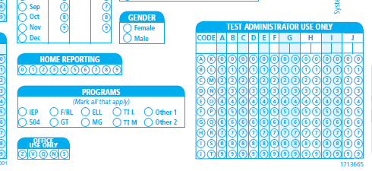
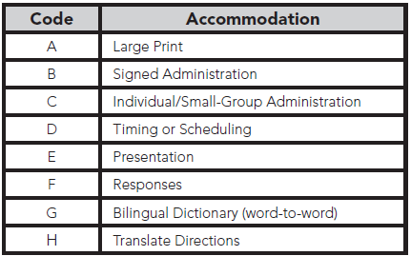
Coding Accommodations for Students with Documented Disabilities and ML Students
Notes:
The types of accommodations provided to students must be recorded on the student test booklet in the “Test Administrator Use Only” block.

Slide 17
Large Print Materials
Braille test booklets are NOT available for CogAT or the Iowa Assessment at the second-grade level.
Large-print test books are available for both the Iowa Assessments and CogAT. Student responses must be transcribed to the student’s barcoded test booklet.
To order the Large Print books, please contact Celia Ortiz. We will begin to fulfill requests starting on Monday, 9/23.
Please order these materials no later than Monday, October 21, 2024.
Notes:
Why isn’t CogAT offered in Braille? The visual nature of the majority of CogAT items makes them impossible to convert into Braille.
Students may mark directly in the large print booklet with a pencil, pen, or crayon. Later, the test administrator can transfer the responses to the student’s barcoded test booklet.
If a student’s visual impairment is such that the large print booklet is insufficient, you may work with a clinician or school psychologist in your district to administer an appropriate individually administered assessment, such as the Woodcock-Johnson IV. Both the standard WJ IV kits from Riverside and the Braille kit from the American Printing House for the Blind (APH) will need to be ordered. Please contact David Trombly for more information.

Slide 18
What is CogAT Alt-V Scoring for Grades K-2?
Why?
To better identify ML students in grades K-2.
To provide a composite score and Ability Profile that can be used for instructional grouping.
How?
Teachers will administer only the Picture Analogies and Picture Classification subtests. The Sentence Completion subtest will be skipped. Students will complete the full Quantitative and Nonverbal batteries.
TAs or STCs would bubble in “S” in the Office Use Only field box on the demographic page of the CogAT answer document.
Students will receive a composite score and an ability profile that can be used for instructional grouping.
Notes:
Alt-V scoring involves the elimination of the Sentence Completion subtest from the Verbal battery.
SCDE states only ML students are eligible for Alt-V scoring where they have the option to omit the Sentence Completion subtest.
Consideration for Alt-V Scoring should be determined for each individual ML student. ML students receiving an ACCESS for ELL’s composite score between 1.0-4.9 may be coded for Alt-V Scoring (TAM page 14). ML students without an ACCESS score may have their screener score used; 1.0–4.5 may be considered.

Slide 19
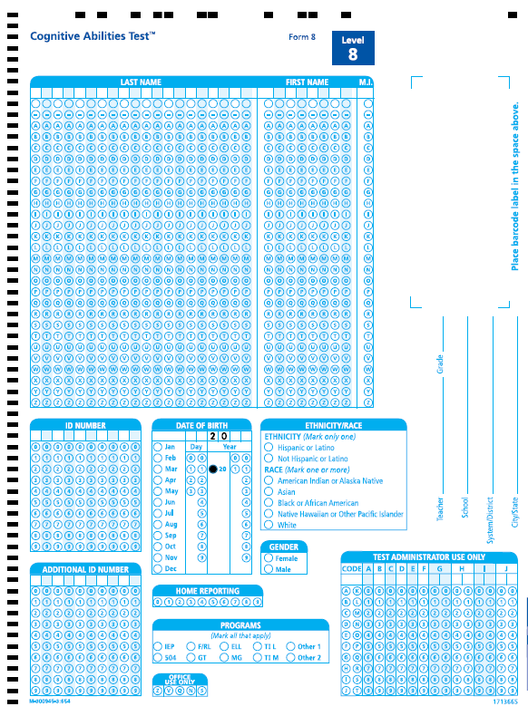
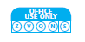
CogAT Alt-V Coding
  Code these students as “S” in ‘Office Use Only’ field box on the demographic page of the test booklet back cover.
  Our scanners are programmed to pick up anything bubbled “S” so that the eligible ML student will be scored as “Alt-V” in which the student would still receive a Verbal score and a total VQN composite score.
  Please remind teachers NOT to administer the Sentence Completion subtest to these ML grade 2 students.

Slide 20


Slide 21
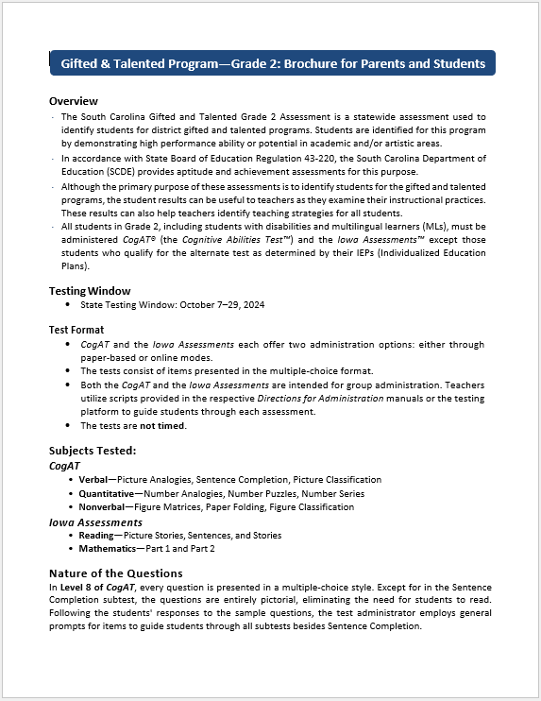
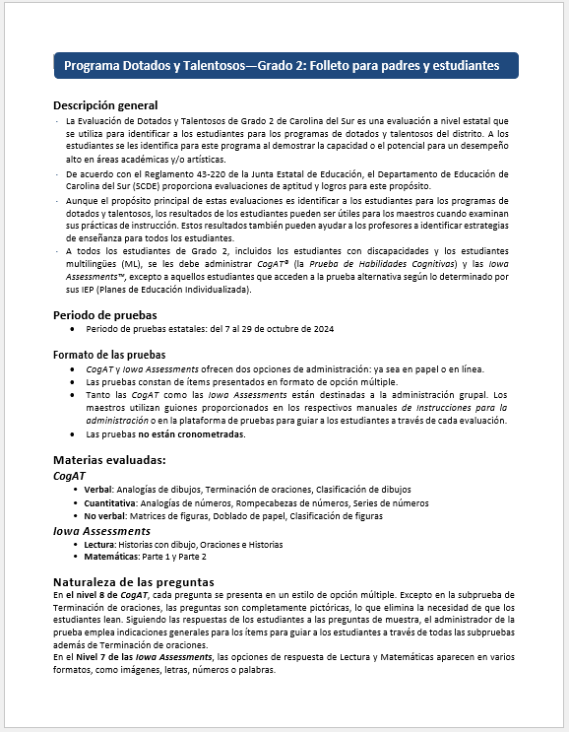
New this year!
Gifted & Talented Program- Grade 2: Brochure for Parents and Students- Spanish translation
Make-up Testing window eliminated.

Slide 22



Preparing Students for Testing
Informing parents
Testing environment
TEST ADMINISTRATION
Notes:
Effective communication between school and home before testing can ensure a smooth process and help students perform their best.
Parents should be informed about the purpose of the tests and how the results will be used. It's important to clarify that there is no opt-out option—all second-grade students must be given the opportunity to participate in testing.
Last year, we introduced a new brochure that can be sent home to inform parents about the test. A Spanish-translated digital version is now available for districts to use if needed.
Parent permission is not required for these tests, but all parents should be notified in advance of the dates and times for each test and/or subtest at their child's school. Be sure to send them the testing schedule.
Testing Environment: Students should be tested in well-lit and well-ventilated classrooms. There should be adequate spacing between students to enhance test security. The classrooms should be quiet, free from distractions, and any content related to grade 2 standards in reading and math should be covered or removed.
Test Administration:
Determine how the test will be administered and who will oversee it.
Monitor students to ensure they understand the test instructions.
Adjust the pacing of the test to suit the students' needs. For classes where some students may take significantly longer than others, consider administering the test in two separate groups..

Slide 23
Suggested Testing Schedule
Day | Test | Test Booklet Page Numbers | Estimated Time (minutes)
Day 1 | CogAT Picture Analogies Sentence Completion Picture Classification | Pages 1-7 Pages 9-14 Pages 15-24 | 13 14 13
Day 2 | CogAT Number Analogies Number Puzzles Number Series | Pages 25-31 Pages 33-38 Pages 39-45 | 15 15 15
Day 3 | CogAT Figure Matrices Paper Folding Figure Classification | Pages 47-53 Pages 55-63 Pages 65-70 | 13 11 13
Day 4 | Iowa Reading: Picture Stories Reading: Sentences Reading: Stories | Pages 12-14 Page 15 Pages 16-20 | 10 10 25
Day 5 | Iowa Mathematics: Part 1 Mathematics: Part 2 | Pages 33-37 Pages 38-41 | 25 25
*Estimated testing times are the same for both paper and online administrations.
Notes:
(TAM page 17)

Slide 24
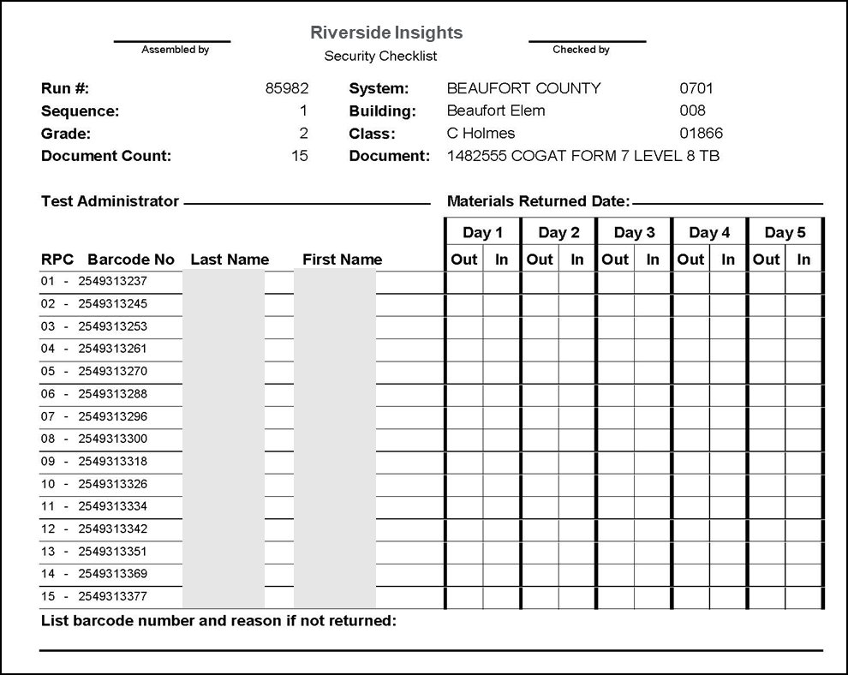
Test Security
Storage of materials – Secure test materials must be kept in a secure, locked storage, at the school and district level, when not in use. This includes the student test booklets and Directions for Administration.
Test security agreement forms (Appendix A - TAM pages 56-71) – DTC/STC, TA and Monitor forms must be signed and collected at the completion of training.
Security checklist (TAM pages 22-23) – Must be counted, signed in and out each day of testing by STC’s and TA’s.
Notes:
The STC is responsible for inventory control within the school. STCs must account for and return all of the test booklets and Directions for Administration manuals to Riverside Insights. Schools and districts are required to use the security checklists to track the distribution and return of all secure test materials.
STC’s must use the School Security Checklists to count and sign-in and sign-out test materials.
* It is highly recommended that you make a copy of the security checklist for your records.

Slide 25
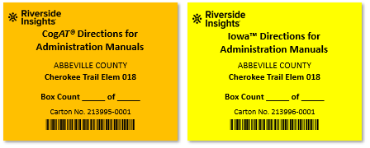
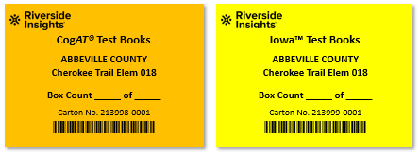
Box Labeling
Directions for Administration Manuals
Box 1 Labels- to be used on Box 1 of the CogAT DFA shipment.
!
ATTENTION: TEST COORDINATOR
BOX 1
OPEN FIRST
Iowa and CogAT Test Books
Notes:
UPDATE LABELS

Slide 26

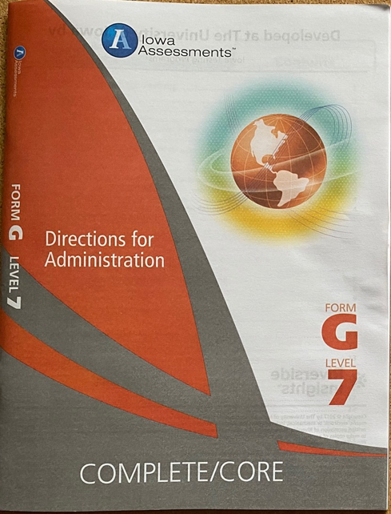

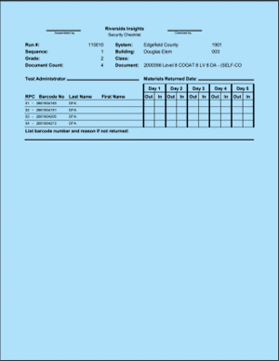


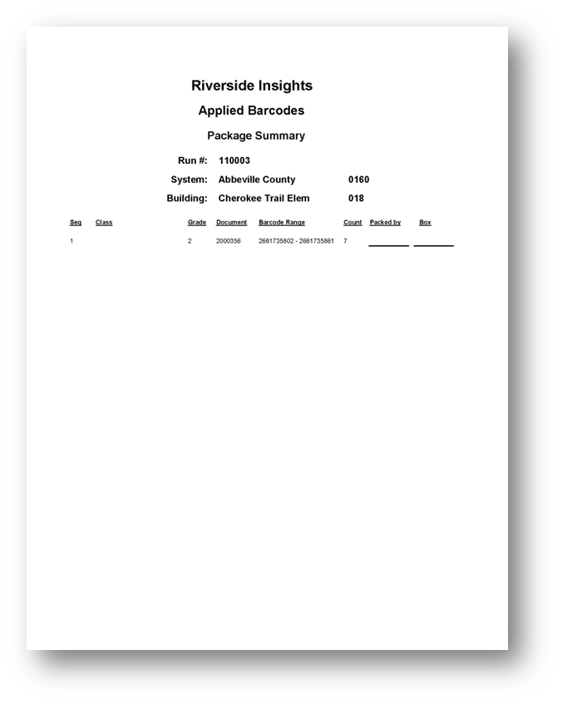

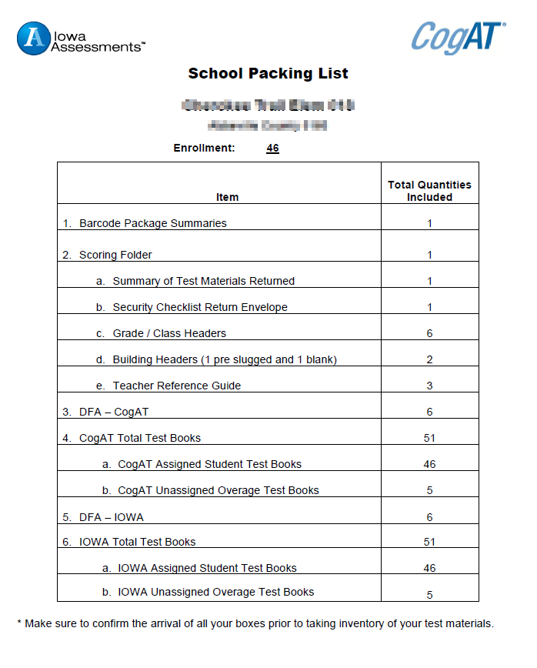
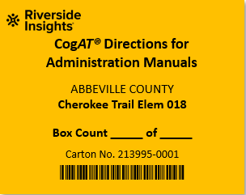

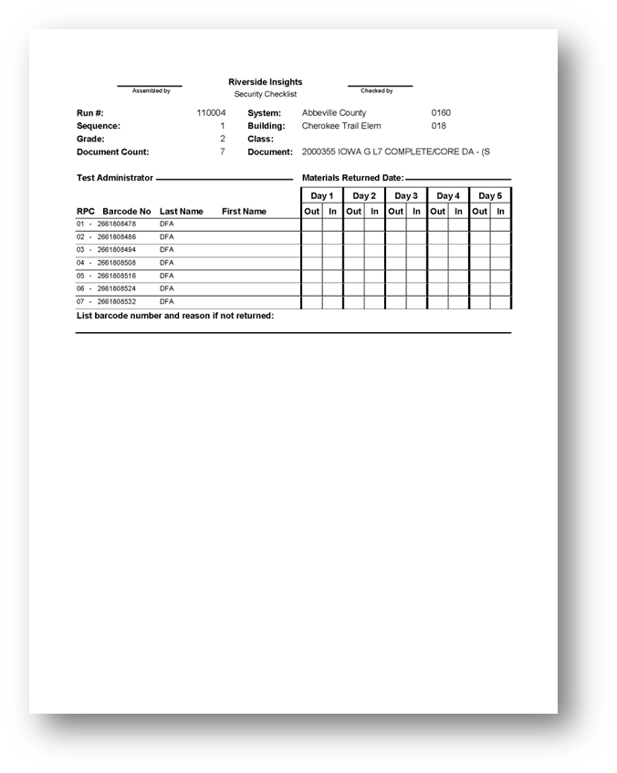
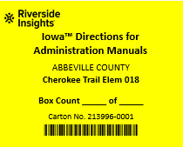
Packaging and Labeling- DFAs
Packaging CogAT DFA’s:
Building Packing list
Barcode Package Summaries
Scoring Packet
Shrink wrapped CogAT DFAs
Labeling:
  Box 1 of the DFA shipment will include a yellow Box 1 Open First label
  The Orange corresponding label and indicate the box count for the CogAT DFAs.
1
1
Packaging Iowa DFA’s:
Barcode Package Summaries
Shrink wrapped Iowa DFAs
Labeling:
  Yellow corresponding label and indicate the box count for the Iowa DFAs.
1
1
*Copies of Package Summaries will be sent to DTCs

Slide 27

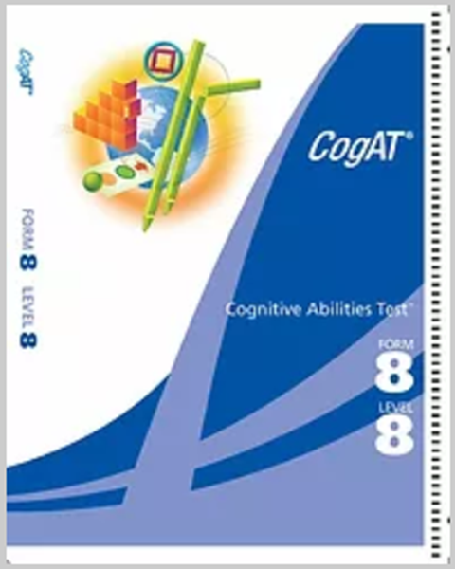

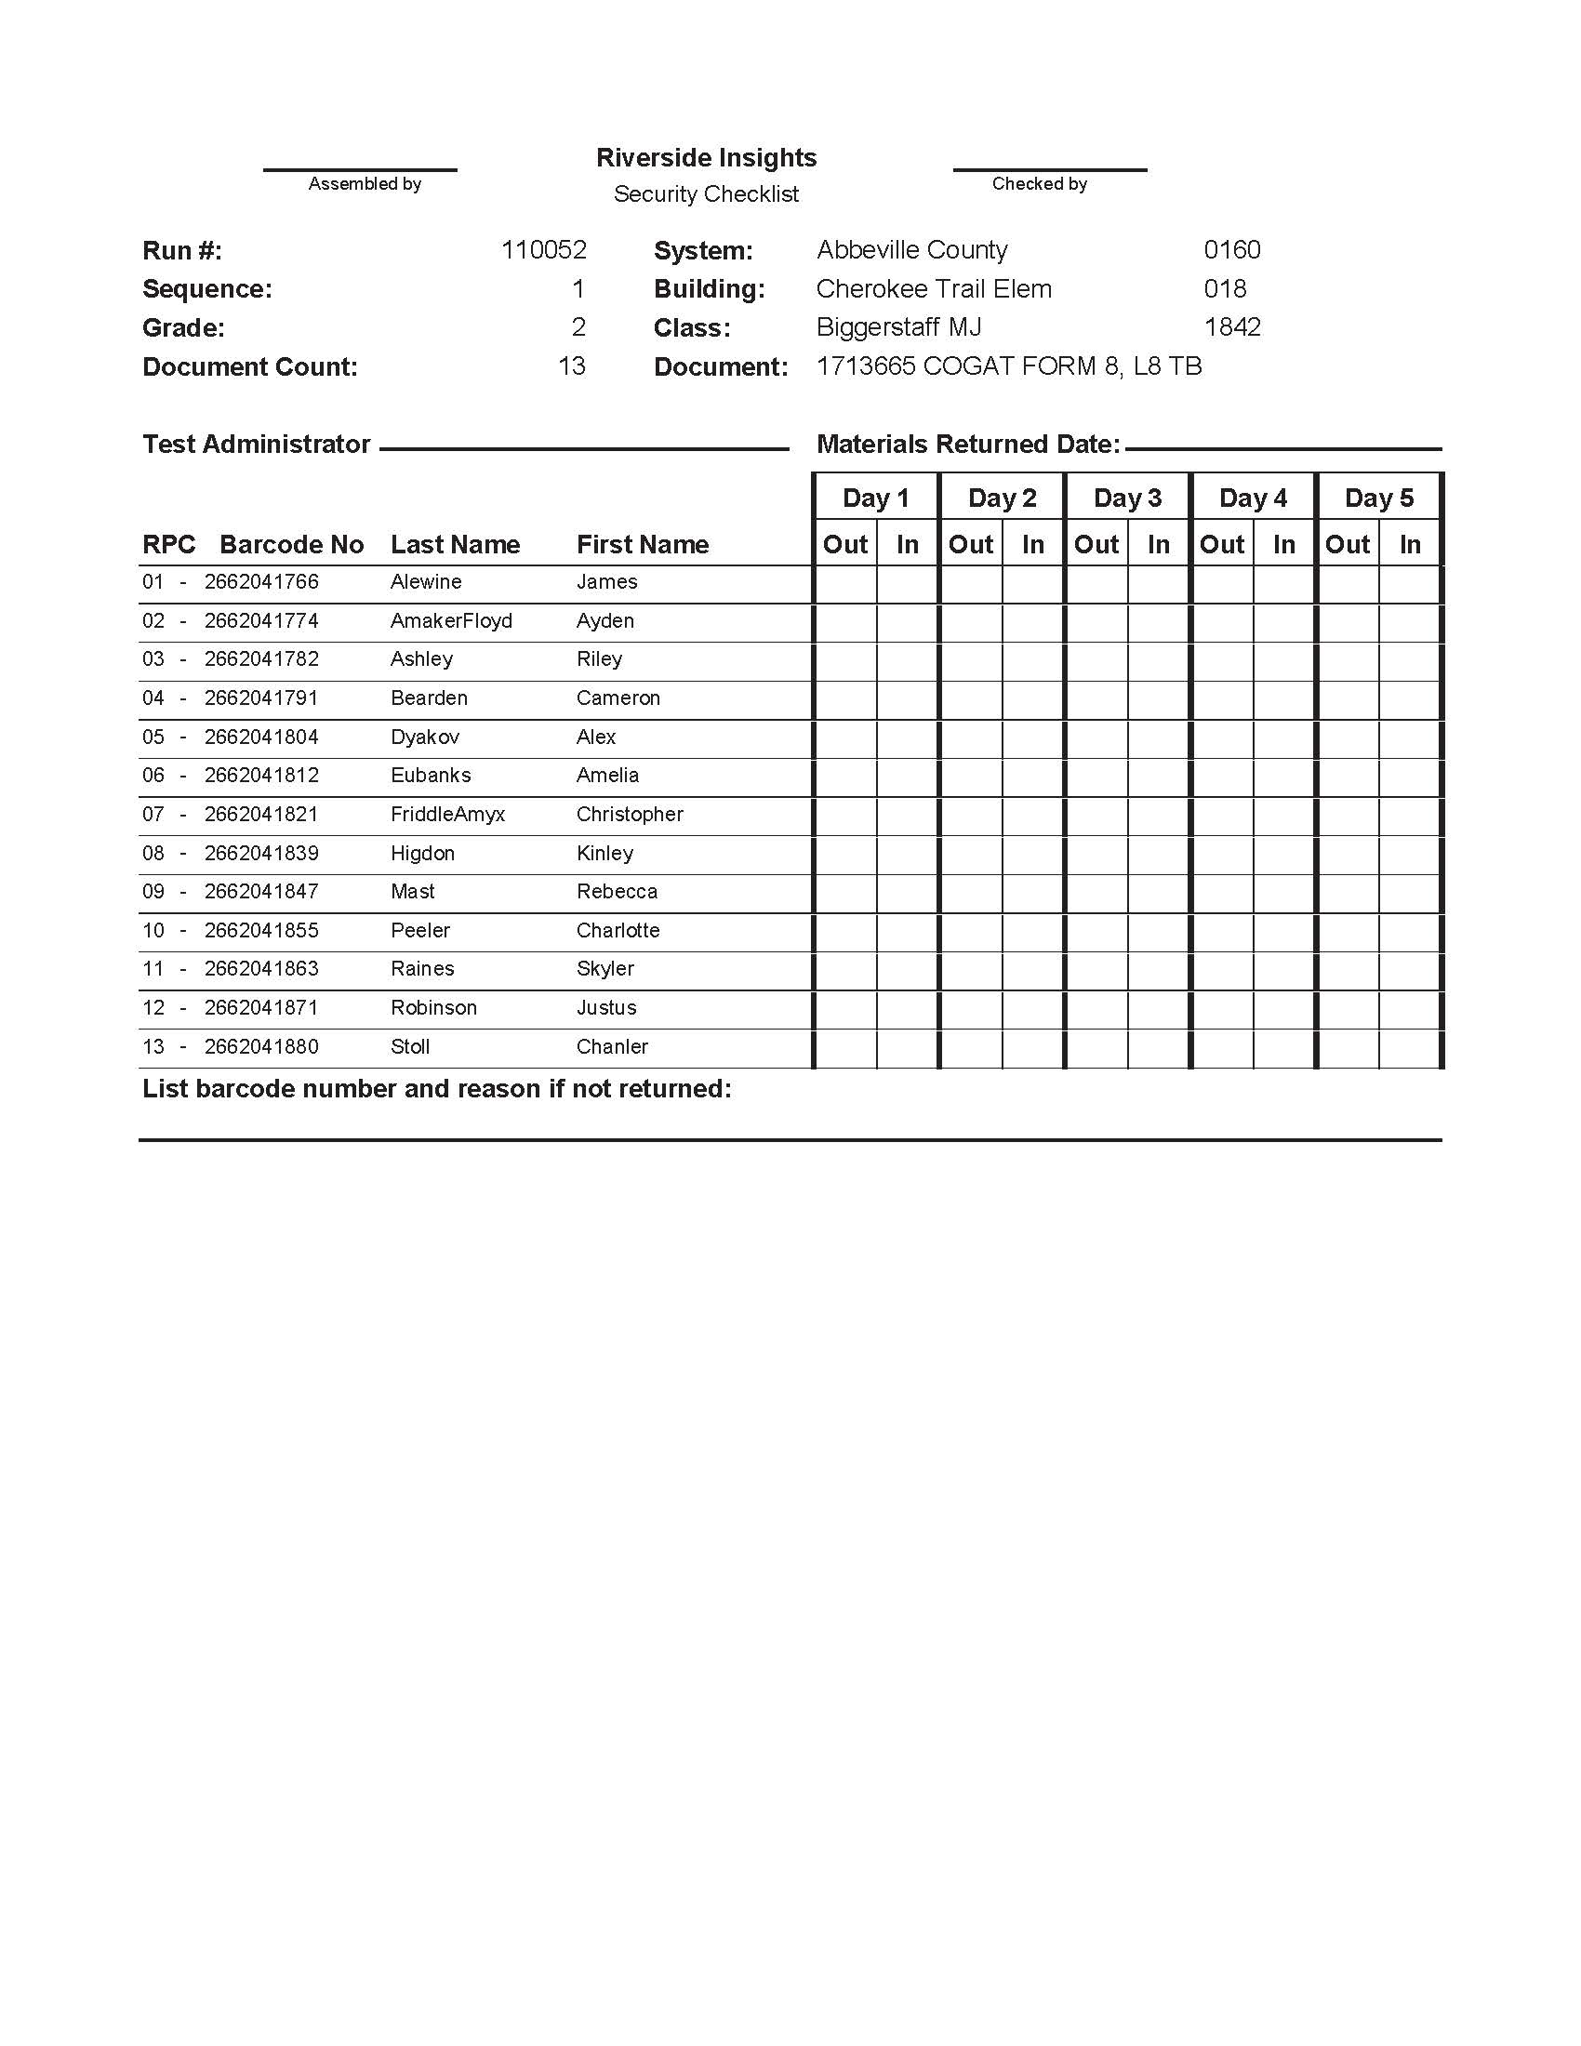
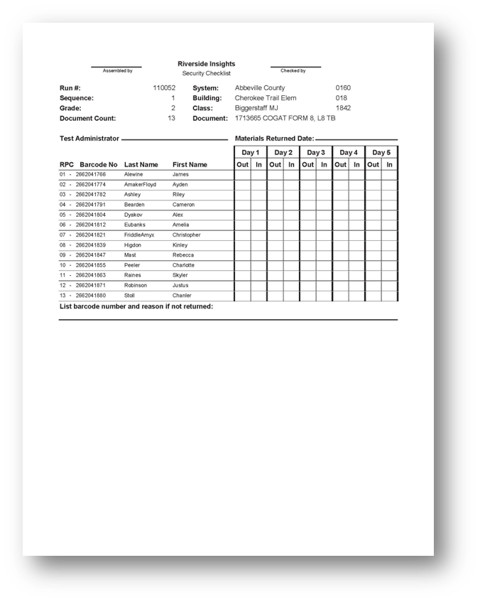
Packaging and Labeling- CogAT Test Books
Packaging CogAT Test Books:
Barcode Package Summaries in box 1 of Test Book shipment.
Shrink wrapped CogAT Test Books
Labeling:
  Orange corresponding label and indicate box count for the CogAT test books.
1
3
2
3
3
3
*Copies of Package Summaries will be sent to DTCs

Slide 28



Packaging and Labeling- Iowa Test Books
Packaging Iowa Test Books:
Barcode Package Summaries in box 1 of Test Book shipment.
Shrink wrapped Iowa Test Books
Labeling:
  Yellow corresponding label and indicate the box count of the Iowa test books.
1
3
2
3
3
3
*Copies of Package Summaries will be sent to DTCs

Slide 29
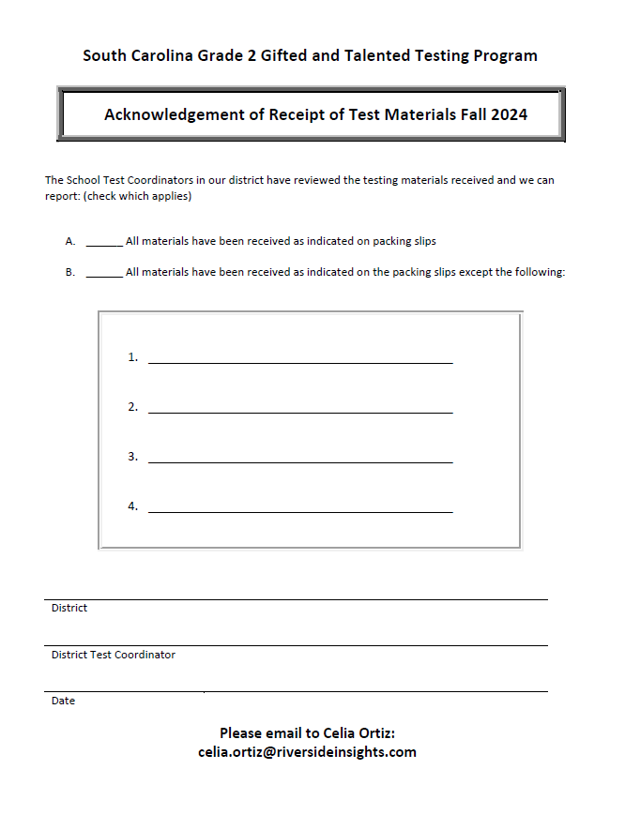
Receipt of Test Materials
Schools need to Inventory test materials upon arrival.
Use School Packing List (in box #1 of CogAT DFA shipment) to verify materials received.
Fill out Acknowledgment of Receipt of Test Materials form to indicate receipt of all materials.
E-mail a PDF copy of the completed form to Celia Ortiz at celia.ortiz@riversideinsights.com.
Notes:
DTCs to collect Acknowledgement of Receipt of Test Materials from the schools and send to Celia.

Slide 30
DTC Checklist- Before Testing
DTCs are required to attend the pretest workshops.
DTCs are responsible for ensuring that all personnel involved in administering or monitoring the Gifted and Talented assessments receive proper training.
DTCs must organize training sessions for all STCs.
DTCs and/or STCs must provide training for all Test Administrators (TAs) and monitors.
DTCs, STCs, TAs, and monitors must complete the “Agreement to Maintain Test Security and Confidentiality” forms, located on pages 66-71 of the Paper TAM..
Notes:
(TAM page 34)

Slide 31
DTC Checklist- Before Testing cont’
Develop a test administration schedule for the district- see page 17 of the TAM for a sample testing schedule
Ensure that each school has enough Test Administration Manuals- Paper Administration (TAM)
If additional quantities are needed, use the Request for Additional Test Materials form included with the test materials.

Slide 32
STC Checklist- Before Testing
Conduct Training at your school for all Test Administrators and monitors.
Inform teachers of the test schedule
Inventory test materials immediately upon receipt at the school site.
Ensure that arrangements have been made for any student who requires accommodations to respond to the test.

Slide 33
STC Checklist- Before Testing cont’
Communicate Teacher responsibilities
  Make sure they have a test booklet for each student.
  New Students- Complete the information blanks and name grids on the back of each student’s test booklet if the booklet is not pre-printed with the student’s information.
  Have a copy of the DFA for the appropriate test.
  Make sure each student has a sharpened pencil with an eraser and scratch paper for the Iowa Math test.

Slide 34
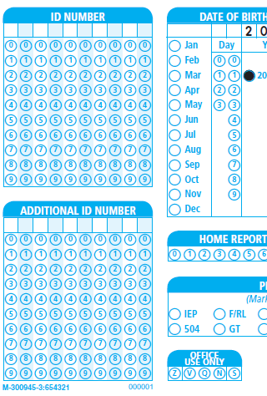
SUNS and Power School ID Numbers
Student Identification Number (State ID)
Enter the 10-digit State ID number assigned to each student in the 10-digit ID NUMBER field on the back of the student test booklet.
Student Power School Number
Enter the Power School Number in the 10-digit ADDITIONAL ID NUMBER field.
Left-justify the PS student ID numbers.
Write and bubble in IDs. The scanners only pick up the gridded fields.

Slide 36
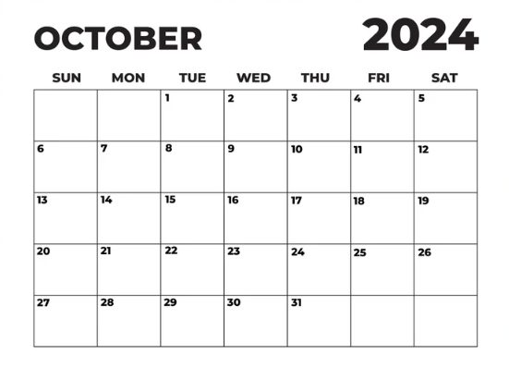
After the Test Administration
Testing window closes on Tuesday, October 29, 2024.
Paper test materials should be shipped to the Riverside Scoring Center no later than Friday, November 1st.

Slide 37
Return Material Procedures
Step 1: Collection of Test Materials
The School Test Coordinator should collect all test materials, including Directions for Administration, from the Test Administrators. Ensure that all materials are accounted for and organized before proceeding to the next steps.
Step 2: Prepare Scorable and Nonscorable Materials
Separate the test materials into two categories: scorable and nonscorable. Scorable materials are those that require scoring by Riverside Scoring Service, while nonscorable materials do not need scoring.
Stack A (Scorable Materials) | Stack B (Nonscorable Materials)
Building Identification Sheet Grade/Class Identification Sheets ALL Pre-ID barcoded CogAT and Iowa Assessments test booklets (except for z coded damaged test booklets). Overage CogAT and Iowa Assessments test booklets used by students for testing. | All unused Overage Test Booklets All Directions for Administration manuals (CogAT and Iowa Assessments) All Large Print Test Booklets- Prior to packaging for return, student responses must be transferred to the student’s precoded test booklet in a secure setting. If an overage book is used, ensure that the student’s demographic information has been completed. Security Checklists/Return Envelope

Slide 38
Return Material Procedures cont’
Step 3: Check the Scorable materials before packaging
Student Test Books | Class/Grade Identification Sheets
Ensure that a no. 2 pencil was used Gridding of all student information is complete and correct Miscellaneous materials are removed Stray marks have been erased All test booklets are assembled with the demographic page facing up | Use one Grade/Class Identification sheet per TA. Complete the indicated sections 1. INFORMATION BOX 2. CLASS NAME 3. CLASS CODE- Do not complete 4. GRADE 5. FORM 6. ANSWER DOCUMENT COUNT- Use leading zeros (i.e., for forty-four books grid and write 0044). 7. Scoring Service Only- Do not complete

Slide 39
Return Material Procedures cont’
Things to look for when packing your test materials
Please Remove: | Other checks:
scratch paper tape of any kind Post-itTM Sticky Notes staples pins paper clips | stray marks light marks for answers darken response marks so that they fill the circles. complete erasures where the student changed answers.
Notes:
Failure to do any of the above may result in a delay in getting your test scores back from Riverside Insights Scoring Center.

Slide 40
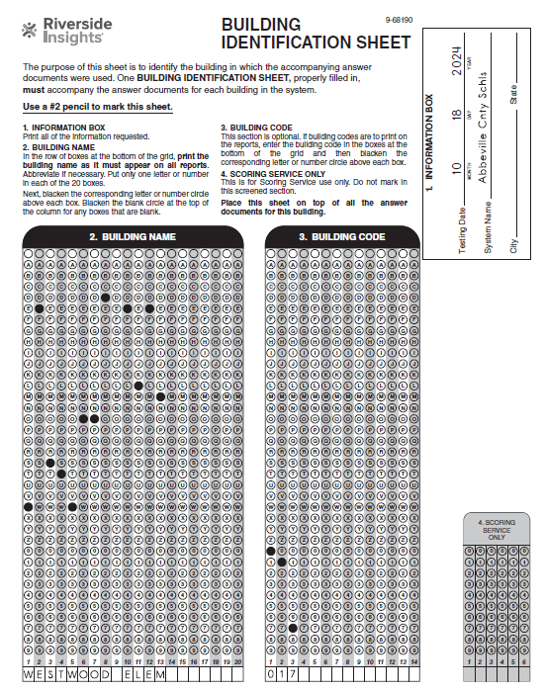
Building Identification Sheets
Districts received extra Building (School) Identification Sheets that are blank.
Schools receive two Building Identification Sheets - one that is pre-slugged and one that is blank.
Please do NOT PHOTOCOPY the School/Building Identification Sheet.
Do NOT complete Box #4 SCORING SERVICE ONLY section as this is done by Riverside Scoring Center.

Slide 41
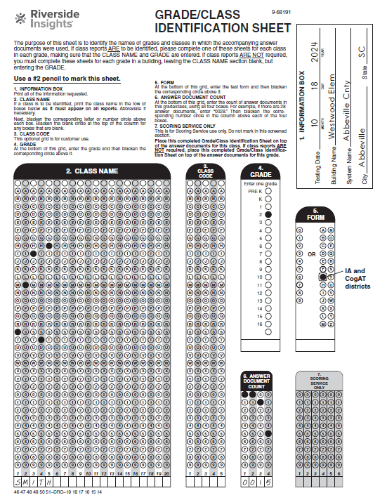
Grade Class Identification Sheets
Included in each Building Package are plenty of blank Grade/Class Identification Sheets.
Please do NOT PHOTOCOPY the GIS document. School Test Coordinators will have to contact the District Test Coordinators if more GIS documents are needed.
It’s important to include your document count.
Do NOT complete Box #4 SCORING SERVICE ONLY section as that is done by Riverside Scoring Center.

Slide 42
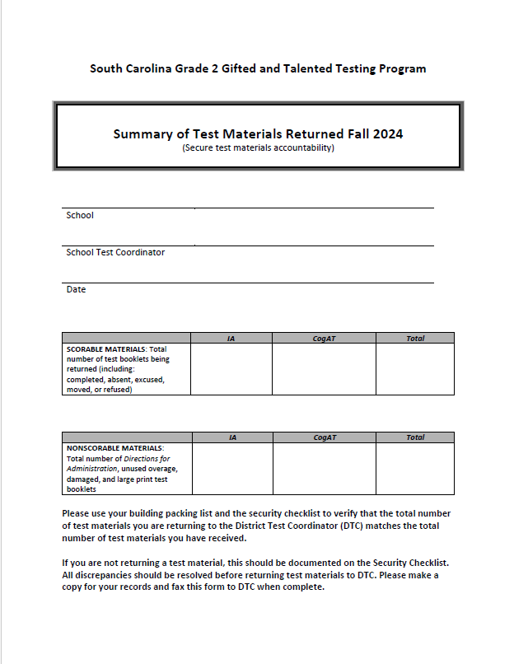
Summary of Test Materials Returned
Indicate the number of scorable materials (test booklets) returned.
Indicate the number of nonscorable test materials returned.
Fill in all 6 boxes shown in the diagram.
To be used by DTCs to complete the OSS.
60
60
120
14
14
28
Notes:
Please use your School Packing List and the Security Checklist to verify that the total number of test materials you are returning to the District Test Coordinator (DTC) matches the total number of test materials you received.
If you are not returning any of a particular test material, this should be documented on the Security Checklist. All discrepancies should be resolved before returning test materials to the DTC. Please make a copy for your records and return this form to the DTC when completed.

Slide 43
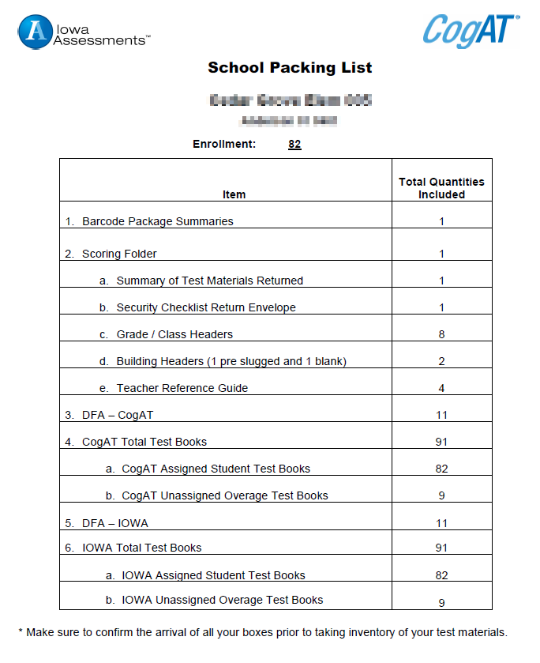
Summary of Test Materials Returned cont’
The School Packing List can be used as a reference when completing the Summary of Test Materials form.
These booklets belong in the Scorable materials boxes
If unused, these booklets belong in the Non-Scorable materials boxes
Notes:
Please use your School Packing List and the Security Checklist to verify that the total number of test materials you are returning to the District Test Coordinator (DTC) matches the total number of test materials you received.
If you are not returning any of a particular test material, this should be documented on the Security Checklist. All discrepancies should be resolved before returning test materials to the DTC. Please make a copy for your records and return this form to the DTC when completed.

Slide 44
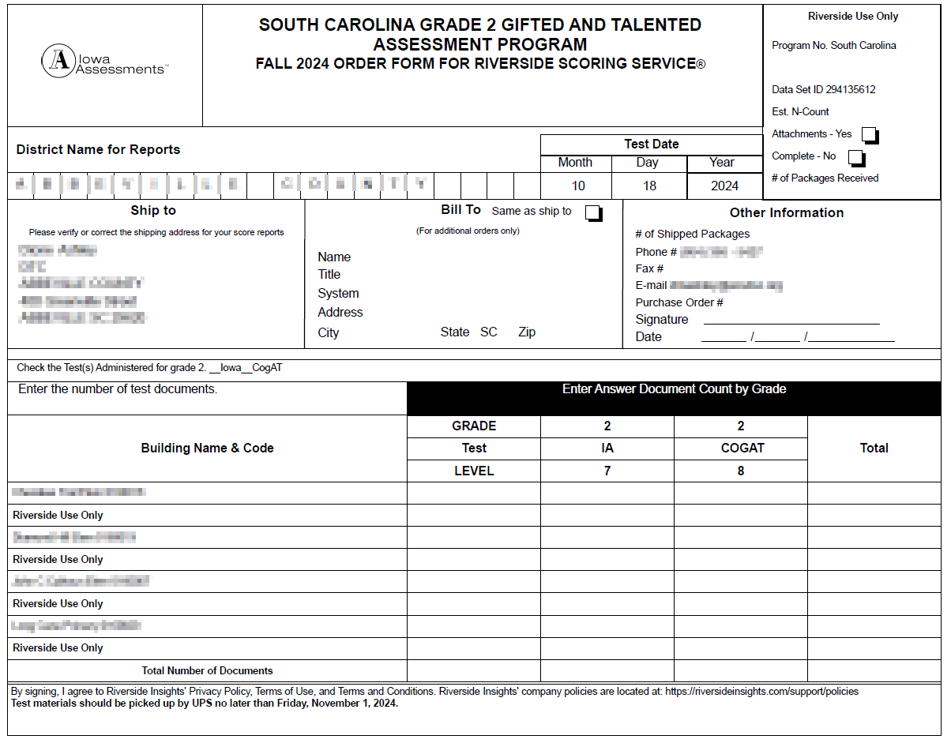
DTC – After the Paper Administration
Order for Riverside
Scoring Service (OSS)
must be filled out by the DTC.
The OSS must be
returned in Box #1 of the
scorable materials.
Use numbers from Summary of Test Materials Return Form, per school (Pg. 83, Appendix L), to complete the OSS.

Slide 45
Packing Instructions
District Test Coordinators:
Boxes should be packed by building.
Boxes should be numbered consecutively.
School Test Coordinators:
Follow diagram for packing test materials.
Pack CogAT test booklets in bottom of scorable box, and then pack IA on top for each class.
Place grade/class identification sheets on top of each class.
Place purple Building (Schools) Identification Sheet on top of first scorable box.

Slide 46
Packing Instructions (cont’)
SCORABLE
Order for Riverside Scoring Service (OSS) Building (School) Identification Sheets Grade/Class Identification Sheets All Pre-ID barcoded Student Test Booklets All used overage CogAT and Iowa Test Booklets
Scorable vs Nonscorable Materials
NONSCORABLE
Directions for Administration (CogAT and Iowa) Unused Overage Test Books Large Print Test Books School Security Checklists/Return Envelope

Slide 47
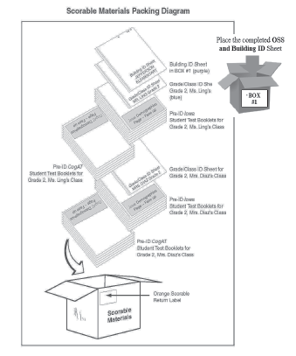
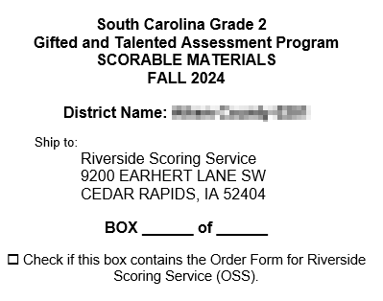
Packing Instructions (cont’)
Packing Scorable Materials at the schools should follow this diagram (TAM page 86)
Apply the orange scorable label on the boxes containing your scorable materials

Slide 48
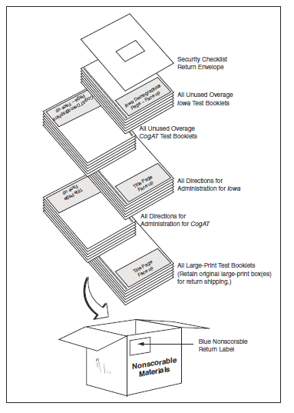
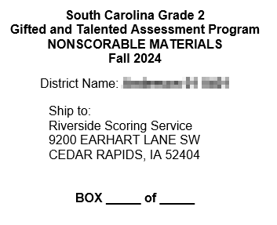
Packing Instructions (cont’)
Packing Nonscorable Materials at the schools should follow this diagram (TAM page 88)
Apply the blue non-scorable label on the boxes containing non-scorable materials

Slide 49

Returning of Test Materials

Slide 50

Information about UPS RS shipping labels
For your convenience, arrangements have been made to “Bill 3rd party” for this shipment. Therefore, you do not pay UPS.
Districts are responsible for scheduling a UPS pick-up for test materials. If requested, you may provide Riverside’s UPS Account Number G2E-237.
If your district has regular UPS service, UPS can collect the boxes during your regular pick-up time. However, it is best to call your local UPS office to let them know the number of boxes to pick up.
Plan ahead and ensure you arrange for pick-up on or before Friday, November 1, 2024. When contacting UPS, be sure to specify that you are requesting a 'Return Service' pick-up, using UPS RS labels. You will need the tracking number from one of the boxes.

Slide 51
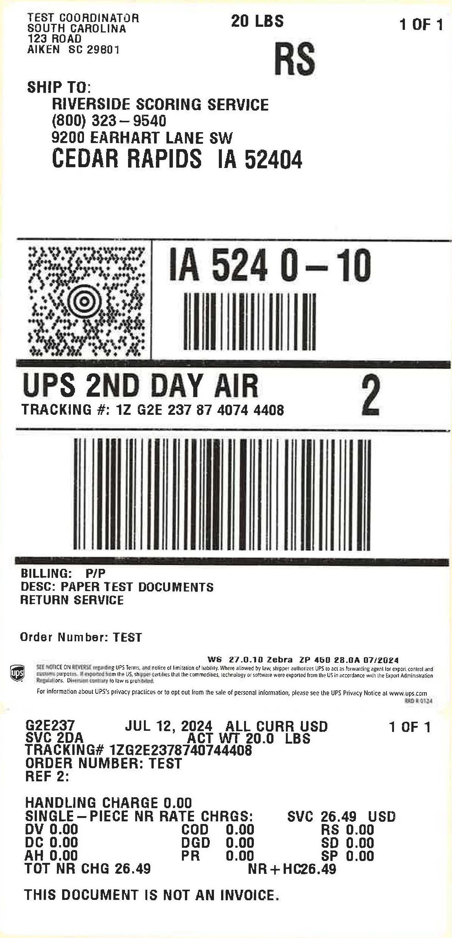

Using the UPS Labels
When shipping the test materials back to Riverside, be certain to cover the original shipping labels with black marker or paper.
DTCs should retain UPS tracking numbers by removing the sticker with the tracking number information from the bottom portion of the RS label and keep this number for your records.
Use the labels provided in sequential order.
*Please contact Celia to request additional UPS shipping labels.

Slide 52
Don’t Forget - First In! First Out!
A “first in/first out” reporting approach will be used for scoring services.
If materials are shipped to Riverside Scoring Center by November 1 with no issues, reports will arrive in the district no later than December 4, 2024.
Districts returning test materials after November 1 or returning test materials with issues to be resolved will receive reports 15 business days after the test materials are ready to be processed.

Slide 53

Scoring and Reporting
DataManager Reporting is a dynamic online reporting tool that allows you to perform the following tasks:
Create customized reports using the options available for your account
View and edit reports online
Save, edit, and re-use report criteria
Print reports
Export reports to PDF, RTF, or Microsoft Excel® format
Notes:
DataManager Reporting is a dynamic online reporting tool that allows you to perform the following tasks:
Create customized reports using the options available for your account
View and edit reports online
Save, edit, and re-use report criteria
Print reports
Export reports to PDF, RTF, or Microsoft Excel® format
From DataManager, you can locally download and/or print the following reports and more.
List Report of Student Scores
Classroom Summaries
School Summaries
District Summary
Student data file
*The schools will also receive 2 copies of the Student Profile Narrative and the Student Score Labels- 1 for Iowa, 1 for CogAT
Step-by-step instructions on how to generate the reports above is be posted on the SC Microsite as well as a live demo during the Posttest Workshop.

Slide 54

Scoring and Reporting
In addition, the schools will receive the following reports in paper form-
Two (2) copies of the Student Profile Narrative
Student Score Labels- 1 for Iowa, 1 for CogAT
*Packing List and box labeling for ease of unpacking your reports and distributing to the schools.
Notes:
DataManager Reporting is a dynamic online reporting tool that allows you to perform the following tasks:
Create customized reports using the options available for your account
View and edit reports online
Save, edit, and re-use report criteria
Print reports
Export reports to PDF, RTF, or Microsoft Excel® format
From DataManager, you can locally download and/or print the following reports and more.
List Report of Student Scores
Classroom Summaries
School Summaries
District Summary
Student data file
*The schools will also receive 2 copies of the Student Profile Narrative and the Student Score Labels- 1 for Iowa, 1 for CogAT
Step-by-step instructions on how to generate the reports above is be posted on the SC Microsite as well as a live demo during the Posttest Workshop.

Slide 55
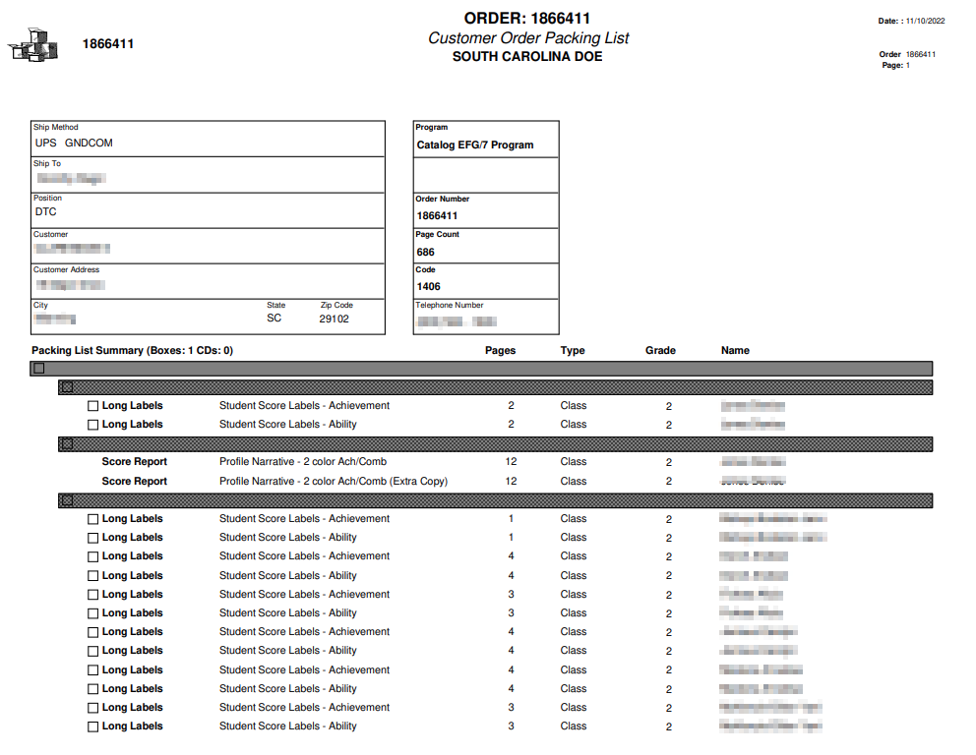
Packing List & Box Labeling
South Carolina Grade 2 Gifted and Talented Assessment Program
Score Paper Reports
Box _____of_____
1
1
Green folders- Score Labels
White folders- Profile Narrative

Slide 56

SC Assessment Consultant
Sierra Scott
Assessment Consultant sierra.scott@riversideinsights.com
Phone: 407-362-8204
Contact your Assessment Consultant with any questions about pricing, Quotes, and to submit orders for off-grade-level materials.

Slide 57
Ordering Off-Grade-Level Materials
Contact Sierra Scott with any questions about pricing, Quotes, and to submit orders for off-grade-level materials.
Do NOT ship off-grade-level test materials with the on-grade-level test materials for this program.
Do NOT use the orange scorable and blue nonscorable return labels when shipping off-grade-level test materials.

Slide 58

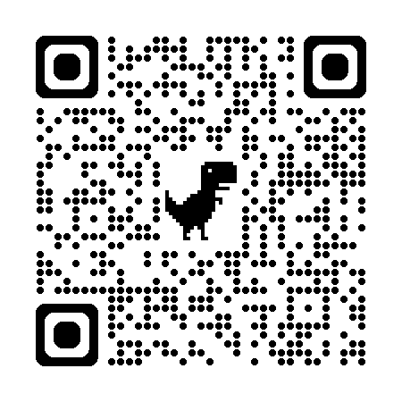
SCDoE Grade 2 Gifted and Talented Assessment Website
Follow the following link to access the website: https://info.riversideinsights.com/scdoe
You can find digital resources to support the Fall 2024 Testing Administration:
  Required tests
  Test Administration Manuals
  Pretest Workshop PowerPoint presentation
  Test security affidavit for DTC’s and STC’s
  Test security affidavit for TA’s
  Test Security Violation Forms
  Links to DataManager Proctor training
  Gr 2 Brochure for Parents and Students

Slide 59


Slide 60
Gifted and Talented Assessment Program for Grade 2 Students
Thank you for participating in this Workshop!
Fall 2024 Pretest Workshop-
Paper Administration

