Slide 1
Gifted and Talented Assessment Program for Grade 2 Students
Fall 2023 Pretest Workshop-
Paper Administration

Slide 2
Who to Contact
Riverside Insights South
Carolina Team
South Carolina Department of Education Staff
Celia Montanez
Sr. Project Manager celia.montanez@riversideinsights.com Phone: 630-760-4419
Sierra Scott
Assessment Consultant Executive sierra.scott@riversideinsights.com Phone: 407-362-8204
Paul King
Achievement Assessment Consultant paul.king@riversideinsights.com Phone: 224-371-8540
David Trombly
Office of Assessment and Standards, SCDE
dctrombly@ed.sc.gov
Phone: 803-734-8274
Dr. Susan Creighton
Office of Assessment and Standards, SCDE
screight@ed.sc.gov
Phone: 803-734-8535

Slide 3
Schedule of Important Dates- 2023-2024
Milestone, Task, or Deliverable | Date
Pretest Workshops via Webinar Online Administration Paper Administration | Tuesday, September 12 Wednesday, September 13
Districts receive test materials and Directions for Administrations | September 25
Last day to order additional test materials or large print test booklets | October 20
Test administration window | October 9 – 27
Last day to ship back to Riverside for scoring | November1
Reports arrive in districts if returned by November 1, 2023 | December 4
Last day to order make-up test materials | December 29, 2023
Make-up testing window | January 4-12, 2024
Districts receive their make-up test results | February 5
Notes:
(TAM page iii)

Slide 4
SC Gr 2 Gifted & Talented Assessment Program
The Gifted and Talented Grade 2 Assessment is a statewide assessment used to identify students for district gifted and talented programs. Students are identified for this program by demonstrating high performance ability or potential in academic and/or artistic areas.
Notes:
State Board of Education regulation 43-220 requires the administration of assessments measuring cognitive, academic, and/or artistic abilities to identify students for district gifted and talented programs. The South Carolina Department of Education (SCDE) provides an aptitude and an achievement assessment for this purpose.
South Carolina law requires districts to screen all students at the elementary and secondary levels for district Gifted and Talented services.
Districts are required to provide services for all gifted and talented students.
Although the primary purpose of these assessments is to identify students for the Gifted and Talented programs, student results can be useful to teachers as they examine their instructional practices and can help them identify teaching strategies for all students.

Slide 5
Criteria for Gifted & Talented Selection
Students may be eligible for placement into the district Gifted and Talented program based on their aptitude score alone.
A composite score on the CogAT® at or above the 96th national age percentile.
Qualifying aptitude scores are good for five years.

Slide 6
Criteria for Gifted & Talented Selection
Students are also identified for services by demonstrating high performance in two of the following dimensions:
Dimension A (Reasoning Abilities)- Aptitude (93rd national age percentile) in one or more of the following areas:
verbal/linguistic
quantitative/mathematical
nonverbal
and/or a composite of the three
Dimension B (High Achievement in Reading and/or Mathematics)- achievement (94th percentile and above)
Dimension C (Intellectual/Academics)- score of 16 on either the verbal or nonverbal component of the Performance Task Assessments
Notes:
For placement into the Gifted and Talented grade 2 program, students must meet the criteria for two out of the three dimensions outlined in the regulation.
Dimension A (Reasoning Abilities) requires students to demonstrate high aptitude (93rd national age percentile) in one or more of these areas: verbal/linguistic, quantitative/mathematical, nonverbal, and/or a composite of the three. Scores on CogAT may be used for this purpose. Students who meet the 96th or higher national age percentile composite score on CogAT are automatically eligible for placement into a district gifted and talented program.
Dimension B (High Achievement in Reading and/or Mathematical Areas) of the regulation requires that students demonstrate high achievement in reading and/or mathematical areas (94th national percentile and above) as measured by a nationally normed or statewide assessment.
Students who meet the eligibility requirements of either Dimension A (aptitude) or Dimension B (achievement), but not both dimensions, must take the Performance Task Assessments (Dimension C).
Dimension C (Intellectual/Academic Performance) requires students to demonstrate a high degree of interest in and commitment to academic and/or intellectual pursuits or demonstrate intellectual characteristics such as curiosity/inquiry, reflection, persistence/tenacity in the face of challenge, and creative productive thinking. One of the methods by which these characteristics may be demonstrated is with a score of sixteen on either the verbal or nonverbal component of the Performance Task Assessments for grade 3 placement.
If a student meets the criteria for Dimensions A and B, the student qualifies for Gifted & Talented services without taking the Performance Tasks Assessment.
If a student meets the criteria for Dimensions A or B, but not both, the student will take the Performance Tasks Assessment

Slide 7
Who to Test
SCDE provides these assessments for all grade 2 students.
Students with an IEP or 504 Accommodations Plan must participate in the grade 2 assessment.
ML students must be given the opportunity to participate in the CogAT and Iowa Assessments.

Slide 8
Administration of CogAT and IA
CogAT and Iowa Assessments are group-administered by classroom teachers.
It is best for tests to be administered by someone who is familiar to the students.
Teachers must be trained before administering the Gifted and Talented assessments.
Tests are not timed.
The pace at which test questions are presented should be adjusted to suit the characteristics of the students being tested.

Slide 9
Administration of CogAT and IA
For a paper administration tests are read aloud by classroom teachers, word for word.
Teachers read a prepared script found in the DFA (Directions for Administration) manual for each test.
Teachers should read these directions, and make notes if need, prior to the actual administration to become familiar with the text.
Each test begins with a practice item to give students some experience.
Speak distinctly and at a constant rate. Do not use inflection in your voice.

Slide 10
Administration of CogAT and IA
Monitor Students – It is important to monitor the students to make certain each one understands the subtest instructions, is working on the correct question, and is marking in the test booklet properly.
Review practice questions with students – Always try to ensure that students understand what they are supposed to do before starting the subtest.
Pace the test to fit the students – Tests are designed to measure how well, rather than how rapidly students can solve reasoning problems. Adjust the pace of the testing to fit the skill level of the students.

Slide 11
Cognitive Ability Test (CogAT®)
All the following CogAT tests must be administered:
CogAT Form 8, Level 8 | Test Booklet Page Numbers | Directions for Administration Page Numbers
Verbal Battery Picture Analogies Sentence Competition Picture Classification | Practice items on inside of front cover Pages 1-7 Pages 9-14 Pages 15-24 | Pages 16-18 Pages 19-23 Pages 24-27 Pages 28-32
Quantitative Battery Number Analogies Number Puzzles Number Series | Pages 25-31 Pages 33-38 Pages 39-45 | Pages 33-37 Pages 38-41 Pages 42-46
Nonverbal Battery Figure Matrices Paper Folding Figure Classification | Pages 47-53 Pages 55-63 Pages 65-70 | Pages 47-51 Pages 52-56 Pages 57-60
All nine tests are combined to obtain a Composite Aptitude score.

Slide 12
Iowa Assessments™
All the following subtests in the IA level 7 tests must be administered:
IA Form G, Level 7 Core Battery | Test Booklet Page Numbers | Directions for Administration Page Numbers
Reading: Picture Stories* | Pages 12-14 | Page 22
Reading: Sentences* | Page 15 | Page 23
Reading: Stories* | Page 16-20 | Pages 24-25
Mathematics: Part 1** | Pages 33-37 | Pages 39-42
Mathematics: Part 2** | Pages 38-41 | Pages 43-47
*All three reading tests need to be completed to receive a Reading score.
**Mathematics (Parts 1 and 2) need to be completed to receive a Total Math score
Notes:
Online Reading
Part 1 includes Picture Stories and Sentences
Part 2 includes Stories

Slide 13
Testing Students with Documented Disabilities and ML Students
Testing Students with IEP/504 Plans
Definition of a Student with Disabilities
Student Participation
IEP and 504 Plans
IEP and 504 Accommodation Plan Requirements
South Carolina-Allowed Accommodations
Notes:
A student with a documented disability is either a student who has been evaluated and found to meet the eligibility criteria for enrollment in special education as defined by the Individuals with Disabilities Education Act (IDEA 97) and South Carolina State Board of Education Regulation 43-243.1 or a student who has a disability covered under Section 504 of the Rehabilitation Act of 1973.
Students with a current Individualized Education Program (IEP) or 504 Accommodations Plan must participate in screening for identification for the academic gifted and talented program. Students should participate in CogAT and Iowa Assessments testing, as appropriate, or in an alternative screening process that includes a documented review of existing data from a norm-referenced aptitude and norm-referenced mathematics and reading comprehension assessment.
The student’s IEP team determines whether the student will participate in the assessment in the same manner as other students, or with accommodations. Students cannot be excluded from screening because of a disability.
SC Allowed Accommodations- Some accommodations listed in the Directions for Administration (DFA) for both CogAT and Iowa Assessments are not approved for use in South Carolina. Make sure that Test Administrators (TAs) are aware that the accommodations listed in the TAM pages 8-14 are the only approved accommodations for the South Carolina Grade 2 Gifted and Talented Assessment program.

Slide 14
State-Allowed Accommodations
Setting – individual or small group
Timing – frequent and extended breaks
Scheduling - multiple sessions or days
Presentation – highlighting, cueing, read aloud to self, repeating or signing the directions, repeated directions, signed administration
Response – nonverbal indication of answer choices or dictation of responses
Bilingual Dictionary – word-to-word dictionary only with no pictures, definitions, etc.
Translate Directions – only general test directions may be translated
Notes:
Setting-
The small-group size should be consistent with the group size used for routine classroom assessments.
Preferential seating
Separate location
Timing- Frequent and Extended Breaks – This accommodation is used if additional time is needed beyond the break structure of the assessment. These breaks may occur:
In the classroom/separate location, with no contact between students; or
Outside of the classroom/separate location, with contact between students monitored to ensure there is no discussion of the assessment.
Scheduling- Multiple Test Sessions/Days – The student may take portions of CogAT or the Iowa Assessments over several days, as long as all testing is completed by the last day of the testing window. Students must begin testing on the regularly scheduled testing date and may not go back to previously completed sections of the test.
Presentation- Highlighting – The Test Administrator may highlight key words or phrases for students in the directions but not in any other part of the tests. The student may highlight words, phrases, sentences, etc., in passages.
Cueing – The Test Administrator may write cues, use cue symbols, or orally cue the directions only in the test booklet
Read Aloud to Self – All items on CogAT are pictorial. For the Iowa Assessments, the student may read the test questions aloud to himself or herself. This accommodation requires an individual administration.
Repeated Directions- Only test directions may be read aloud as many times as necessary to inform students of the proper procedures to follow in responding. This accommodation applies only to the general test directions prior to the first test item for each subtest. Additionally, any student may have the general directions repeated or clarified to ensure the student understands the proper procedures to follow in responding.
Notice that there are differences between the test administration directions for the CogAT and Iowa Assessments tests. These administration directions apply to all students. CogAT- you may repeat the directions as many times necessary. Iowa- Read the directions for each question only once. Do not repeat the directions. This applies to the entire test, even for students with “repeated directions” in their IEP, because repeating the directions changes the construct of the test.
Bilingual Dictionary- Students may use a word-to-word bilingual dictionary. However, the dictionary must not include any examples, pictures, or definitions..
Translate Directions- The general test directions may be translated into the student’s native language. This translation cannot go beyond the scope and meaning of the directions. Test questions/individual test question directions may not be translated. Practice items also may not be translated as they are embedded in the test.

Slide 15
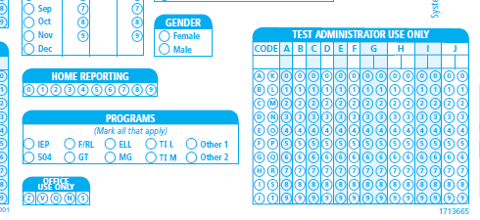
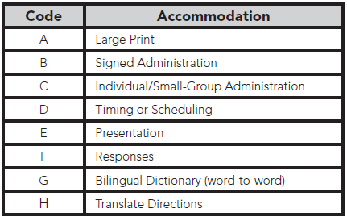
Coding Accommodations for Students with Documented Disabilities and ML Students
Notes:
The types of accommodations provided to students must be recorded on the student test booklet in the “Test Administrator Use Only” block.

Slide 16
What is CogAT Alt-V Scoring for Grades K-2?
Why?
To better identify ML students in grades K-2.
To provide a composite score and Ability Profile that can be used for instructional grouping.
How?
TAs or STCs would bubble in “S” in the Office Use Only field box on the demographic page of the CogAT answer document.
Teachers will administer only the Picture Analogies and Picture Classification subtests. The Sentence Completion subtest will be skipped. Students will complete the full Quantitative and Nonverbal batteries.
Students will receive a composite score and an ability profile that can be used for instructional grouping.
Notes:
Alt-V scoring involves the elimination of the Sentence Completion subtest from the Verbal battery.
The use of Alt-V scoring should be determined for each individual ML student. ML students who receive an ACCESS for ML’s composite score between 1.0 and 4.9 may be considered for Alt-V scoring. ML students without an ACCESS score may have their screener score used; 1.0–4.5 may be considered.
SCDE states only ML students are eligible for Alt-V scoring where they have the option to omit the Sentence Completion subtest.
Consideration for Alt-V Scoring should be determined for each individual ML student. ML students receiving an ACCESS for ELL’s composite score between 1.0-4.9 may be coded for Alt-V Scoring (TAM page 14).

Slide 17
Large Print Materials
Braille test booklets are NOT available for CogAT or the Iowa Assessment at the second-grade level.
Large-print test books are available for both the Iowa Assessments and CogAT. Student responses must be transcribed to the student’s barcoded test booklet.
To order the Large Print books, please contact the Riverside Project Manager- Celia Montanez
Please order these materials no later than Friday, October 20, 2023.

Slide 18
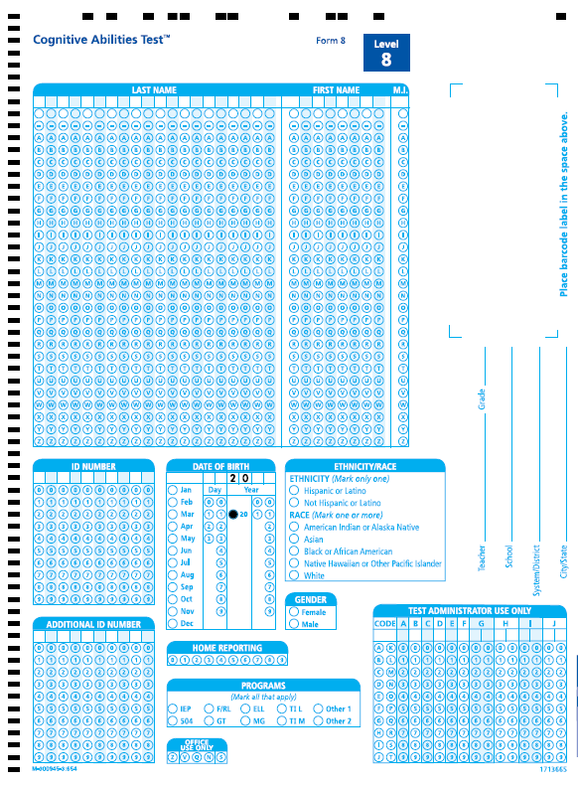
CogAT Alt-V Coding
Code these students as “S” in ‘Office Use Only’ field box on the demographic page of the test booklet back cover.
Our scanners at Riverside Scoring Center are programmed to pick up anything bubbled “S” so that the eligible ML student will be scored as “Alt-V” in which the student would still receive a Verbal score and a total VQN composite score.
Please remind teachers NOT to administer the Sentence Completion subtest to these ML grade 2 students.

Slide 20
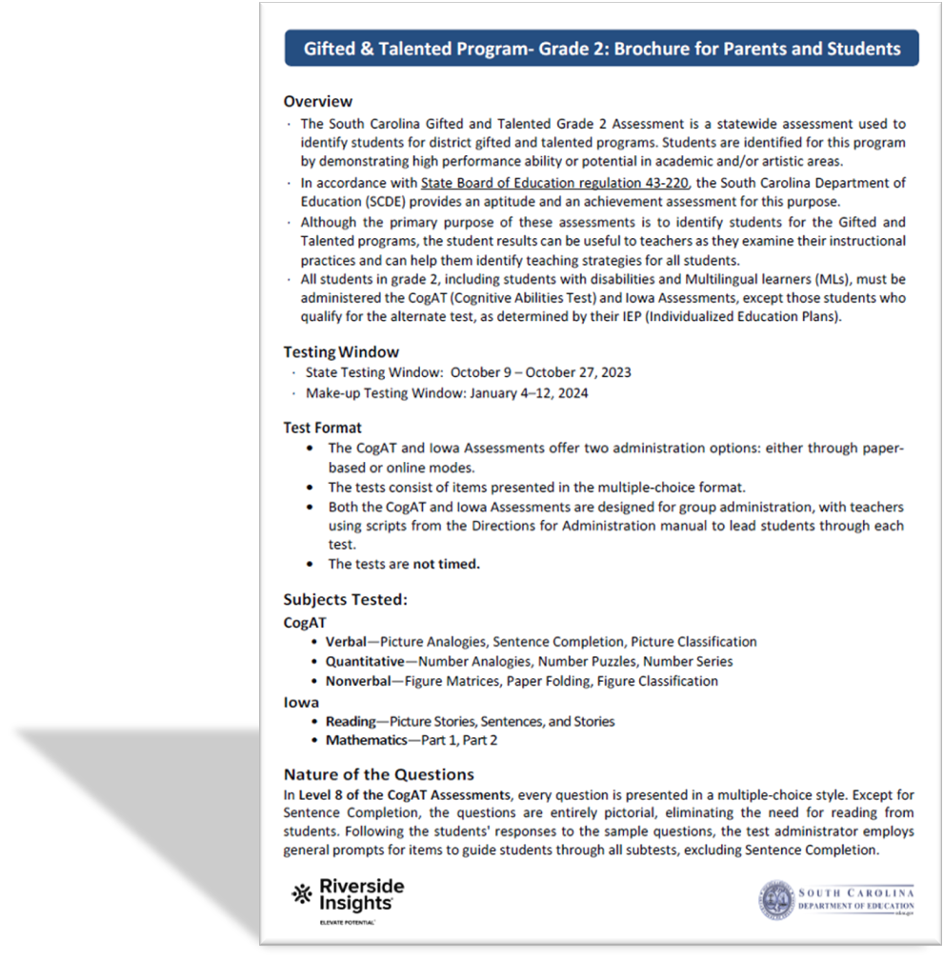
New this year!
Gifted & Talented Program- Grade 2: Brochure for Parents and Students.
Test Administration Manuals and Test Materials (paper administration) shipping directly to the schools.

Slide 21
Preparing Students for Testing
Informing parents
Testing environment
TEST ADMINISTRATION
Notes:
Communication between school and home before testing begins can help make testing run smoothly and make it possible for students to do their best.
Inform parents regarding the purpose of the testing and how the results will be used. Inform parents that there is no opt-out provision. All grade 2 students must be given the opportunity to test. *New this year- We have provided a new brochure with your Test Administration Manuals that provides information about the test that can be sent home to inform parents.
Parent permission to take these tests is not required.
All parents should be told in advance the dates and times each test and/or subtest will be administered in their school. Send them the testing schedule.
A test schedule should be posted on the school website.
Testing Environment- Students should be tested in classrooms with good lighted and well- ventilated, have adequate spacing between students to increase test security, classrooms should be quiet and free from distractions, and anything content related (reading and math) to grade 2 standards should be covered and removed.
Test administration-
Decide how the test will be administered and by whom.
Monitor students to make sure that each one understands the test instructions.
Pace the test to fit the students- for classes in which some of the students are likely to take much longer than others, it may be best to administer the tests in two separate groups.

Slide 22
Suggested Testing Schedule
Day | Test | Test Booklet Page Numbers | Estimated Time (minutes)
Day 1 | CogAT Picture Analogies Sentence Completion Picture Classification | Pages 1-7 Pages 9-14 Pages 15-24 | 13 14 13
Day 2 | CogAT Number Analogies Number Puzzles Number Series | Pages 25-31 Pages 33-38 Pages 39-45 | 15 15 15
Day 3 | CogAT Figure Matrices Paper Folding Figure Classification | Pages 47-53 Pages 55-63 Pages 65-70 | 13 11 13
Day 4 | Iowa Reading: Picture Stories Reading: Sentences Reading: Stories | Pages 12-14 Page 15 Pages 16-20 | 10 10 25
Day 5 | Iowa Mathematics: Part 1 Mathematics: Part 2 | Pages 33-37 Pages 38-41 | 25 25
*Estimated testing times are the same for both paper and online administrations.
Notes:
(TAM page 17)

Slide 23
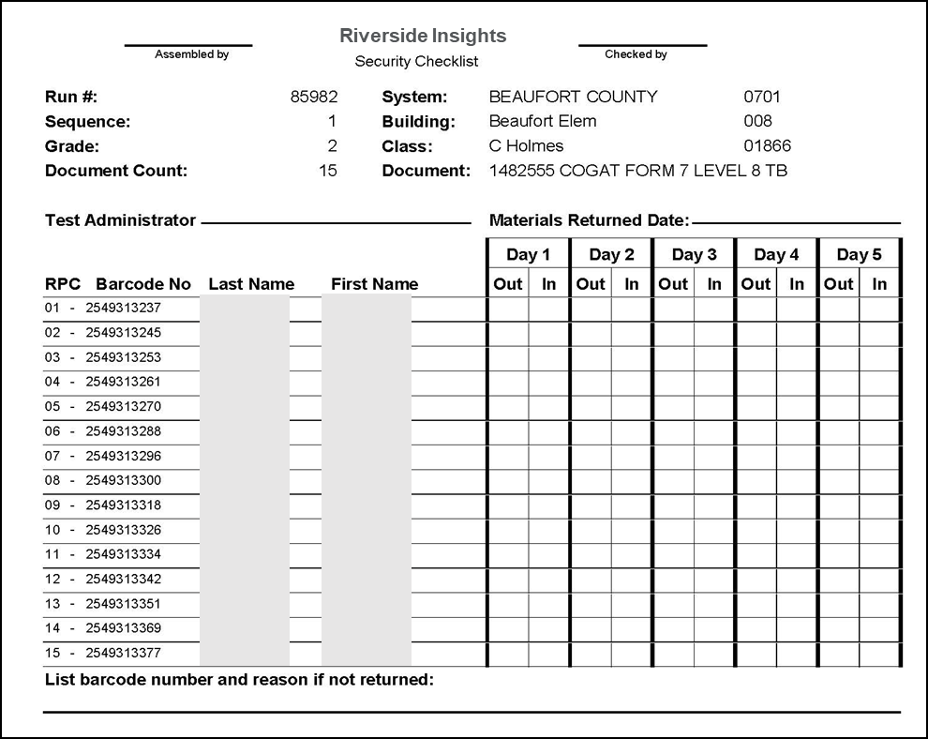
Test Security
Storage of materials – Secure test materials must be kept in a secure, locked storage, at the school and district level, when not in use. This includes the student test booklets and Directions for Administration.
Test security agreement forms (Appendix A - TAM pages 55-70) – DTC/STC, TA and Monitor forms must be signed and collected at the completion of training.
Security checklist (TAM pages 22-23) – Must be counted, signed in and out each day of testing by STC’s and TA’s.
Notes:
The STC is responsible for inventory control within the school. STCs must account for and return all of the test booklets and Directions for Administration manuals to Riverside Insights. Schools and districts are required to use the security checklists to track the distribution and return of all secure test materials.
STC’s must use the School Security Checklists to count and sign-in and sign-out test materials.
* It is highly recommended that you make a copy of the security checklist for your records.

Slide 24
Box Labeling
Directions for Administration Manuals
Box 1 Labels- to be used on Box 1 of the CogAT DFA shipment.
!
CogAT® Directions for Administration Manuals
Iowa™ Directions for
Administration Manuals
ATTENTION: TEST COORDINATOR
ABBEVILLE COUNTY
Cherokee Trail Elem 018
Box Count _____ of _____
Carton No. 213995-0001
213995-0001
ABBEVILLE COUNTY
Cherokee Trail Elem 018
Box Count _____ of _____
Carton No. 213996-0001
213995-0001
BOX 1
OPEN FIRST
Iowa and CogAT Test Books
CogAT® Test Books
Iowa™ Test Books
ABBEVILLE COUNTY
Cherokee Trail Elem 018
Box Count _____ of _____
Carton No. 213998-0001
213995-0001
ABBEVILLE COUNTY
Cherokee Trail Elem 018
Box Count _____ of _____
Carton No. 213999-0001
213995-0001

Slide 25
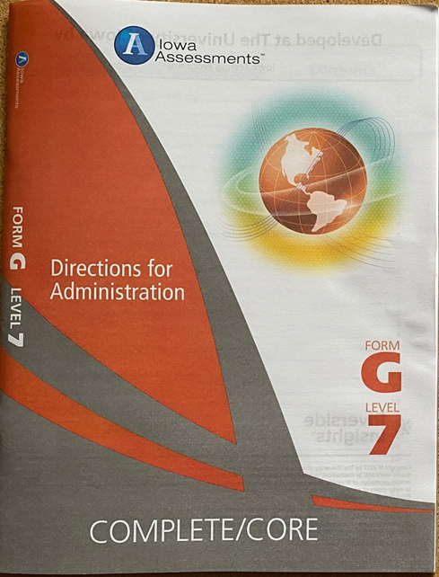
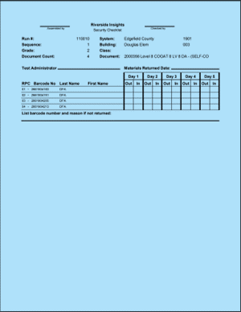
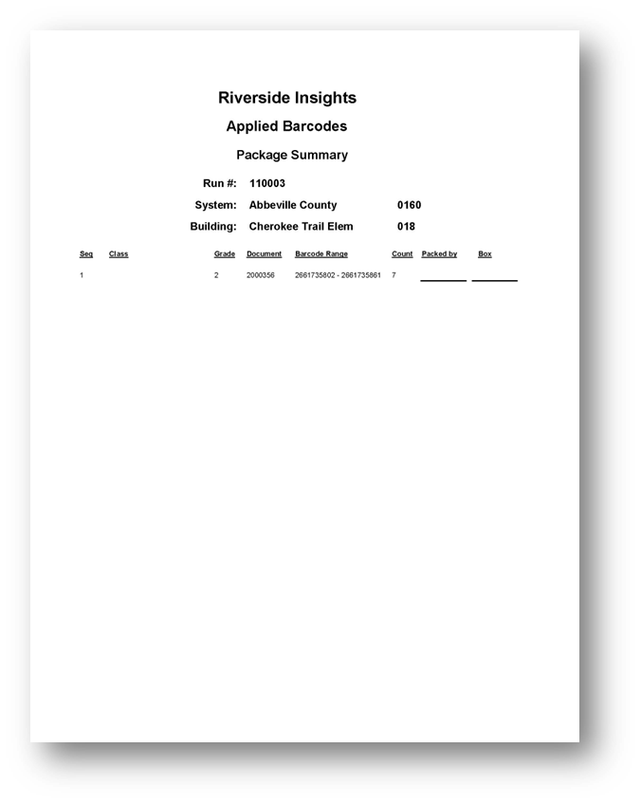
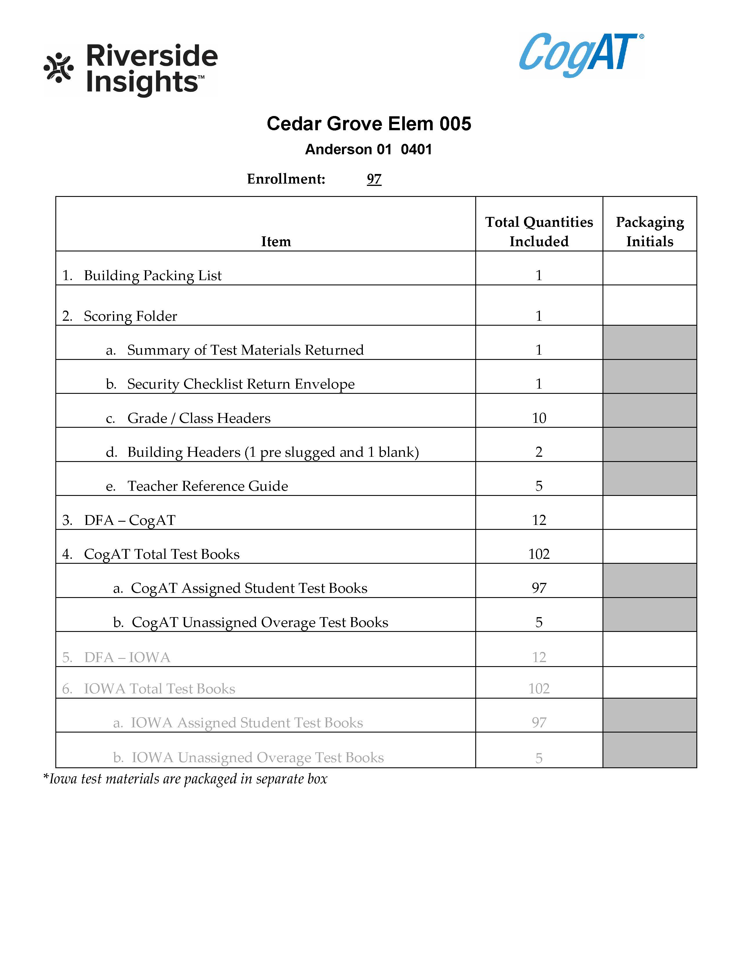
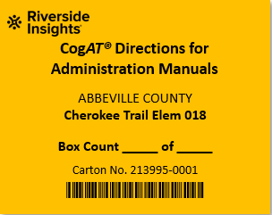
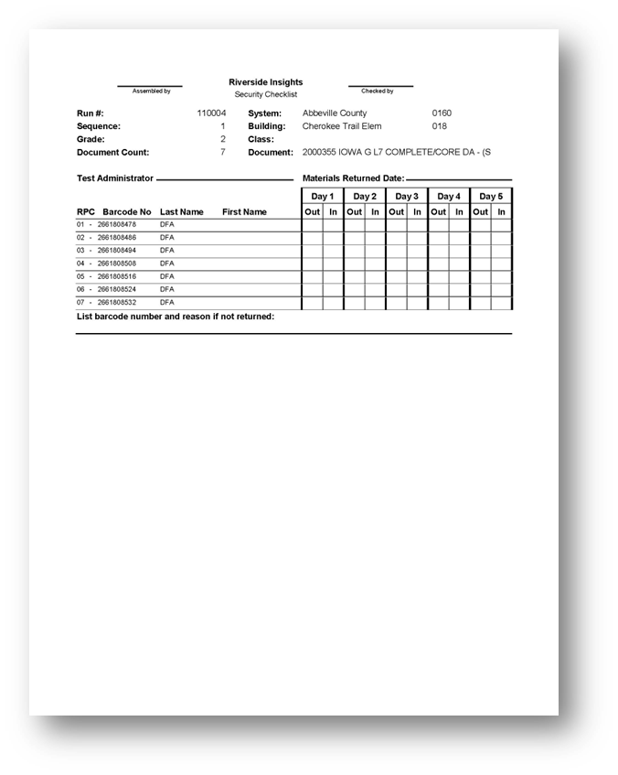
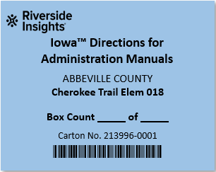
Packaging and Labeling- DFAs
Packaging CogAT DFA’s:
Shrink wrapped CogAT DFAs
Scoring Packet
Barcode Package Summaries
Building Packing list
Labeling:
Box 1 of the DFA shipment will include a yellow Box 1 Open First label
Apply the Orange corresponding label and indicate Box __ of __.
1
1
Packaging Iowa DFA’s:
Shrink wrapped Iowa DFAs
Barcode Package Summaries
Labeling:
Apply the blue corresponding label and indicate Box __ of __.
1
1

Slide 26
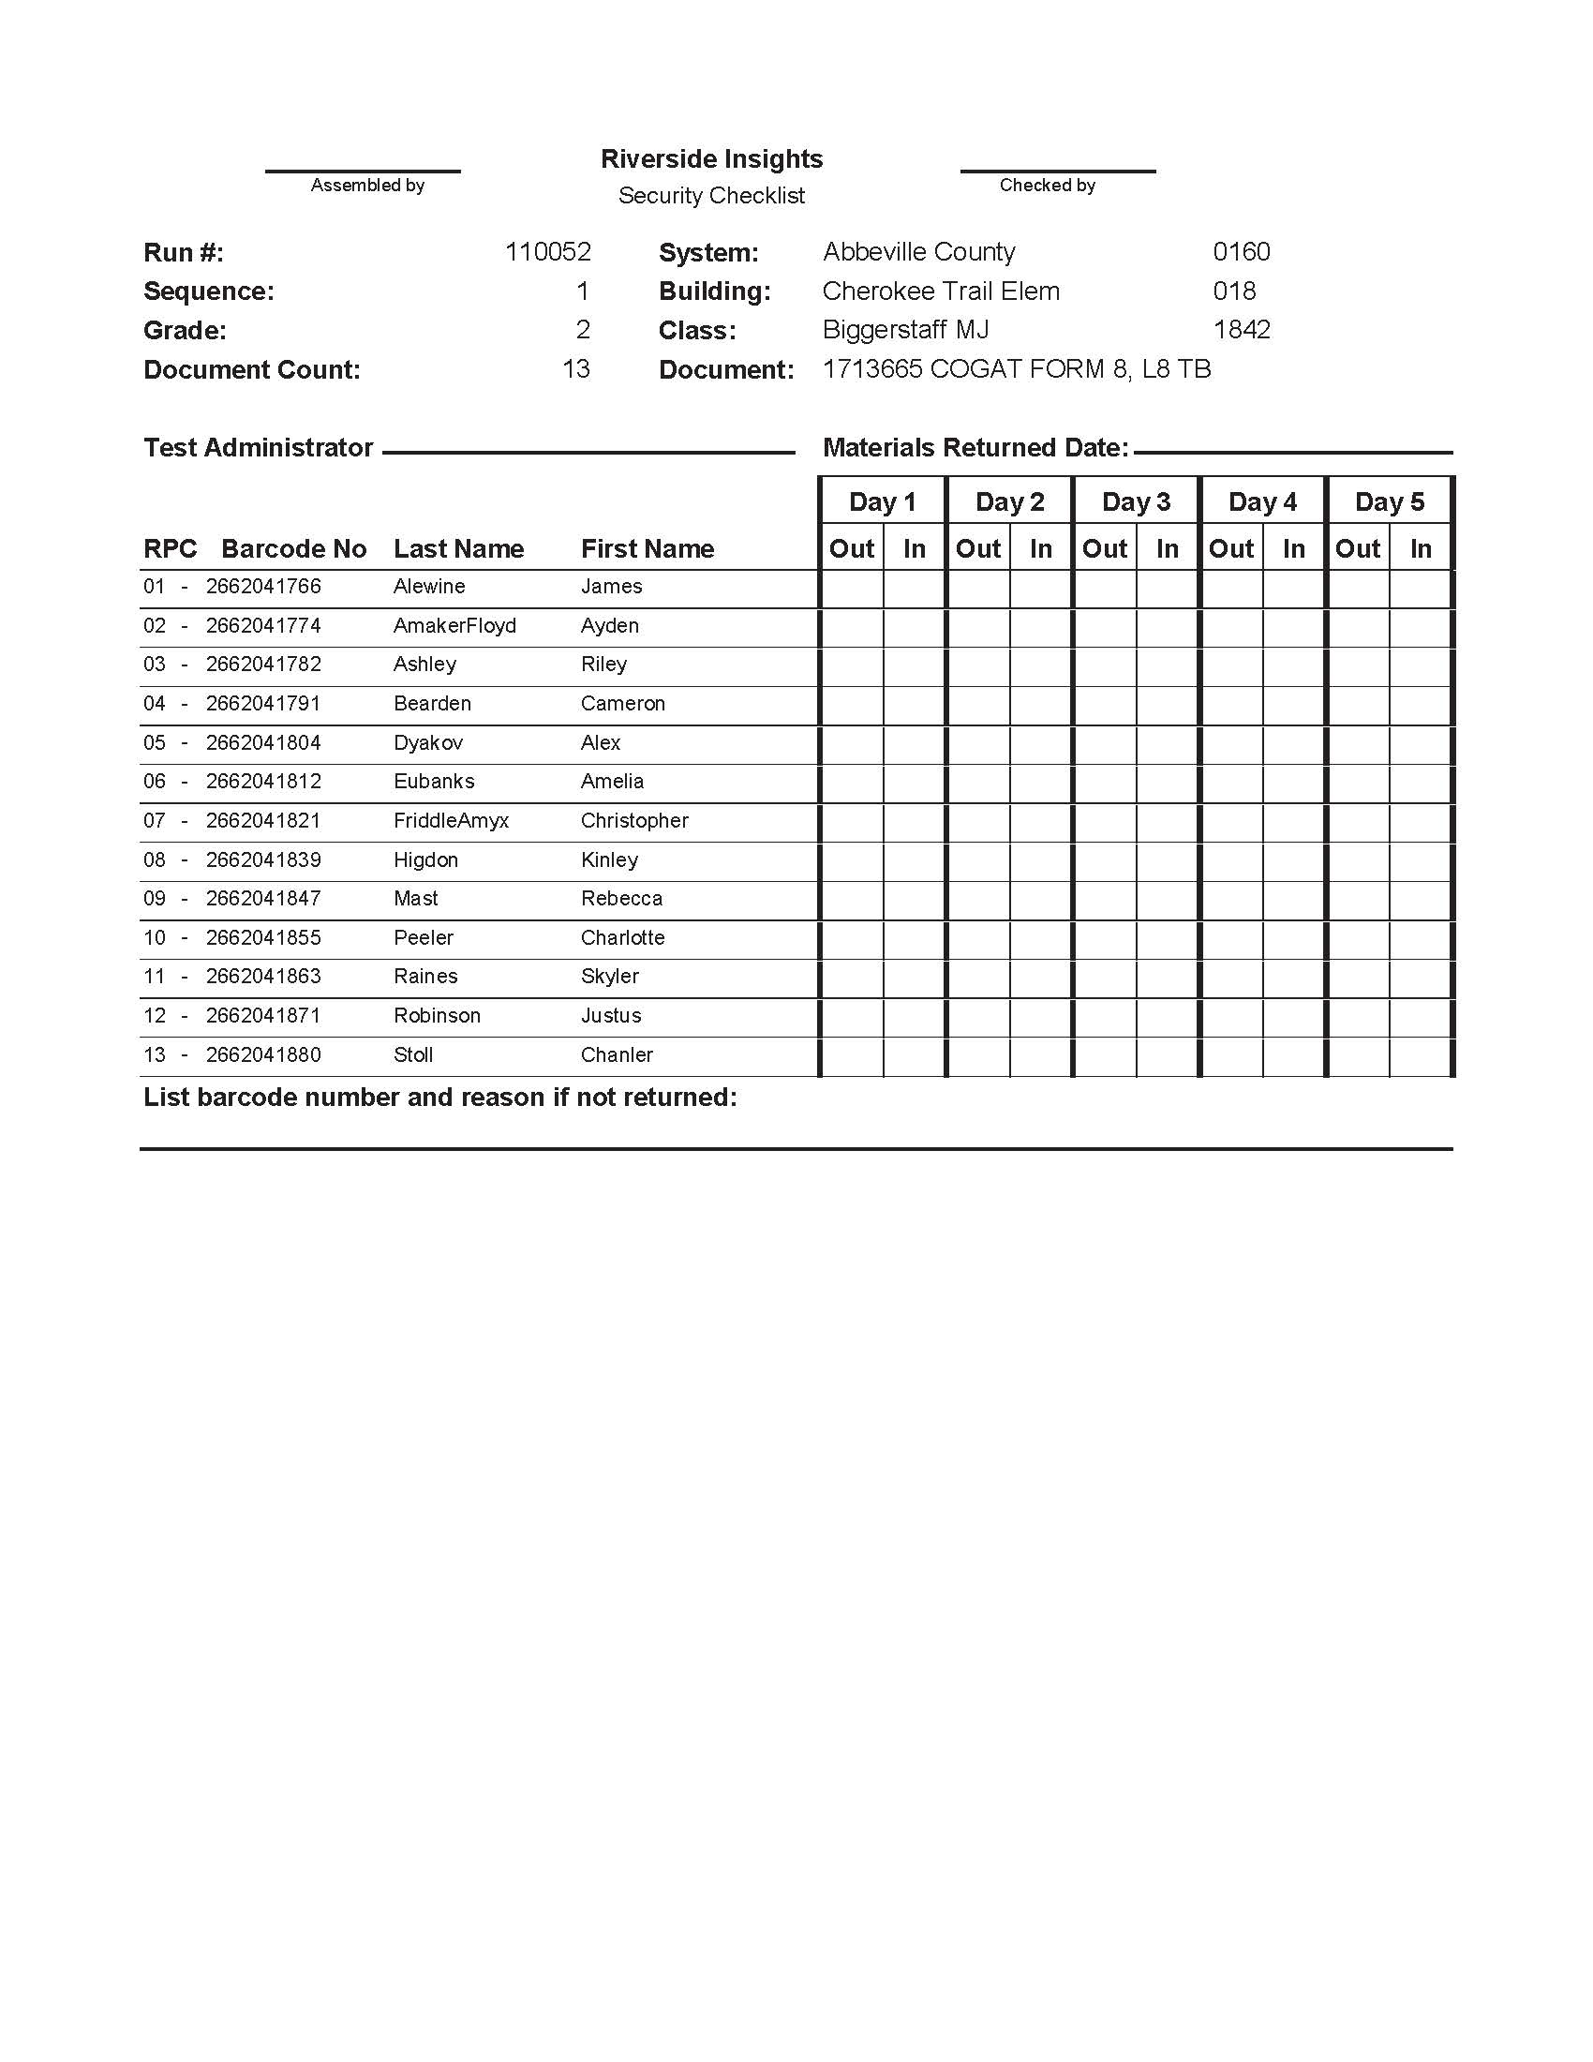
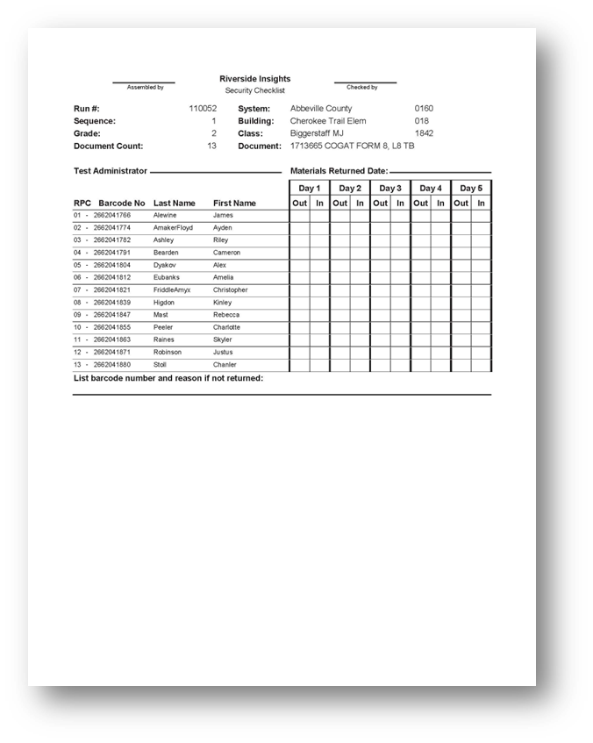
Packaging and Labeling- CogAT Test Books
Packaging CogAT Test Books:
Shrink wrapped CogAT Test Books
Barcode Package Summaries in box 1 of Test Book shipment.
Labeling:
Apply the Orange corresponding label and indicate Box __ of __.
1
3
2
3
3
3

Slide 27
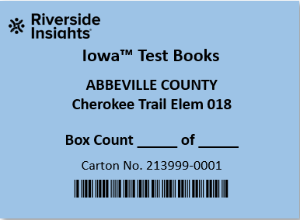
Packaging and Labeling- Iowa Test Books
Packaging Iowa Test Books:
Shrink wrapped Iowa Test Books
Barcode Package Summaries in box 1 of Test Book shipment.
Labeling:
Apply the Blue corresponding label and indicate Box __ of __.
1
3
2
3
3
3

Slide 28
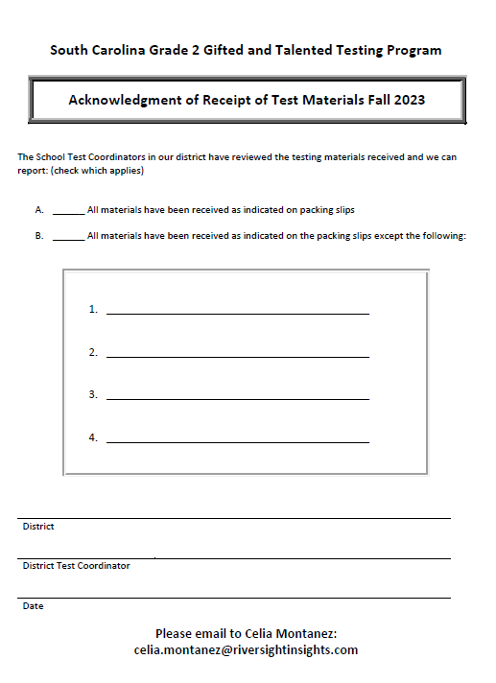
Receipt of Test Materials
Schools need to Inventory test materials upon arrival.
Use School Packing List (in box #1 of CogAT DFA shipment) to verify materials received.
Fill out Acknowledgment of Receipt of Test Materials form to indicate receipt of all materials.
E-mail a PDF copy of the completed form to Celia Montanez at celia.montanez@riversideinsights.com
Notes:
DTCs to collect Acknowledgement of Receipt of Test Materials from the schools and send to Celia.

Slide 29
DTC Checklist- Before Testing
DTCs must participate in the pretest workshops.
It is the responsibility of the DTC to ensure that adequate training is given to all persons who will be administering or monitoring the Gifted and Talented assessments.
DTCs must conduct training sessions for all STCs.
DTCs and/or STCs must hold training sessions for all Test Administrators (TAs) and monitors.
Notes:
(TAM page 34)

Slide 30
DTC Checklist- Before Testing cont’
Develop a test administration schedule for the district- see page 17 of the TAM for a sample testing schedule
Ensure that each school has enough Test Administration Manuals- Paper Administration (TAM)
If additional quantities are needed, use the Request for Additional Test Materials form included with the test materials.

Slide 31
STC Checklist- Before Testing
Conduct Training at your school for all Test Administrators and monitors
Inform teachers of the test schedule
Inventory test materials immediately upon receipt at the school site.
Ensure that arrangements have been made for any student who requires accommodations to respond to the test.

Slide 32
STC Checklist- Before Testing cont’
Communicate Teacher responsibilities
Make sure they have a test booklet for each student.
New Students- Complete the information blanks and name grids on the back of each student’s test booklet if the booklet is not pre-printed with the student’s information.
Have a copy of the DFA for the appropriate test.
Ensure that each student has a sharpened pencil with an eraser and scratch paper.

Slide 33
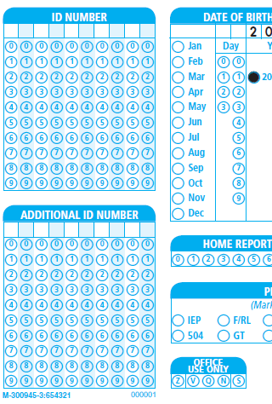
SUNS and Power School ID Numbers
Student Identification Number (State ID)
Enter the 10-digit State ID number assigned to each student in the 10-digit ID NUMBER field on the back of the student test booklet.
Student Power School Number
Enter the Power School Number in the 10-digit ADDITIONAL ID NUMBER field.
Left-justify the PS student ID numbers.
Write and bubble in IDs. The scanners only pick up the gridded fields.

Slide 34
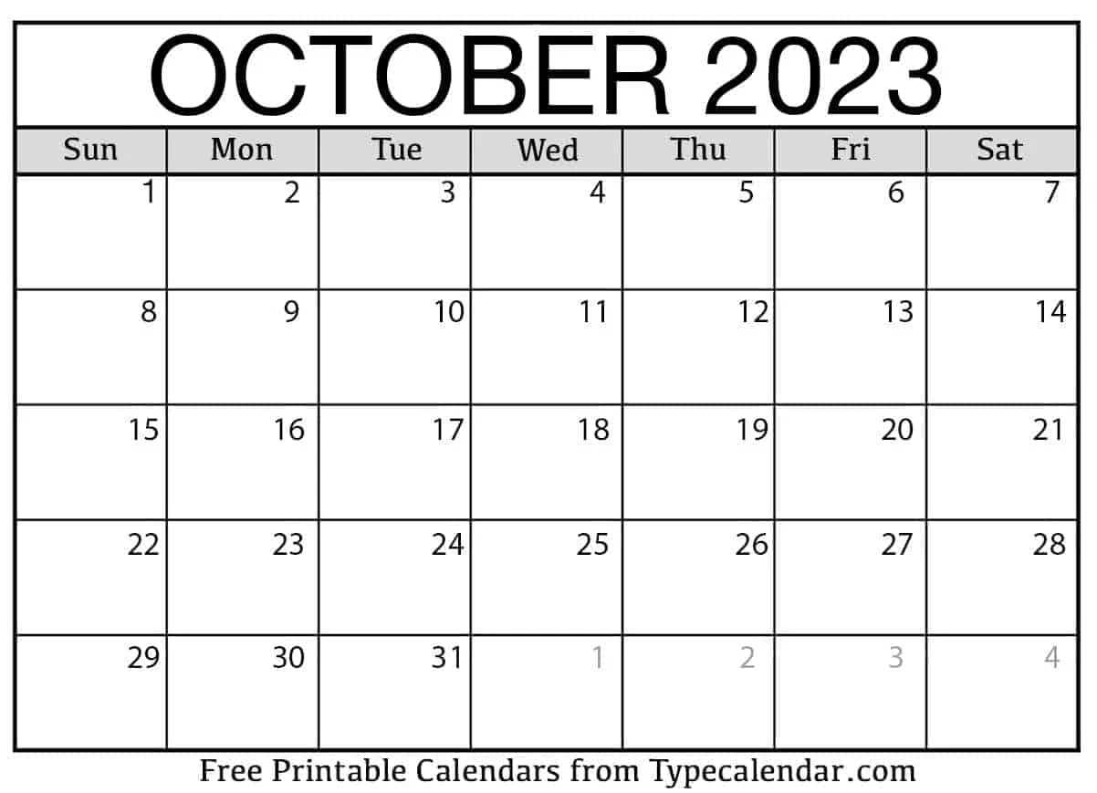
After the Test Administration

Slide 35
Return Material Procedures
Step 1: Collection of Test Materials
The School Test Coordinator should collect all test materials, including Directions for Administration, from the Test Administrators. Ensure that all materials are accounted for and organized before proceeding to the next steps.
Step 2: Prepare Scorable and Nonscorable Materials
Separate the test materials into two categories: scorable and nonscorable. Scorable materials are those that require scoring by Riverside Scoring Service, while nonscorable materials do not need scoring.
Stack A (Scorable Materials) | Stack B (Nonscorable Materials)
Building Identification Sheet Grade/Class Identification Sheets ALL Pre-ID barcoded CogAT and Iowa Assessments test booklets (except for z coded damaged test booklets). Overage CogAT and Iowa Assessments test booklets used by students for testing. | All unused Overage Test Booklets All Directions for Administration manuals (CogAT and Iowa Assessments) All Large Print Test Booklets- Prior to packaging for return, student responses must be transferred to the student’s precoded test booklet in a secure setting. If an overage book is used, ensure that the student’s demographic information has been completed. Security Checklists/Return Envelope

Slide 36
Return Material Procedures cont’
Step 3: Check the Scorable materials before packaging
Student Test Books | Class/Grade Identification Sheets
Ensure that a no. 2 pencil was used Gridding of all student information is complete and correct Miscellaneous materials are removed Stray marks have been erased All test booklets are assembled with the demographic page facing up | Use one Grade/Class Identification sheet per TA. Complete the indicated sections 1. INFORMATION BOX 2. CLASS NAME 3. CLASS CODE- Do not complete 4. GRADE 5. FORM 6. ANSWER DOCUMENT COUNT- Use leading zeros (i.e., for forty-four books grid and write 0044). 7. Scoring Service Only- Do not complete

Slide 37
Return Material Procedures cont’
Things to look for when packing your test materials
Please Remove: | Other checks:
scratch paper tape of any kind Post-itTM Sticky Notes staples pins paper clips | stray marks light marks for answers darken response marks so that they fill the circles. complete erasures where the student changed answers.
Notes:
Failure to do any of the above may result in a delay in getting your test scores back from Riverside Insights Scoring Center.

Slide 38
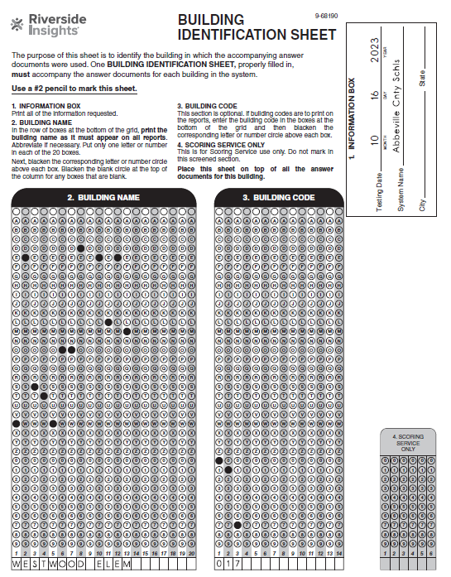
Building Identification Sheets
Districts received extra Building (School) Identification Sheets that are blank.
Schools receive two Building Identification Sheets - one that is pre-slugged and one that is blank.
Please do NOT PHOTOCOPY the School/Building Identification Sheet.
Do NOT complete Box #4 SCORING SERVICE ONLY section as this is done by Riverside Scoring Center.

Slide 39
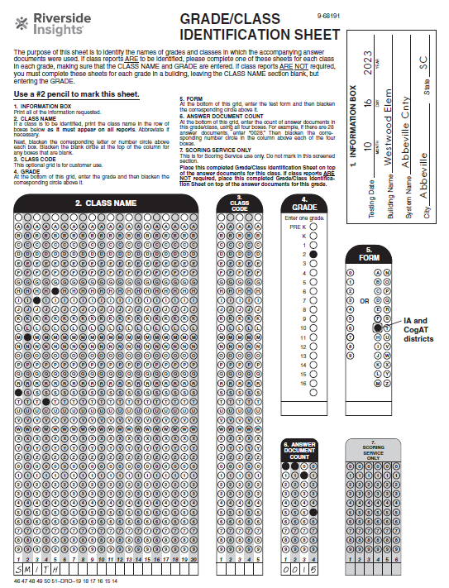
Grade Class Identification Sheets
Included in each Building Package are plenty of blank Grade/Class Identification Sheets.
Please do NOT PHOTOCOPY the GIS document. School Test Coordinators will have to contact the District Test Coordinators if more GIS documents are needed.
It’s important to include your document count.
Do NOT complete Box #4 SCORING SERVICE ONLY section as that is done by Riverside Scoring Center.

Slide 40
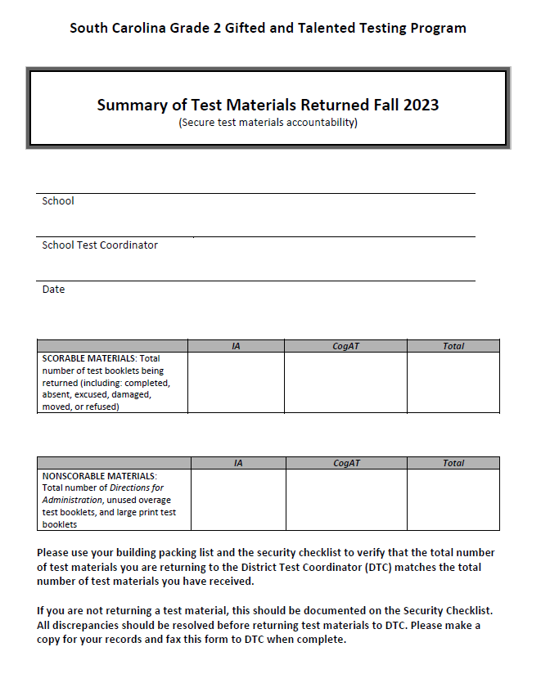
Summary of Test Materials Returned
Indicate the number of scorable materials (test booklets) returned.
Indicate the number of nonscorable test materials returned.
Fill in all 6 boxes shown in the diagram.
To be used by DTCs to complete the OSS.
60
60
120
14
14
28
Notes:
Please use your School Packing List and the Security Checklist to verify that the total number of test materials you are returning to the District Test Coordinator (DTC) matches the total number of test materials you received.
If you are not returning any of a particular test material, this should be documented on the Security Checklist. All discrepancies should be resolved before returning test materials to the DTC. Please make a copy for your records and return this form to the DTC when completed.

Slide 41
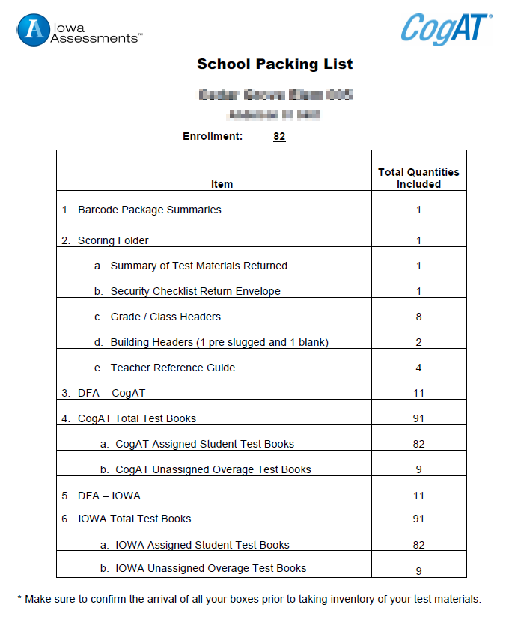
Summary of Test Materials Returned cont’
The School Packing List can be used as a reference when completing the Summary of Test Materials form.
These booklets belong in the Scorable materials boxes
If unused, these booklets belong in the Non-Scorable materials boxes
Notes:
Please use your School Packing List and the Security Checklist to verify that the total number of test materials you are returning to the District Test Coordinator (DTC) matches the total number of test materials you received.
If you are not returning any of a particular test material, this should be documented on the Security Checklist. All discrepancies should be resolved before returning test materials to the DTC. Please make a copy for your records and return this form to the DTC when completed.

Slide 42
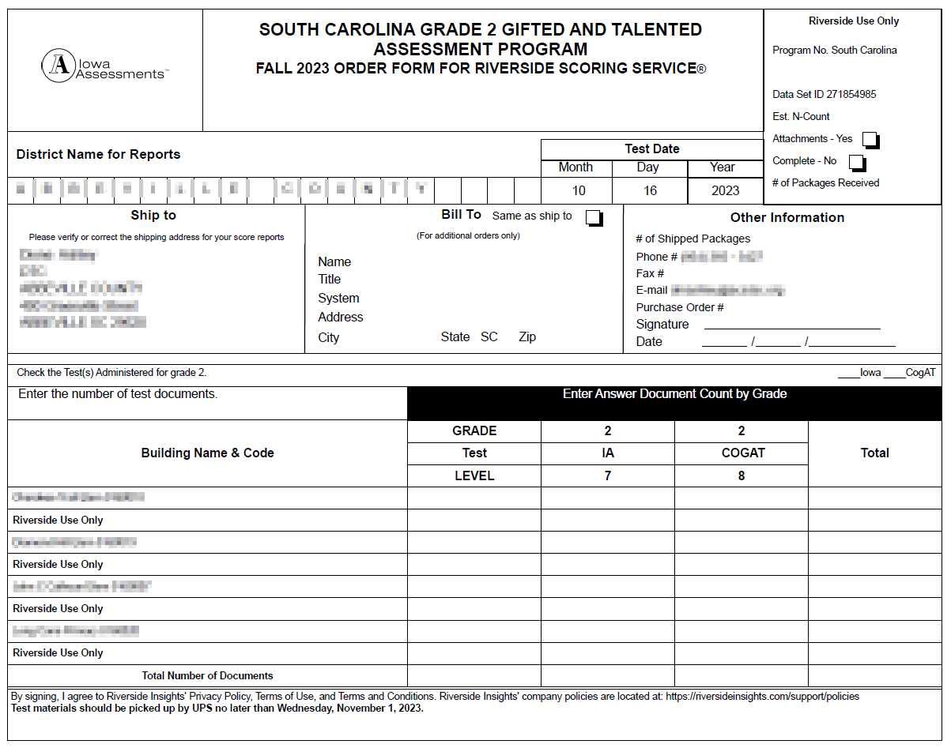
DTC – After the Paper Administration
Order for Riverside Scoring Service (OSS) must be filled out by the DTC.
The OSS must be returned in Box #1 of the scorable materials.
Use numbers from Summary of Test Materials Return Form, per school (Pg. 82, Appendix L), to complete the OSS.

Slide 43
Packing Instructions
District Test Coordinators:
Boxes should be packed by building.
Boxes should be numbered consecutively.
School Test Coordinators:
Follow diagram for packing test materials.
Pack CogAT test booklets in bottom of scorable box, and then pack IA on top for each class.
Place Grade/Class Sheets on top of each class.
Place purple Building (Schools) Identification Sheet on top of first scorable box.

Slide 44
DTC – After the Paper Administration
Scorable
Nonscorable
Order for Riverside Scoring Service (OSS)
Building (School) Identification Sheets
Grade/Class Identification Sheets
All Pre-ID barcoded Student Test Booklets
All used overage CogAT and Iowa Test Booklets
Directions for Administration (CogAT and Iowa)
Unused Overage Test Books
Large Print Test Books
School Security Checklists/Return Envelope
Scorable vs Nonscorable Materials

Slide 45
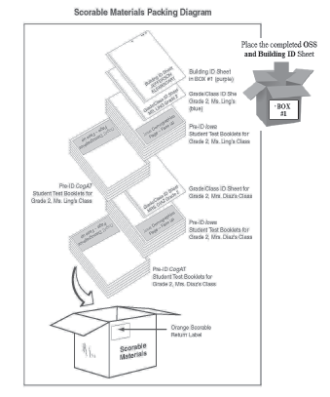
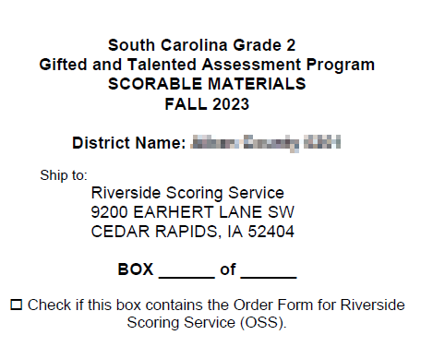
Packing Instructions (cont’)
Packing Scorable Materials at the schools should follow this diagram (TAM page 86)
Apply the orange scorable label on the boxes containing your scorable materials

Slide 46
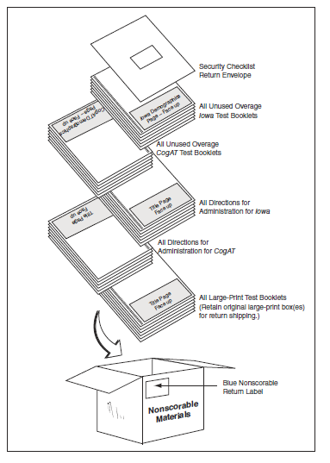
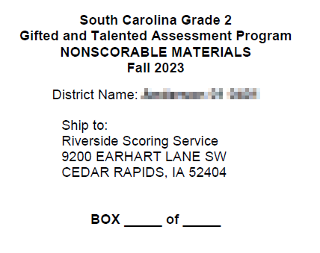
Packing Instructions (cont’)
Packing Nonscorable Materials at the schools should follow this diagram (TAM page 88)
Apply the blue non-scorable label on the boxes containing non-scorable materials

Slide 47
Returning of Test Materials

Slide 48
Using the UPS Labels
When shipping the test materials back to Riverside, be certain to cover the original shipping labels with black marker or paper.
DTCs should retain UPS tracking numbers by removing the sticker with the tracking number information from the bottom portion of the RS label and keep this number for your records.
Use the labels provided in sequential order.
*Please contact Celia to request additional UPS shipping labels.

Slide 49
Additional Information about UPS RS shipping labels
For your convenience, arrangements have been made to “Bill 3rd party” for this shipment. Therefore, you do not pay UPS.
Districts are responsible for scheduling a UPS pick-up for test materials. If requested, you may provide Riverside’s UPS Account Number RV7-896
If your district has regular UPS service, UPS can collect the boxes during your regular pick-up time. However, it is best to call your local UPS office to let them know the number of boxes to pick up.
Plan ahead and make sure you make arrangements for pick up on or before Wednesday, November 1, 2023 . When calling UPS, make sure to indicate that you are calling for a “Return Service” pickup, using a UPS RS labels. You will need the tracking number off of one box.

Slide 50
Don’t Forget - First In! First Out!
A “first in/first out” reporting approach will be used for scoring services.
If materials are shipped to Riverside Scoring Center by November 1 with no issues, reports will arrive in the district no later than December 4, 2023.
Districts returning test materials after November 1 or returning test materials with issues to be resolved will receive reports 15 business days after the test materials are ready to be processed.

Slide 51
Scoring and Reporting
DataManager Reporting is a dynamic online reporting tool that allows you to perform the following tasks:
Create customized reports using the options available for your account
View and edit reports online
Save, edit, and re-use report criteria
Print reports
Export reports to PDF, RTF, or Microsoft Excel® format
Notes:
DataManager Reporting is a dynamic online reporting tool that allows you to perform the following tasks:
Create customized reports using the options available for your account
View and edit reports online
Save, edit, and re-use report criteria
Print reports
Export reports to PDF, RTF, or Microsoft Excel® format
From DataManager, you can locally download and/or print the following reports and more.
List Report of Student Scores
Classroom Summaries
School Summaries
District Summary
Student data file
*The schools will also receive 2 copies of the Student Profile Narrative and the Student Score Labels- 1 for Iowa, 1 for CogAT
Step-by-step instructions on how to generate the reports above is be posted on the SC Microsite as well as a live demo during the Posttest Workshop.

Slide 52
Scoring and Reporting
In addition, the schools will receive the following reports in paper form
Two (2) copies of the Student Profile Narrative
Student Score Labels- 1 for Iowa, 1 for CogAT
*Packing List and box labeling for ease of unpacking your reports and distributing to the schools.
Notes:
DataManager Reporting is a dynamic online reporting tool that allows you to perform the following tasks:
Create customized reports using the options available for your account
View and edit reports online
Save, edit, and re-use report criteria
Print reports
Export reports to PDF, RTF, or Microsoft Excel® format
From DataManager, you can locally download and/or print the following reports and more.
List Report of Student Scores
Classroom Summaries
School Summaries
District Summary
Student data file
*The schools will also receive 2 copies of the Student Profile Narrative and the Student Score Labels- 1 for Iowa, 1 for CogAT
Step-by-step instructions on how to generate the reports above is be posted on the SC Microsite as well as a live demo during the Posttest Workshop.

Slide 53
Packing List & Box Labeling
South Carolina Grade 2 Gifted and Talented Assessment Program
Score Paper Reports
Box _____of_____
1
1
Green folders- Score Labels
White folders- Profile Narrative

Slide 54
SC Grade 2 Make-Up Testing

Slide 55
Reasons for Make-up Testing include:
Student is new to the district and wasn’t tested prior to moving.
Teacher did not administer all required parts of the test.
Student was ill during the main testing window.

Slide 56
Make-Up Testing Schedule
Districts need to match their scores and reconcile any discrepancies with Riverside | No later than December 8, 2023
If your district needs to do make-ups, all orders need to be placed with Riverside (if needed) | December 5-29, 2023
Make-Up Administration Window | January 4-12, 2024
Return test materials to Riverside | No later than January 17, 2024
Score reports delivered, if there are no alerts | February 5
Districts will not be allowed to administer make-ups to students outside of this schedule. Please make sure to look at your results immediately upon receipt.

Slide 57
SC Assessment Consultants
Sierra Scott
Ability Assessment Consultant sierra.scott@riversideinsights.com Phone: 407-362-8204
Paul King
Achievement Assessment Consultant paul.king@riversideinsights.com Phone: 224-371-8540
Contact your Assessment Consultants with any questions about pricing, Quotes, and to submit orders for off-grade-level materials.

Slide 58
Ordering Off-Grade-Level Materials
Contact Sierra Scott with any questions about pricing, Quotes, and to submit orders for off-grade-level materials.
Do NOT ship off-grade-level test materials with the on-grade-level test materials for this program.
Do NOT use the orange scorable and blue nonscorable return labels when shipping off-grade-level test materials.

Slide 59
SCDoE Grade 2 Gifted and Talented Assessment Website
Follow the following link to access the website: https://info.riversideinsights.com/scdoe
You can find digital resources to support the Fall 2023 Testing Administration:
Required tests
Test Administration Manuals
Pretest Workshop PowerPoint presentation
Test security affidavit for DTC’s and STC’s
Test security affidavit for TA’s
Test Security Violation Forms
Links to DataManager Proctor training

