Slide 1
Gifted and Talented Assessment Program for Grade 2 Students
Fall 2023 Pretest Workshop-
Online Administration

Slide 2
Who to Contact
Riverside Insights South
Carolina Team
South Carolina Department of Education Staff
Celia Montanez
Sr. Program Manager celia.montanez@riversideinsights.com Phone: 630-760-4419
Sierra Scott
Ability Assessment Consultant sierra.scott@riversideinsights.com Phone: 407-362-8204
Paul King
Achievement Assessment Consultant paul.king@riversideinsights.com Phone: 224-371-8540
David Trombly
Office of Assessment and Standards, SCDE
dctrombly@ed.sc.gov
Phone: 803-734-8274
Dr. Susan Creighton
Office of Assessment and Standards, SCDE
screight@ed.sc.gov
Phone: 803-734-8535

Slide 3
Schedule of Important Dates- 2023-2024
Milestone, Task, or Deliverable | Date
Pretest Workshops via Webinar Online Administration Paper Administration | Tuesday, September 12, 2023 Wednesday, September 13, 2023
DataManager Proctor Training | Monday, Sept 25 at 9 AM Wednesday, Sept 27 at 2 PM Friday, Sept 28 at 2 PM
Gr 2 GT Testing 2022-23 Roster | September 22
Online Test Events Open | September 25
Test administration window | October 9 – 27
Online Test Events Close | October 27
Post test Webinar for District Test Coordinators | November 8
Reports arrive in districts if returned by November 1, 2023 | December 4
Make-up testing window | January 4-12, 2024
Districts receive their make-up test results | February 5
Notes:
(TAM page iii)

Slide 4
SC Gr 2 Gifted & Talented Assessment Program
The Gifted and Talented Grade 2 Assessment is a statewide assessment used to identify students for district gifted and talented programs. Students are identified for this program by demonstrating high performance ability or potential in academic and/or artistic areas.
Notes:
State Board of Education regulation 43-220 requires the administration of assessments measuring cognitive, academic, and/or artistic abilities to identify students for district gifted and talented programs. The South Carolina Department of Education (SCDE) provides an aptitude and an achievement assessment for this purpose.
South Carolina law requires districts to screen all students at the elementary and secondary levels for district Gifted and Talented services.
Districts are required to provide services for all gifted and talented students.
Although the primary purpose of these assessments is to identify students for the Gifted and Talented programs, student results can be useful to teachers as they examine their instructional practices and can help them identify teaching strategies for all students.

Slide 5
Criteria for Gifted & Talented Selection
Students may be eligible for placement into the district Gifted and Talented program based on their aptitude score alone.
A composite score on the CogAT® at or above the 96th national age percentile.
Qualifying aptitude scores are good for five years.

Slide 6
Criteria for Gifted & Talented Selection
Students are also identified for services by demonstrating high performance in two of the following dimensions:
Dimension A (Reasoning Abilities)- Aptitude (93rd national age percentile) in one or more of the following areas:
verbal/linguistic
quantitative/mathematical
nonverbal
and/or a composite of the three
Dimension B (High Achievement in Reading and/or Mathematics)- achievement (94th percentile and above)
Dimension C (Intellectual/Academics)- score of 16 on either the verbal or nonverbal component of the Performance Task Assessments
Notes:
For placement into the Gifted and Talented grade 2 program, students must meet the criteria for two out of the three dimensions outlined in the regulation.
Dimension A (Reasoning Abilities) requires students to demonstrate high aptitude (93rd national age percentile) in one or more of these areas: verbal/linguistic, quantitative/mathematical, nonverbal, and/or a composite of the three. Scores on CogAT may be used for this purpose. Students who meet the 96th or higher national age percentile composite score on CogAT are automatically eligible for placement into a district gifted and talented program.
Dimension B (High Achievement in Reading and/or Mathematical Areas) of the regulation requires that students demonstrate high achievement in reading and/or mathematical areas (94th national percentile and above) as measured by a nationally normed or statewide assessment.
Dimension C (Intellectual/Academic Performance) requires students to demonstrate a high degree of interest in and commitment to academic and/or intellectual pursuits or demonstrate intellectual characteristics such as curiosity/inquiry, reflection, persistence/tenacity in the face of challenge, and creative productive thinking. One of the methods by which these characteristics may be demonstrated is with a score of sixteen on either the verbal or nonverbal component of the Performance Task Assessments for grade 3 placement.
If a student meets the criteria for Dimensions A and B, the student qualifies for Gifted & Talented services without taking the Performance Tasks Assessment.
Students who meet the eligibility requirements of either Dimension A (aptitude) or Dimension B (achievement), but not both dimensions, must take the Performance Task Assessments (Dimension C).

Slide 7
Who to Test
SCDE provides these assessments for all grade 2 students.
Students with an IEP or 504 Accommodations Plan must participate in the grade 2 assessment.
ML students must be given the opportunity to participate in the CogAT and Iowa Assessments.

Slide 8
Administration of CogAT and IA
CogAT and Iowa Assessments are group-administered by classroom teachers.
It is best for tests to be administered by someone who is familiar to the students.
Teachers must be trained before administering the CogAT and Iowa assessments.
Tests are not timed.
The pace at which test questions are presented should be adjusted to suit the characteristics of the students being tested.

Slide 9
Administration of CogAT and IA
There are two modes of online administration, proctor led and audio.
Proctor led the tests are read aloud by classroom teachers, word for word. Teachers should speak distinctly, at a constant rate, with inflection in their voice.
With audio led proctoring students use headphones during testing.
Teachers cannot view the test before testing; however, audio test directions are available in the TAM (pages 81-83).
Each test begins with a practice item to give students some experience.
Notes:
Subtest directions- TAM pages 81-83
Practice items- the students are prompted to try again if they answer incorrectly. This is only for the practice items, not the actual test.

Slide 10
Administration of CogAT and IA
Monitor Students – It is important to monitor the students to make certain each one understands the subtest instructions, is working on the correct question, and is marking their selections in the online test properly.
Review practice questions with students – Always try to ensure that students understand what they are supposed to do before starting the subtest.
Pace the test to fit the students – Tests are designed to measure how well, rather than how rapidly students can solve reasoning problems. Adjust the pace of the testing to fit the skill level of the students.

Slide 11
Cognitive Ability Test (CogAT®)
All of the following CogAT tests must be administered:
Required Sections of Each Test | Number of Items | Estimated Time (minutes)
Verbal Battery Picture Analogies Sentence Competition Picture Classification | 18 18 18 | 13 14 13
Quantitative Battery Number Analogies Number Puzzles Number Series | 18 14 18 | 15 15 15
Nonverbal Battery Figure Matrices Paper Folding Figure Classification | 18 16 18 | 13 11 13
All nine tests are combined to obtain a Composite Aptitude score.

Slide 12
Iowa Assessments
All the following subtests in the IA level 7 tests must be administered:
IA Form G, Level 7 Core Battery | Number of Items | Estimated Time (minutes)
Reading: Part 1* | 17 | 20
Reading: Part 2* | 18 | 25
Reading Totals | 35 | 45
Mathematics: Part 1** | 26 | 25
Mathematics: Part 2** | 15 | 25
Mathematics Totals | 41 | 50
*All two reading tests need to be completed to receive a Reading score.
**Mathematics (Parts 1 and 2) need to be completed to receive a Total Math score
Notes:
Online Reading
Part 1 includes Picture Stories and Sentences
Part 2 includes Stories

Slide 13
Testing Students with Documented Disabilities and ML Students
Testing Students with IEP/504 Plans
Definition of a Student with Disabilities
Student Participation
IEP and 504 Plans
IEP and 504 Accommodation Plan Requirements
South Carolina-Allowed Accommodations
Notes:
A student with a documented disability is either a student who has been evaluated and found to meet the eligibility criteria for enrollment in special education as defined by the Individuals with Disabilities Education Act (IDEA 97) and South Carolina State Board of Education Regulation 43-243.1 or a student who has a disability covered under Section 504 of the Rehabilitation Act of 1973.
Students with a current Individualized Education Program (IEP) or 504 Accommodations Plan must participate in screening for identification for the academic gifted and talented program. Students should participate in CogAT and Iowa Assessments testing, as appropriate, or in an alternative screening process that includes a documented review of existing data from a norm-referenced aptitude and norm-referenced mathematics and reading comprehension assessment.
The student’s IEP team determines whether the student will participate in the assessment in the same manner as other students, or with accommodations. Students cannot be excluded from screening because of a disability.
SC Allowed Accommodations- Some accommodations listed in the Directions for Administration (DFA) for both CogAT and Iowa Assessments are not approved for use in South Carolina. Make sure that Test Administrators (TAs) are aware that the accommodations listed in the TAM pages 8-14 are the only approved accommodations for the South Carolina Grade 2 Gifted and Talented Assessment program.

Slide 14
State-Allowed Accommodations
Setting – individual or small group
Timing – frequent and extended breaks
Scheduling - multiple sessions or days
Presentation –read aloud to self, repeating or signing the directions, repeated directions, signed administration
Response – nonverbal indication of answer choices or dictation of responses
Bilingual Dictionary – word-to-word dictionary only with no pictures, definitions, etc.
Translate Directions – only general test directions may be translated
Notes:
Setting-
The small-group size should be consistent with the group size used for routine classroom assessments.
Preferential seating
Separate location
Timing- Frequent and Extended Breaks – This accommodation is used if additional time is needed beyond the break structure of the assessment. These breaks may occur:
In the classroom/separate location, with no contact between students; or
Outside of the classroom/separate location, with contact between students monitored to ensure there is no discussion of the assessment.
Scheduling- Multiple Test Sessions/Days – The student may take portions of CogAT or the Iowa Assessments over several days, as long as all testing is completed by the last day of the testing window. Students must begin testing on the regularly scheduled testing date and may not go back to previously completed sections of the test.
Presentation- Highlighting and Cueing are not available with online testing
Read Aloud to Self – All items on CogAT are pictorial. For the Iowa Assessments, the student may read the test questions aloud to himself or herself. This accommodation requires an individual administration.
Repeated Directions- Only test directions may be read aloud as many times as necessary to inform students of the proper procedures to follow in responding. This accommodation applies only to the general test directions prior to the first test item for each subtest. Additionally, any student may have the general directions repeated or clarified to ensure the student understands the proper procedures to follow in responding.
Notice that there are differences between the test administration directions for the CogAT and Iowa Assessments tests. These administration directions apply to all students. CogAT- you may repeat the directions as many times necessary. Iowa- Read the directions for each question only once. Do not repeat the directions. This applies to the entire test, even for students with “repeated directions” in their IEP, because repeating the directions changes the construct of the test.
Signing the Directions – The student may need to repeat/sign the directions to the Test Administrator for clarification or to demonstrate his or her understanding.
Signed Administration (Communication Assistance) – The online system does not have the capability of signing the test, so a Test Administrator or Interpreter may sign the entire administration to a student. The TA/Interpreter must sign exactly as written in the Proctor screen and may not interpret test item content beyond what is allowed by the subject. Care must be taken not to use signs that might convey answers to any test questions.
Bilingual Dictionary- Students may use a word-to-word bilingual dictionary. However, the dictionary must not include any examples, pictures, or definitions..
Translate Directions- The general test directions may be translated into the student’s native language. This translation cannot go beyond the scope and meaning of the directions. Test questions/individual test question directions may not be translated. Practice items also may not be translated as they are embedded in the test.
In DataManager, the directions and item prompts may be administered in the student’s native language using audio proctoring. Seven additional languages are available including Spanish, Arabic, Chinese-Mandarin, Chinese-Cantonese, Russian, Somali, and Vietnamese. If your student’s native language is not available, then the general test directions may be translated into the student’s native language. This translation cannot go beyond the scope and meaning of the directions. Test questions/individual test question directions may not be translated. Practice items also may not be translated as they are embedded in the test

Slide 15
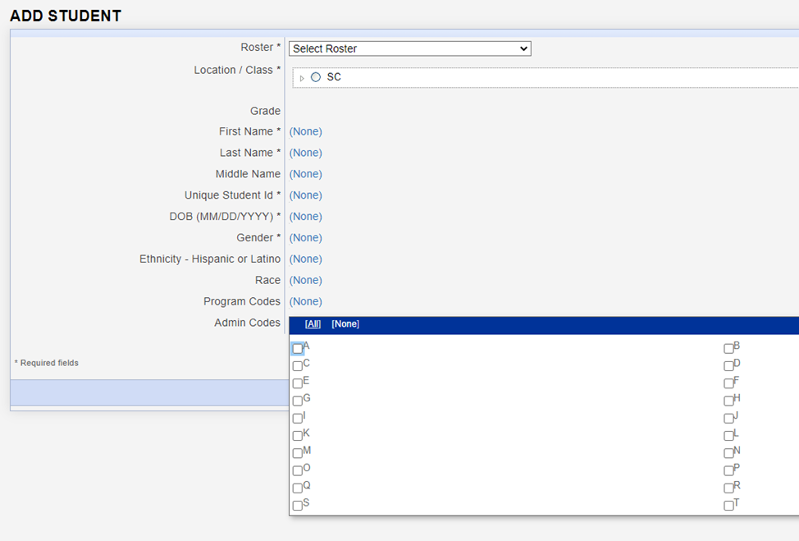
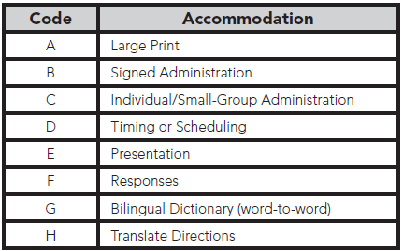
Coding Accommodations for Students with Documented Disabilities and ML Students
Notes:
The types of accommodations provided to students must be recorded in the student record in DataManager.
Even though more accommodations are allowed for testing, the codes listed on the following page are the only accommodations that must be recorded. This information will be included in the student data file that is provided to the district and school, but it will not appear on any of the reports.

Slide 16
Large Print Materials
Braille test booklets are NOT available for CogAT or the Iowa Assessment at the second-grade level.
Large-print test books are available for both the Iowa Assessments and CogAT. Students may mark directly in the large print booklet with a pencil, pen, or crayon. Later, the test administrator can transfer the responses to the online test in a secure setting.
To order the Large Print books, please contact the Riverside Project Manager- Celia Montanez.
Please order these materials no later than Friday, October 20, 2023.
Notes:
Why isn’t CogAT offered in Braille? The visual nature of the majority of CogAT items makes them impossible to convert into Braille.
Students may mark directly in the large print booklet with a pencil, pen, or crayon. Later, the test administrator can transfer the responses to the online test in a secure setting.
An alternative method of testing large-print online using the zoom feature in the standard web browser is also available.
If a student’s visual impairment is such that the large print booklet won’t suffice, you may work with a clinician or school psychologist in your district to test the student with the appropriate individually administered assessment like the Woodcock-Johnson IV. Both the regular WJ IV kits from Riverside, as well as the Braille kit from American Printing House for the Blind (APH) must be ordered.

Slide 17
What is CogAT Alt-V Scoring for Grades K-2?
Why?
To better identify ML students in grades K-2.
To provide a composite score and Ability Profile that can be used for instructional grouping.
How?
Teachers will administer only the Picture Analogies and Picture Classification subtests of the Verbal battery. The Sentence Completion subtest will be skipped. Students will complete the full Quantitative and Nonverbal batteries.
Students will receive a composite score and an ability profile that can be used for instructional grouping.
Notes:
Alt-V scoring involves the elimination of the Sentence Completion subtest from the Verbal battery.
SCDE states only ML students are eligible for Alt-V scoring where they have the option to omit the Sentence Completion subtest.
Consideration for Alt-V Scoring should be determined for each individual ML student. ML students receiving an ACCESS for ELL’s composite score between 1.0-4.9 may be coded for Alt-V Scoring (TAM page 14).

Slide 18
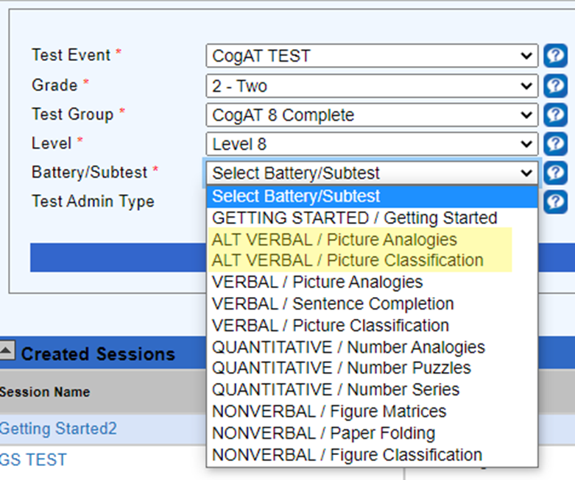
Administering the Alt-V Online
Alt-V Required subtests:
Picture Analogies (ALT V)
Picture Classification (ALT V)
Number Analogies (Q)
Number Puzzles (Q)
Number Series (Q)
Figure Matrices (NV)
Paper Folding (NV)
Figure Classification (NV)

Slide 19
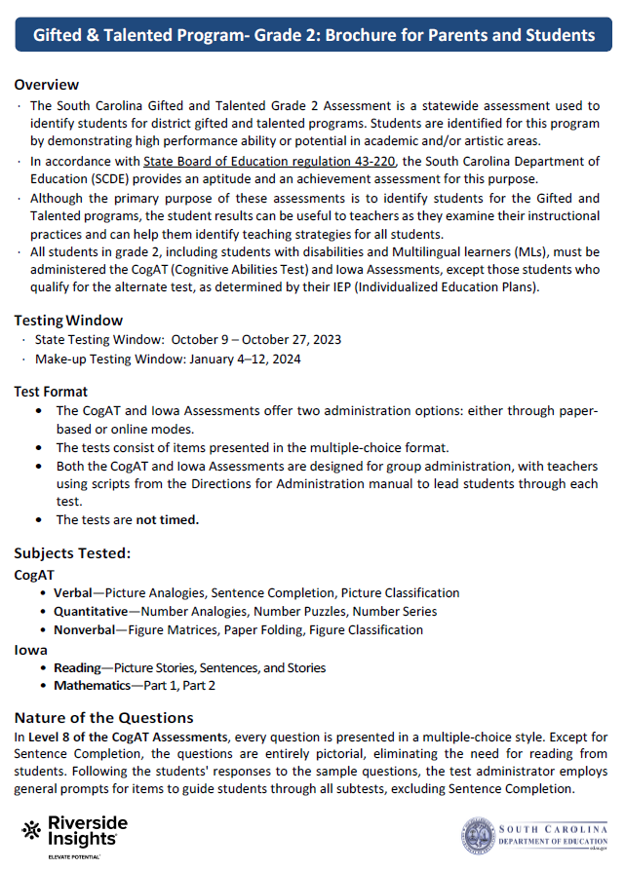
New this year!
Gifted & Talented Program- Grade 2: Brochure for Parents and Students.
Test Administration Manuals and Test Materials (paper administration) shipping directly to the schools.
Online Testing Export- end of second week of testing.

Slide 20
Riverside Preparations for Online Testing- BTS 2023
Load testing and system enhancement
Customer support training and preparations to support testing
Creating an Online Testing Export.
Notes:
Preparations to support the increase in online testing-
System upgrades and load testing
Increase in tech support coverage (including the chat option)
As the popularity of online testing increases, the Riverside Engineering and Tech Operations teams diligently prepare for very busy testing seasons. We work closely with our supporting technology vendors and partners to be ready for a significantly higher testing volume than the traffic forecasted, and routinely conduct thorough systems analysis and load testing to ensure that server capacity and performance far exceed anticipated usage.
Support team-
Designated support agent to prioritize SC support tickets, calls, escalate tickets as needed
Monitor test progress
We’ll have regularly scheduled internal meetings

Slide 21
Preparing Students for Testing
Informing parents
Testing environment
Test administration
Notes:
Communication between school and home before testing begins can help make testing run smoothly and make it possible for students to do their best.
Inform parents regarding the purpose of the testing and how the results will be used. Inform parents that there is no opt-out provision. All grade 2 students must be given the opportunity to test. *New this year- We have provided a new brochure with your Test Administration Manuals that provides information about the test that can be sent home to inform parents.
Parent permission to take these tests is not required.
All parents should be told in advance the dates and times each test and/or subtest will be administered in their school. Send them the testing schedule.
A test schedule should be posted on the school website.
Testing Environment- Students should be tested in classrooms with good lighting and well- ventilated, have adequate spacing between students to increase test security, classrooms should be quiet and free from distractions, and anything content related (reading and math) to grade 2 standards should be covered and removed.
Test administration-
Decide how the test will be administered and by whom.
Monitor students to make sure that each one understands the test instructions.
Pace the test to fit the students- for classes in which some of the students are likely to take much longer than others, it may be best to administer the tests in two separate groups.
Student Illness- If a student becomes ill during testing or displays other severe distress symptoms, the following guidelines should be implemented, as needed.
The sick student should be excused from the classroom. The determination to remove a student depends on the severity and the timing of the sickness.
If possible, send a monitor to accompany the student to the restroom, nurse’s office, or other sick room.

Slide 22
Suggested Testing Schedule
Day | Test | Estimated Time (minutes)
Day 1 | Verbal Picture Analogies Sentence Completion Picture Classification | 13 14 13
Day 2 | Quantitative Number Analogies Number Puzzles Number Series | 15 15 15
Day 3 | Nonverbal Figure Matrices Paper Folding Figure Classification | 13 11 13
Day 4 | Iowa Reading: Part 1 Reading: Part 2 | 20 25
Day 5 | Iowa Mathematics: Part 1 Mathematics: Part 2 | 25 25

Slide 23
Online Testing Roadmap
Tech Readiness
DataManager Training
Test Preparations
Materials Needed for testing
Check system and network requirements
Install the Kiosk Mode Browser (Riverside App) on all student devices.
Ensure student devices are ready for testing,.
STCs and TAs to attend the DataManager training.
Live Training Sessions:
Monday 9/25 at 9 AM EST
Wednesday 9/27 at 2 PM EST
Thursday 9/28 at 2 PM EST
STCs to confirm student are rostered correctly.
Ensure that all STCs, and TAs have access to the DataManager Platform.
Decide who will create test sessions
Student devices
Scratch Paper
Pencils
Student login Information: Student ID and session code
Ready to test

Slide 24
Pretesting Activities for Online Testing
Review System/Network Requirements
System/Network Requirements and DataManager Domain and Port Listing. *New- Windows 11 is now supported.
Considerations:
If schools are testing with wireless devices, do you have access points (APs) in each room or another setup.
If possible, postpone scheduled network scans and updates to devices during testing window.
How many students are testing simultaneously? If their testing schedules allow plan on staggered start times.
While TAs are performing live proctoring it is nevertheless still important to minimize local network processes and programs that compete for bandwidth.

Slide 25
Pretesting Activities for Online Testing
Prepare student devices for testing
Ensure the Riverside App is installed on all devices.
Verify that student devices are completely charged.
Confirm the functionality of the volume.
Provide headphones for audio proctoring.
Have additional devices on standby.
Close any active applications, including extra browser windows or tabs, on the devices, including Proctor devices.

Slide 26
Pretesting Activities for Online Testing
Rostering
Student Roster
The SCDE will be submitting a student roster to be used by ALL districts for the grade 2 administration of CogAT and the Iowa Assessments during the main and make-up test windows. Roster will be available in DataManager by September 22, 2023.
Roster name- SCDE Gr 2 GT Testing- 2023-24
School Test Coordinators can download the roster to confirm that all students in their schools are included.
Please Do not rename the roster
Districts do not need to submit or create separate rosters for the grade 2 GT testing

Slide 27
Pretesting Activities for Online Testing
Rostering
Staff file
DTCs need to ensure that anyone administering the CogAT and Iowa Assessments online have access to DataManager.
Step 1- Export a list of staff users using the Manage Staff functionality in DataManager
Step 2- Update the users as necessary and add new staff if needed.
Step 3- Submit the file to Celia Montanez for upload
*Manual entry of new staff or edits to existing staff is also available

Slide 28
Pretesting Activities for Online Testing
Test Events
The SCDE will create the Test events that will be used by all districts for the grade 2 administration of CogAT and Iowa Assessment during the main and make-up test windows.
The scheduled opening date for Test Events is September 25, 2023
Important reminders:
Districts are not required to create separate Test Events for grade 2 GT testing.
Please refrain from closing the Test Events that have been set up for grade 2 GT testing.
Avoid reopening a Test Event once it has been closed.
After the Test Events have been closed, no additional testing will be permitted.

Slide 29
DTC Checklist- Before Testing
DTCs must participate in the pretest workshops.
It is the responsibility of the DTC to ensure that adequate training is given to all persons who will be administering or monitoring the Gifted and Talented assessments.
DTCs must conduct training sessions for all STCs.
DTCs and/or STCs must hold training sessions for all Test Administrators (TAs) and monitors.

Slide 30
DTC Checklist- Before Testing cont’
Develop a test administration schedule for the district- see page 19 of the TAM for a sample testing schedule
Ensure that each school has sufficient Test Administration Manuals (TAM).
If paper materials are needed to support accommodations, use the Request for Additional Test Materials form posted on the SC microsite and email your request to me.

Slide 31
STC Checklist- Before Testing
Review the Test Administration Manual
Ensure that adequate training is given to all persons who will be administering or monitoring the CogAT and Iowa Assessments.
Inform teachers of the testing schedule.
Confirm that all grade 2 students are rostered correctly
Ensure that arrangements have been made for any student who requires accommodations to respond to the test.
Determine who will create Test Sessions in preparations for testing.

Slide 32
SUNS and Power School ID Numbers
Student Identification Number (State ID)
The 10-digit State ID number assigned to each student is used for testing online.
Student Power School Number
The 5-12 digit Power School Number is not unique across the entire state and will likely cause problems if used for online testing.

Slide 33
Checklist- During & After Testing
District Test Coordinators
School Test Coordinators
Ensure that schools are on track to complete all required subtests during the test window.
Provide ongoing support to schools
Return any paper materials used for accommodations
Ensure that STCs have validated score results. Contact Celia Montanez with discrepancies
Ensure that TAs are on track to complete all required subtests during the test window.
Provide ongoing support to TAs
Return any paper materials used for accommodations to the DTC
Validate score results. Contact DTC with discrepancies.

Slide 34
Testing Recommendations
Why are we making recommendations?
Issues reported during online testing- latency and technology issues
Optimize your testing experience
Standard browser vs kiosk mode browser
Audio proctoring vs Proctor led
Interval testing start times between classes
Notes:
Latency Issues
Proctor screens not matching up with student screens
Students’ tests not advancing with classmates
Not showing complete
End all testing button gray; can’t end
Technology issues
Students getting kicked out
Student stuck/frozen

Slide 35
Testing Recommendations cont’
Standard browser vs kiosk mode browser
The primary purpose of the kiosk mode browser (app) is to lock a student’s device into a full screen mode, which prevents students from easily exiting the app on their own.
The kiosk mode browser also runs a continuous process on a student’s computer or device to check for ‘blacklisted’ applications running in the background, and blocks use of these applications during testing. Some clients find that this process can slow the performance of the student test taking experience.
Notes:
Latency Issues
Proctor screens not matching up with student screens
Students’ tests not advancing with classmates
Not showing complete
End all testing button gray; can’t end
Technology issues
Students getting kicked out
Student stuck/frozen

Slide 36
Testing Recommendations cont’
Using the Standard browser
Every year 2.1 million tests are delivered using the standard browser
The same student data privacy and security considerations still apply (COPPA and FERPA compliance)
Students simply connect to the test via the URL www.riversideonlinetest.com instead of clicking on an app; but the login process and testing experience is the same from that point on.
Proctors are still in control of the testing environment in the classroom or lab.
Proctors retain the same abilities to monitor students’ progress and watch for irregularities via the DataManager Proctor Session screens, just as before.
Notes:
Latency Issues
Proctor screens not matching up with student screens
Students’ tests not advancing with classmates
Not showing complete
End all testing button gray; can’t end
Technology issues
Students getting kicked out
Student stuck/frozen

Slide 37
Testing Recommendations cont’
Audio proctoring vs Proctor led
Proctor led mode requires a lot of internet “chatter” for successful communication between proctor commands and the student devices receiving those commands (i.e. navigate to the next question, give me a checkmark on my screen when the student has answered the question, etc.) Audio led testing reduces the probability of devices getting out of sync with proctor screens.
Notes:
Latency Issues
Proctor screens not matching up with student screens
Students’ tests not advancing with classmates
Not showing complete
End all testing button gray; can’t end
Technology issues
Students getting kicked out
Student stuck/frozen

Slide 38
Testing Recommendations cont’
Audio proctoring vs Proctor led
Benefits of audio led proctoring
Students use headphones during testing, as opposed to a live proctor pacing the entire group through the test
Frees up the proctor to have better visibility of the room; improved ability to actively monitor students
Students have a little more autonomy to work at their own pace within a test, reducing student stress, frustration or boredom while waiting for others to answer a test question or have a proctor led technical difficulty/out of synch issue addressed.
Proctors still retain the control to pace the group to the next test

Slide 39
Testing Recommendations cont’
Interval testing start times between classes
Staggered test start times at least 10-15 minutes apart. This helps reduce the possibility of bottlenecking occurring from large numbers of students logging in at the exact same time (once students are past the login screens and into the test questions, there is less stress on networks from load).
STC to take in consideration when creating the testing schedule

Slide 41
Scoring and Reporting
DataManager Reporting is a dynamic online reporting tool that allows you to perform the following tasks:
Create customized reports using the options available for your account
View and edit reports online
Save, edit, and re-use report criteria
Print reports
Export reports to PDF, RTF, or Microsoft Excel® format
Notes:
DataManager Reporting is a dynamic online reporting tool that allows you to perform the following tasks:
Create customized reports using the options available for your account
View and edit reports online
Save, edit, and re-use report criteria
Print reports
Export reports to PDF, RTF, or Microsoft Excel® format
From DataManager, you can locally download and/or print the following reports and more.
List Report of Student Scores
Classroom Summaries
School Summaries
District Summary
Student data file
*The schools will also receive 2 copies of the Student Profile Narrative and the Student Score Labels- 1 for Iowa, 1 for CogAT
Step-by-step instructions on how to generate the reports above is be posted on the SC Microsite as well as a live demo during the Posttest Workshop.

Slide 42
Scoring and Reporting
In addition, the schools will receive the following reports in paper form
Two (2) copies of the Student Profile Narrative
Student Score Labels- 1 for Iowa, 1 for CogAT
*Packing List and box labeling for ease of unpacking your reports and distributing to the schools.
Notes:
DataManager Reporting is a dynamic online reporting tool that allows you to perform the following tasks:
Create customized reports using the options available for your account
View and edit reports online
Save, edit, and re-use report criteria
Print reports
Export reports to PDF, RTF, or Microsoft Excel® format
From DataManager, you can locally download and/or print the following reports and more.
List Report of Student Scores
Classroom Summaries
School Summaries
District Summary
Student data file
*The schools will also receive 2 copies of the Student Profile Narrative and the Student Score Labels- 1 for Iowa, 1 for CogAT
Step-by-step instructions on how to generate the reports above is be posted on the SC Microsite as well as a live demo during the Posttest Workshop.

Slide 43
Packing List & Box Labeling
South Carolina Grade 2 Gifted and Talented Assessment Program
Score Paper Reports
Box _____of_____
1
1
Green folders- Score Labels
White folders- Profile Narrative

Slide 44
DataManager Platform Presentation
https://www.riversidedatamanager.com/BalancedManagement/user/signin

Slide 45
SC Grade 2 Make-Up Testing

Slide 46
Reasons for Make-up Testing include:
Student is new to the district and wasn’t tested prior to moving.
Teacher did not administer all required parts of the test.
Student was ill during the main testing window.

Slide 47
Make-Up Testing Schedule
Districts need to match their scores and reconcile any discrepancies with Riverside | No later than December 8, 2023
If your district needs to do make-ups, all orders need to be placed with Riverside (if needed) | December 5-29, 2023
Make-Up Administration Window | January 4-12, 2024
Return test materials to Riverside | No later than January 17, 2024
Score reports delivered, if there are no alerts | February 5
Districts will not be allowed to administer make-ups to students outside of this schedule. Please make sure to look at your results immediately upon receipt.

Slide 48
SC Assessment Consultants
Sierra Scott
Ability Assessment Consultant sierra.scott@riversideinsights.com Phone: 407-362-8204
Paul King
Achievement Assessment Consultant paul.king@riversideinsights.com Phone: 224-371-8540
Contact your Assessment Consultants with any questions about pricing, Quotes, and to submit orders for off-grade-level materials.

Slide 49
Ordering Off-Grade-Level Materials
Contact Sierra Scott with any questions about pricing, Quotes, and to submit orders for off-grade-level materials.
Do NOT ship off-grade-level test materials with the on-grade-level test materials for this program.
Do NOT use the orange scorable and blue nonscorable return labels when shipping off-grade-level test materials.

Slide 50
SCDoE Grade 2 Gifted and Talented Assessment Website
Follow the following link to access the website: https://info.riversideinsights.com/scdoe
You can find digital resources to support the Fall 2023 Testing Administration:
Required tests
Test Administration Manuals
Pretest Workshop PowerPoint presentation
Test security affidavit for DTC’s and STC’s
Test security affidavit for TA’s
Test Security Violation Forms
Links to DataManager Proctor training

