Slide 1

The WJ IV Interpretation and Instructional Interventions Program™ (WIIIP™)

Slide 2
Agenda
Overview
Interpretive Overview Options
Description and Use of the Checklists
Evidence-Based Interventions
Formative Interventions
Dyslexia Reports
Availability & Pricing

Slide 3
Overview

Slide 4

Overview
Why was WIIIP Created?
Designed to help examiners create comprehensive psychological and educational reports
Facilitates report writing to increase focus on interpretation and program planning
Links WJ IV results to evidence-based and formative interventions
Provides criterion-referenced checklists for documenting and integrating direct observations, self-reports, teacher-reports, and parent-reports.

Slide 5
Overview
Background
Created to meet practice needs linking WJ IV assessment results with instructional interventions
Created out of a need for enhancement and quality changes to a student’s educational programming.
Legal and regulatory mandates designed to improve educational outcomes
  NCLB, 2001
  IDEA, 2004
General Ed and Special Ed have a need for evidence-based interventions.
Notes:
WIIIP was designed to link WJ-IV tests and cluster scores to instructional interventions in response to the needs of professional examiners.
WIIIP is based on the philosophy that assessment is most valuable when it results in recommendations for instruction and quality changes to the educational programming provided to a student.

Slide 6
Overview
How does WIIIP fit in?
Helps educators meet legal and regulatory mandates
Supports a widely used, comprehensive assessment (WJ IV Suite of Assessments: COG, OL, ACH, and ECAD)
Provides evidence-based interventions based on individual needs
Facilitates data-based decision making

Slide 7
Overview
What does WIIIP include?
Comprehensive report options
Qualitative checklists
Hundreds of formative and evidence-based interventions
Formative interventions for five ACH tests (over 400 in the WIIIP database)
Interventions for oral reading errors

Slide 8
The Comprehensive Report

Slide 9
The Comprehensive Report
Summary
Report provides interpretive overview narrative of performances on the tests and clusters administered
More detail can be included by selecting the “Appendix A: Detailed Interpretation of Clusters and Tests” report option
If selected, checklists, evidence-based and formative interventions can be included
Score report is included in body of report

Slide 10
The Comprehensive Report
Two Options for Basis of Interpretation
The Comprehensive Report narrative can be based on:
  Standard Scores (SS)
    Peer comparison
  Proficiency (RPI based on the W-Difference Score)
    Describes functionality
Notes:
Standard Score: To describe relative standing in norm group (among same age or grade peers). These are the classification ranges and labels used in WJ IV including:
Score Range Percentile Rank Range Classification
131 and above 98 to 99.9 Very Superior
121 to 130 92 to 97 Superior
111 to 120 76 to 91 High Average
90 to 110 25 to 75 Average
80 to 89 9 to 24 Low Average
70 to 79 3 to 8 Low
69 and below 0.1 to 2 Very Low
The W-DIFF score is the difference between an individual’s ability and the ability of the average person at his or her age or grade. The W-DIFF is used to link instructional interventions to an individual’s test or cluster scores. W-DIFF is similar to the decibel scale, which is used to measure hearing. Normal hearing is referenced at 0. If an individual has hearing loss of -30 decibels, this indicates the additional amplitude needed for that person to hear a standard signal a normal hearing person would hear at 0.
Degree of proficiency scores are metrics derived by transforming the W-DIFF scores, which show how a child performs on a functional level versus tasks that typical children in their same age group or grade would perform at a 90% level of efficiency. Scores can range from 100/90 to 0/90. The table below shows a detailed view of RPI scores, perceived functionality, and the score’s implication for the child’s academic achievement.
RPI Score Functionality Expected Difficulty in Academic Area
100/90 Very Advanced Extremely Easy
98/90 to 100/90 Advanced Very Easy
95/90 Within Normal Limits to Advanced Easy
82/90 to 95/90 Within Normal Limits Manageable
67/90 to 82/90 Mildly Impaired to Within Normal Limits Difficult
24/90 to 67/90 Mildly Impaired Very Difficult
3/90 to 24/90 Moderately Impaired Extremely Difficult
0/90 to 3/90 Severely Impaired Impossible

Slide 11
The Comprehensive Report
Standard Score Option Report Excerpt
John’s overall intellectual ability, as measured by the WJ IV General Intellectual Ability (GIA) standard score (73), is in the low range of others his age. There is a 68% probability that his true GIA score would be included in the range of standard scores from 69 to 77.
Notes:
User can select 68%, 90% or 95% level of confidence for this part of the report or the table of scores.
The appended interpretation that can be included always uses the 68% level to interpret differences between tests/clusters.

Slide 12
The Comprehensive Report
Standard Score Option- overview of WJ IV COG Measures
Among the WJ IV cognitive measures, John’s standard scores are within the superior range for one test (Letter-Pattern Matching); and within the high average range for one test (Verbal Attention). John’s scores are within the average range for two tests (Phonological Processing and Story Recall). John’s scores are within the low range for two tests (Number Series and Visualization). His performance is somewhat lower than expected for his age level on one test (Oral Vocabulary).
Notes:
Will give this overview for the totality of tests administered. In this example, examinee was only given tests 1-7.

Slide 13
The Comprehensive Report
Proficiency Option Report Excerpt
John’s overall intellectual ability, as measured by the WJ IV General Intellectual Ability cluster, is limited when compared to others of his age.
Notes:
Age: 10-7
Grade: 5.7

Slide 14
The Comprehensive Report
Proficiency Option- Overview of Cognitive Measures
Among the WJ IV cognitive measures, John’s proficiency level is within the very advanced range for one test (Letter-Pattern Matching); and within the advanced range for one test (Verbal Attention). John’s proficiency is within the average range for two tests (Phonological Processing and Story Recall). John’s proficiency is within the limited range for one test (Visualization); and within the very limited range for one test (Number Series). His performance is somewhat lower than expected for his age level on one test (Oral Vocabulary).
Notes:
Age: 10-7
Grade: 5.7

Slide 15
The Comprehensive Report
Letter-Pattern Matching (SS and RPI interpretation)
Letter-Pattern Matching: SS is 127
His Letter-Pattern Matching standard score is in the superior range (percentile rank of 96; standard score of 127)
Letter-Pattern Matching: RPI is 100/90
His speed of orthographic processing is very advanced (RPI of 100/90); he will probably find it extremely easy to succeed on age-level tasks requiring rapid discrimination among letter patterns.

Slide 16
The Comprehensive Report
Appendix A: Detailed Interpretation of Clusters and Tests
This appendix provides information about each ability measure, including a description of John’s developmental level, a comparison to age peers using a standard score range classification, and a description of his proficiency level.
WJ IV Tests of Cognitive Abilities
Intellectual Ability
General Intellectual Ability represents a measure of John’s overall intelligence. John’s performance on General Intellectual Ability is comparable to that of the average individual at age 10-1. His general intellectual ability standard score is in the low range (percentile rank of 4; standard score of 73). His overall intellectual ability is limited (RPI of 54/90).

Slide 17
The Comprehensive Report
Summary
Choose SS or Proficiency for basis of interpretation
You retain responsibility and control over content of report and interpretation
Output reports in Word, PDF, or web-based format
Detailed score interpretation can be included in Test Appendix A- Detailed Interpretation of Clusters and Tests
Interventions can be included
One or more checklists can be included

Slide 18
Checklists
Help collect, organize, and document important information about the examinee
Highlights and reinforces the importance of qualitative information in the evaluation process

Slide 19
Checklists
Reproducible Checklists
Reason for Referral Checklist
Parent’s Checklist: School Age & Preschool
Teacher’s Checklist: School Age & Preschool
Classroom Behavior Observation Form
Self-Report Checklist: Adolescent/Adult
Writing Evaluation Scale
Dyslexia Evaluation Checklist (Parent & Teacher)
Additional checklists included in test record:
All three batteries include Test Session Observations Checklist to capture qualitative data for the overall administration of each battery
ACH tests (Standard Battery: 1-11) include qualitative observations checklists
Notes:
NOTES: Reviewed by expert clinicians and Field tested
Provides a means to help interpret scores in the context of relevant environmental, individual, and test situations.
Parent checklists available in Spanish and English
Parent checklists available in school age and preschool

Slide 20
Checklists
Reason for Referral Checklist
Can be included as a brief introductory section in the Comprehensive Report which captures:
  Name of referee and relationship to examinee
  Primary reason for referral
  Common questions and additional specifics are also included.
Can be completed before online entry using the reproducible checklist or during online entry
Checklists located under “Add a Test Record” section

Slide 21
Checklists
Sample Information
REASON FOR REFERRAL
Mrs. Lindsay Mason, John’s mother, referred him for an evaluation of a suspected learning disability. Specifically, it was reported that he has difficulty decoding words, reading fluently, and comprehending text. This evaluation is intended to address the following questions: What cognitive, language, and/or academic strengths and weaknesses exist? What are John’s cognitive, language, and academic developmental levels?
Checklist Information Appears in the Comprehensive Report.

Slide 22
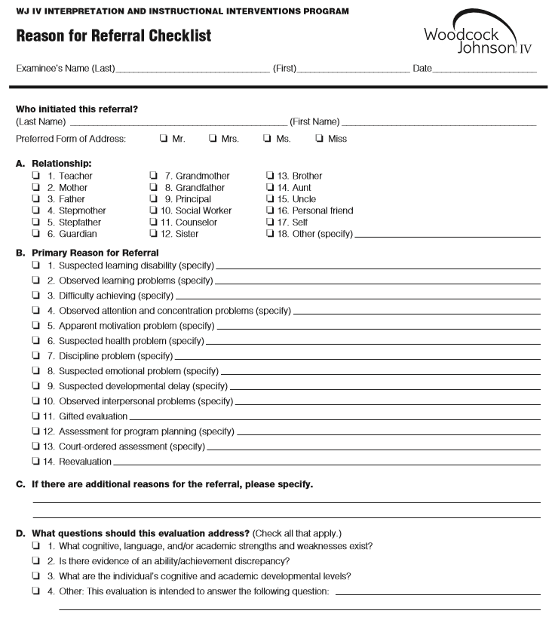
SAMPLE

Slide 23
Checklists
Parent’s Checklist: School Age
Intended for use by parents (or caregivers) of school-aged children
Includes eight parts:
  Parts I through V: Developmental History
  Part VI: Current Temperament and Mood
  Part VII: Current Behaviors
  Part VIII: Behavior Problems at Home

Slide 24
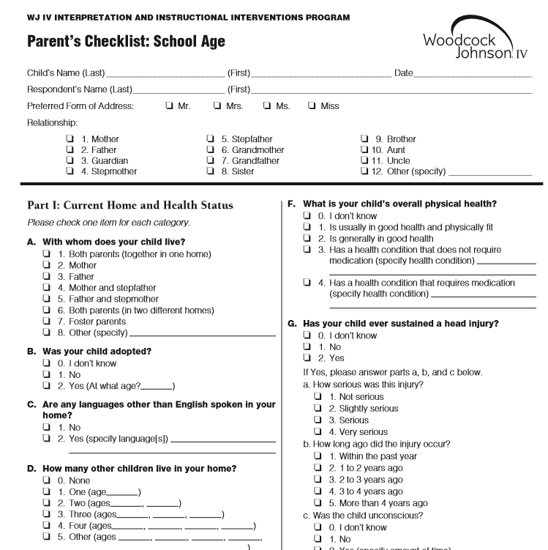
SAMPLE

Slide 25
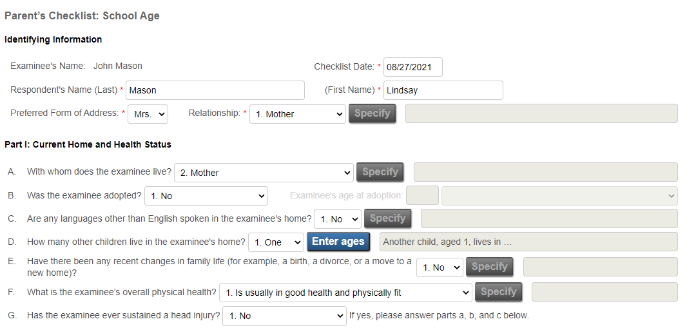
Checklists
Online Entry of Parent’s Checklist

Slide 26
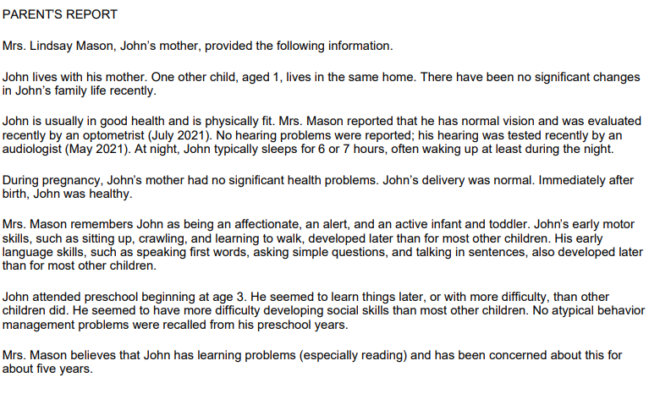
Checklists
Sample Information

Slide 27
Checklists
Teacher’s Checklist: School Age
Intended to integrate information provided by student’s teacher
Includes six parts:
  Part I: Ratings of Oral Language and Achievement
  Part II: Current Level of Instruction
  Part III: Student’s Temperament and Mood
  Part IV: Current Classroom Functioning
  Part V: Primary Concern
  Part VI: Problem Behaviors in the Classroom

Slide 28
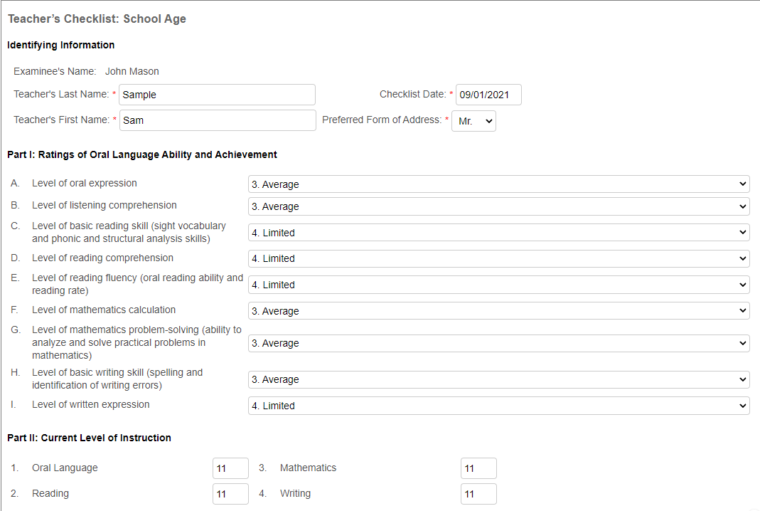
Checklists
Online Entry of Teacher’s Checklist

Slide 29
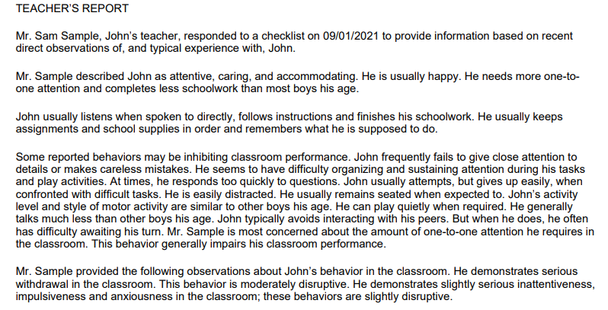
Checklists
Sample Information

Slide 30
Checklists
Classroom Behavior Observation Form
Allows the examiner to integrate direct observations into the Comprehensive Report
Can include one or two classroom observations in the comprehensive report
Includes three parts:
    Part I: Time Sampling Form
      Comparison Student (typical peer) and Referred Student
    Part II: Impact of Problem Behaviors on learning and classroom environment
    Part III: Review of Primary Problem Behavior- identify primary problem and provide additional information.
Notes:
Part I is a time sampling of behavior. Direct observations of the referred student and a comparison student are documented over a 15-minute time period at 30-second intervals. Any off-task behavior exhibited by the referred student is categorized by selecting one of eight listed behaviors.
Part II is used to provide more information about any categories of problem behaviors noted during the time sampling of behavior. This would include a description of the behavior and how the behavior impedes the student’s learning or disrupts other students.
Part III, the evaluator is asked to identify the primary problem behavior and provide an additional description about what was observed before, during, and after the behavior was exhibited.

Slide 31
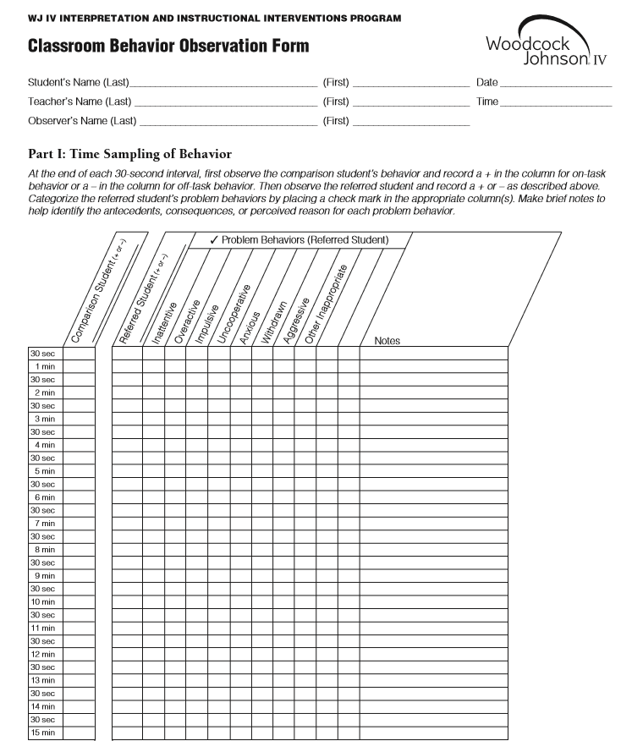
SAMPLE
+
+
+
-
√
Playing with pencil

Slide 32
Checklists
Self-Report Checklist: Adolescent/Adult
Intended for use by adolescent or adult who is capable of reading and understanding the questions
Modification of the Parent’s Checklist: School Age
Includes five parts:
    Part I: Current Home and Health Status
    Part II: Self-Description of Attitudes
    Part III: Self-Rating of Abilities and Skills
    Part IV: School History
    Part V: Recollections of Early Schooling

Slide 33
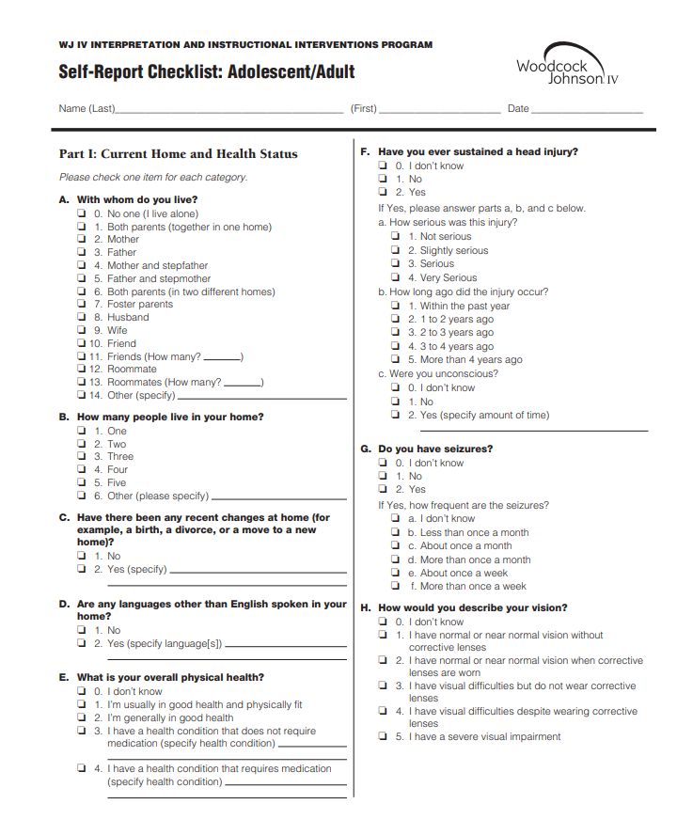
SAMPLE

Slide 34
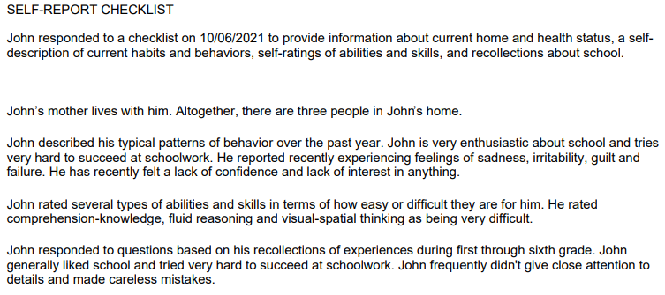
Checklists
Sample Information

Slide 35
Checklists
Writing Evaluation Scale
Provides narrative interpretation of examinee’s writing skills
Supplements test results and provides more detail on individual’s writing competency
Helps identify instructional goals
Assists in monitoring progress
Notes:
Select one or several examples of student’s writing (narrative or expository)
Read and get general impression, reread and mark all errors (categorize errors later)
Combine this info with test results to plan instruction

Slide 36
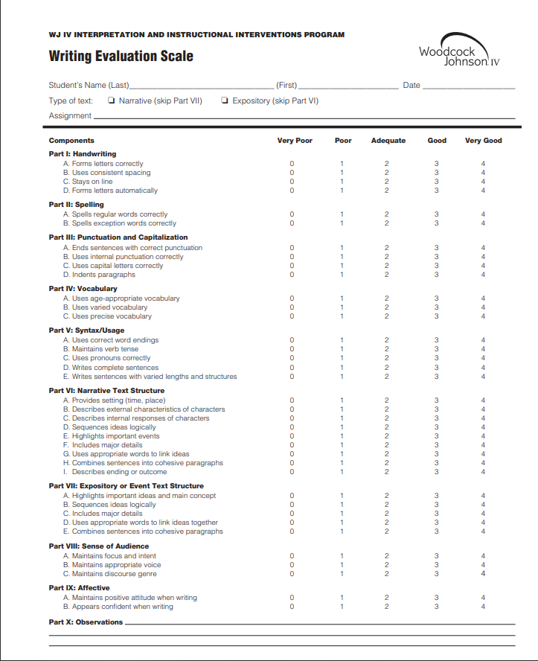
SAMPLE

Slide 37
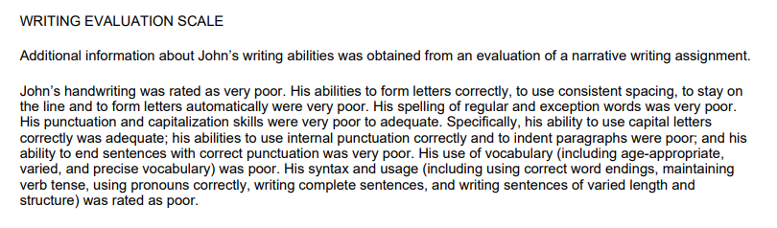
Checklists
Sample Information

Slide 38
Evidence-Based Interventions
Research supports the effectiveness of the intervention.

Slide 39
Evidence-Based Interventions
WJ IV ACH: Instructional interventions
WJ IV OL: Accommodations and interventions
WJ IV COG: Accommodations and interventions
Written in narrative style for reports
Based on individual’s performance
Generated when performance falls within limited or lower range
Notes:
WIIIP has a library of interventions theoretically linked to CHC broad and narrow abilities and conceptually linked to the cognitive processing requirements of each test.

Slide 40
Evidence-Based Interventions
The Tests of Achievement (ACH) Measure:
Reading
Mathematics
Written Language
Academic Knowledge
Notes:
WIIIP has a library of interventions theoretically linked to CHC broad and narrow abilities and conceptually linked to the cognitive processing requirements of each test.

Slide 41
CLUSTER/Test W AE RPI SS (68% Band)
Math Facts Fluency 464 7-8 0/90 50 (43-56)
Evidence-Based Interventions
ACH Sample 1: John, Age 17-1
John needs interactive and intensive practice to master his math facts. It is best to use distributed practice, presenting smaller, but frequent, practice sessions. Also, focus on a few facts at a time, rather than on all the facts. Emphasize reverses or turnarounds, such as 6 + 4 and 4 + 6 or 3 x 2 and 2 x 3. Teach the zero facts and rules. Computer programs and games also are good ways to provide additional practice.

Slide 42
Evidence-Based Interventions
The Tests of Cognitive Abilities (COG) Measure:
Comprehension-Knowledge (Gc)
Fluid Reasoning (Gf)
Short-term Working Memory (Gwm)
Cognitive Processing Speed (Gs)
Auditory Processing (Ga)
Long-term Retrieval (Glr)
Visual Processing (Gv)
Notes:
WIIIP has a library of interventions theoretically linked to CHC broad and narrow abilities and conceptually linked to the cognitive processing requirements of each test.

Slide 43
CLUSTER/Test W AE RPI SS (68% Band)
Comp-Knowledge 461 5-3 1/90 <40 (<40-41)
Evidence-Based Interventions
COG Sample 1: John, Age 17-0
When presenting new information, it may be necessary to help John associate the key points with his prior knowledge or personal experiences.

Slide 44
Evidence-Based Interventions
The Tests of Oral Language (OL) Measure:
Oral Expression
Listening Comprehension
Phonetic Coding and Phonological Awareness
Speed of Lexical Access
Notes:
WIIIP has a library of interventions theoretically linked to CHC broad and narrow abilities and conceptually linked to the cognitive processing requirements of each test.

Slide 45
CLUSTER/Test W AE RPI SS (68% Band)
Oral Language 491 8-6 54/90 76 (71-81)
Evidence-Based Interventions
OL Sample: Cira, Age 13-8
Reading lessons aloud to Cira, either individually or as part of a small group, is a way to identify words she does not understand. Cira should listen to the oral reading while reading along and ask a question if she does not understand a word or concept. If asking a question presents too great a language load, Cira can signal her lack of understanding by using an agreed-upon gesture or by marking the word with a sticky note. Then pause and explain the meaning of the word or concept, using examples, synonyms, or words with similar derivations or structure. Pay particular attention to any false cognates, as these words can lead to misunderstandings.

Slide 46
Formative Interventions
Designed to improve day-to-day teaching and meet the specific needs of the student
Notes:
Formative Assessment is a process used during instruction to provide feedback which is used to adjust instruction.
Formative interventions provide item-level feedback after testing which can be used to address gaps in learning and differentiate instruction for specific student.

Slide 47
Formative Interventions
Availability
Available for five tests in the WJ IV Tests of Achievement Forms A, B, and C:
    Letter-Word Identification
    Applied Problems
    Spelling
    Calculation
    Word Attack
If error types are tallied for Test 8: Oral Reading, a formative intervention for each error type is available.

Slide 48
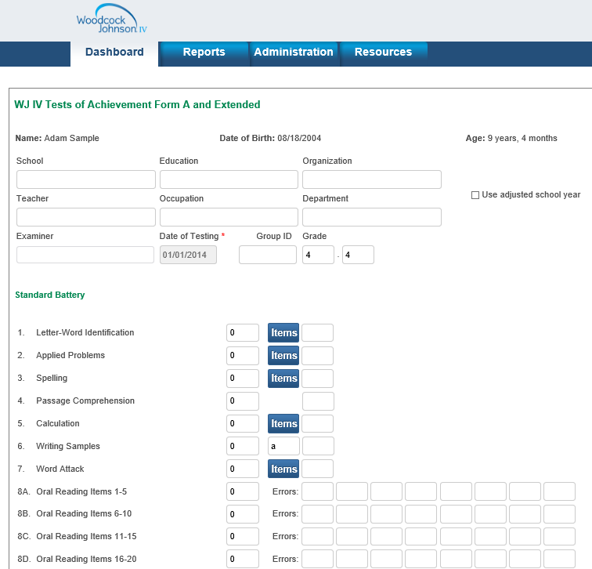
Select items to enter item-level data

Slide 49
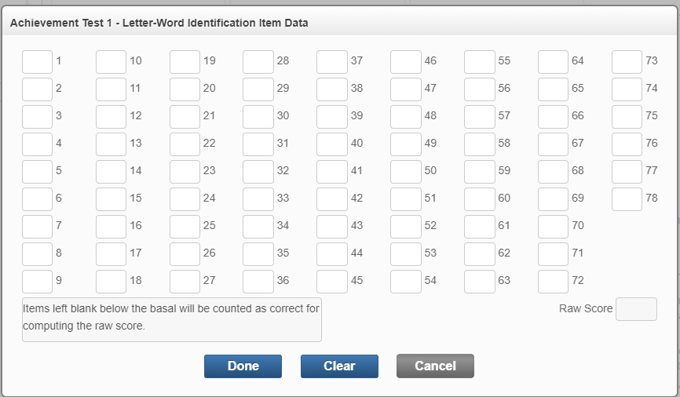
Formative Interventions
Item-Level Data (1, 0) Requirement

Slide 50
Formative Interventions
Other Information
Generates formative intervention when unexpected error occurs
Provides intervention for teaching specific skill or concept
Based on sound teaching practices, but effectiveness is not necessarily backed by research as in evidence-based interventions
Unexpected Error: An incorrect response followed by one or more correct responses.

Slide 51
Formative Interventions
Example 2
Test 2: Applied Problems (teaching simple multiplication word problems)
Explain that multiplication helps us solve problems easily when groups are of equal size. Illustrate the principle using this example: Four children are playing tennis. Each child has five tennis balls. How many tennis balls are there altogether? Ask Missy to draw 4 children using stick figures and then to draw 5 tennis balls by each child. Point out that there are 4 groups of equal size in this problem, which can be represented by writing 4 × 5. Present additional simple word problems requiring multiplication. Ask Missy to write a multiplication sentence for each problem. Remind her that she can draw pictures to help.

Slide 52
Dyslexia Report
Offers a framework using various WJ IV clusters and tests to assist in:
The organization of assessment data
The determination of Dyslexia

Slide 53
Dyslexia Report
Dyslexia Report Elements
The WJ IV Dyslexia Report provides an organizational framework for assessing the characteristics of dyslexia. The report includes a dyslexia score profile and interpretive overviews with comparisons. Examiners can include interventions and information from the new Dyslexia Teacher and Parent Checklists, as well as other WIIIP checklists.
WIIIP Checklists
Examiners can use the following checklists with the WJ IV Dyslexia Report:
Dyslexia Evaluation Checklist: Parent Form
Dyslexia Evaluation Checklist: Teacher Form
Self-Report Checklist: Adolescent/Adult
Classroom Behavior Observations
Writing Evaluation Scale

Slide 54
Goals of the Dyslexia Profile Report
Does not “diagnose” Dyslexia
Framework to discuss the primary and secondary characteristics of a student.
Integrates valuable home and school qualitative information
Aligns with the 6th ASB’s framework of WJ IV’s use in Dyslexia Assessment
Makes conceptualization easier and more targeted

Slide 55
Dyslexia Report Components
Dyslexia Report
Dyslexia Evaluation Checklist: Parent Form
Dyslexia Evaluation Checklist: Teacher Form
Additional Considerations in Dyslexia Assessment (Document)
Notes:
Last document in resources tab.

Slide 56

WJ IV ASB- Assessment of Dyslexia (2015)
Notes:
Released to describe the useful features of the Woodcock-Johnson that may be included in an evaluation for dyslexia, present the WJ IV Dyslexia Profile of Scores, and describe the WJ IV Dyslexia Summary Report. Available through Resources Tab on RS.

Slide 57
Concept Behind the ASB:
Identifying PRIMARY Reading and Spelling Difficulties
Phoneme-Grapheme Knowledge
  Word Attack, Spelling of Sounds
Basic Reading Skills
  Letter-Word Identification, Word Attack
Reading Rate
  Sentence Reading Fluency, Word Reading Fluency
Spelling
  Spelling, Spelling of Sounds
Oral Reading Fluency
  Oral Reading

Slide 58
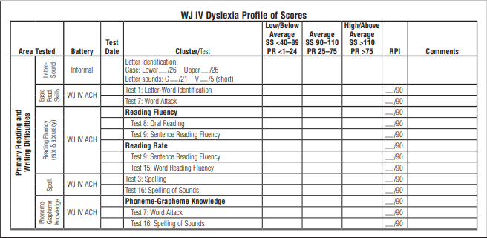
WJ IV Dyslexia Profile of Scores
Scores in the Primary Reading and Writing Difficulties

Slide 59
Identifying SECONDARY Reading and Writing Difficulties:
Reading comprehension
  WJ IV ACH Passage Comprehension
  WJ IV ACH Reading Recall
Written expression
  WJ IV ACH Writing Samples
  WJ IV ACH Writing Fluency
Vocabulary and Academic knowledge
  WJ IV ACH, COG, OL

Slide 60
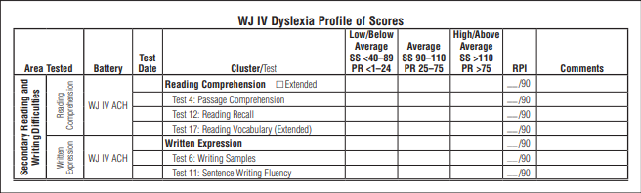
WJ IV Dyslexia Profile of Scores
Scores in the Secondary Reading and Writing Difficulties
Notes:
Note that the framework also considers cognitive abilities as possible contributing factors, in addition to possible strengths (so areas not related to reading)

Slide 61
Cognitive Characteristics of Dyslexia
Non-reading related areas spared
Average to above average overall cognitive functioning
Oral language and math skills may be intact

Slide 62
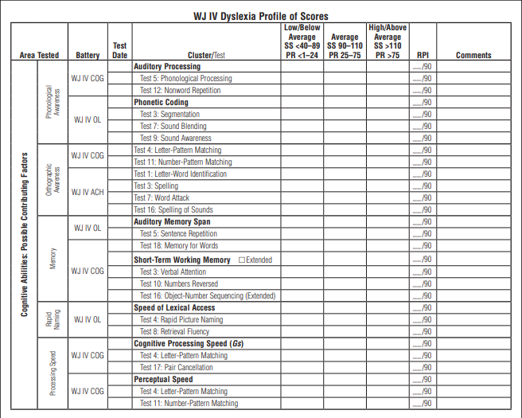
Relevant Cognitive Abilities

Slide 63
Required & Optional Tests/Clusters
Required and Optional Tests and Clusters
To generate the WJ IV Dyslexia Report, examiners must enter the test scores necessary to generate at least one of the following test clusters:
Gf-Gc Composite (WJ IV COG)
Academic Knowledge Cluster (WJ IV ACH)
Broad Oral Language Cluster (WJ IV OL)
*Examiners can choose to use all three clusters but at least one is required to generate the Dyslexia Report.
Examiners are also required to enter test scores for the following test and clusters all included within the Achievement Form:
Spelling Test (WJ IV ACH)
Basic Reading Skills Cluster (WJ IV ACH)
Phoneme-Grapheme Knowledge (WJ IV ACH)
Reading Fluency Cluster (WJ IV ACH)
*The Reading Fluency Cluster is required for all examinees ages 7 and older or grade 2 and above.

Slide 64
Required Tests
  Letter Word Identification
  Word Attack
  Oral Reading
  Sentence Reading Fluency
  Spelling of Sounds
  Spelling
  Picture Vocabulary
  Oral Comprehension
  Understanding Directions
  Oral Vocabulary
  Number Series
  General Information
  Concept Formation

Slide 65
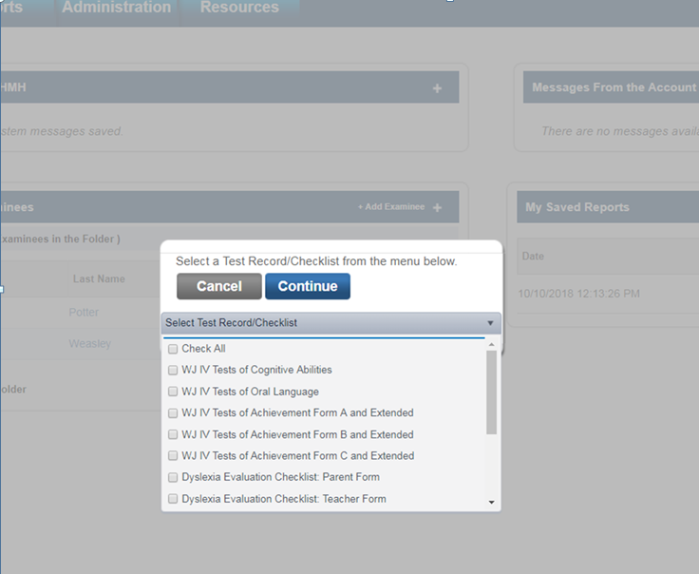
Dyslexia Evaluation Checklists Teacher & Parent Form
If a user is entitled to WIIIP they will find 2 Dyslexia checklists available to them in the Add Test Record drop-down.
Dyslexia Evaluation Checklist: Parent Form
Dyslexia Evaluation Checklist: Teacher Form
Notes:
Please note that a Grade level must be entered into a student’s test record in order for them to populate in the Roster Report.

Slide 66
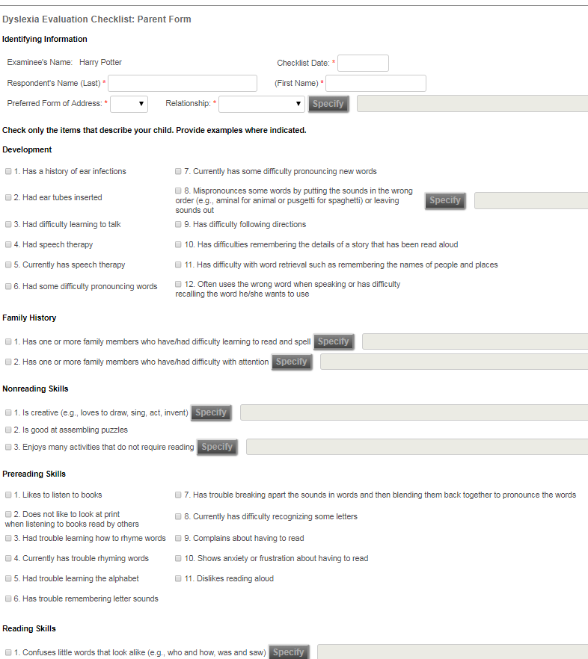
Dyslexia Evaluation Checklist: Parent Form

Slide 67
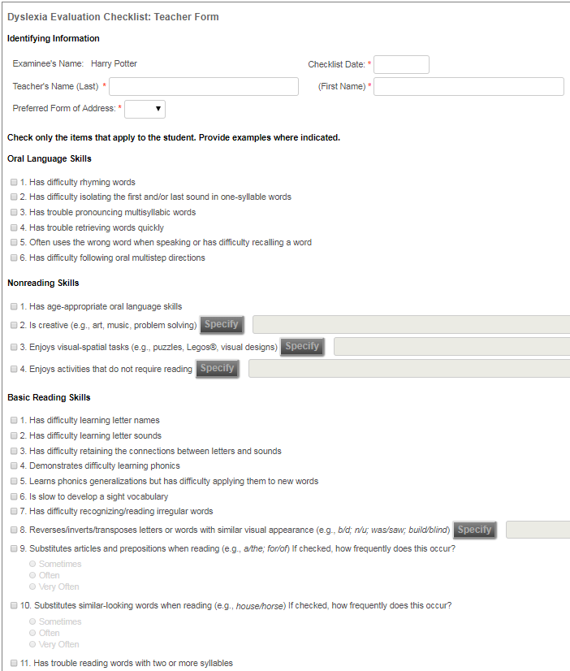
Dyslexia Evaluation Checklist: Teacher Form

Slide 68
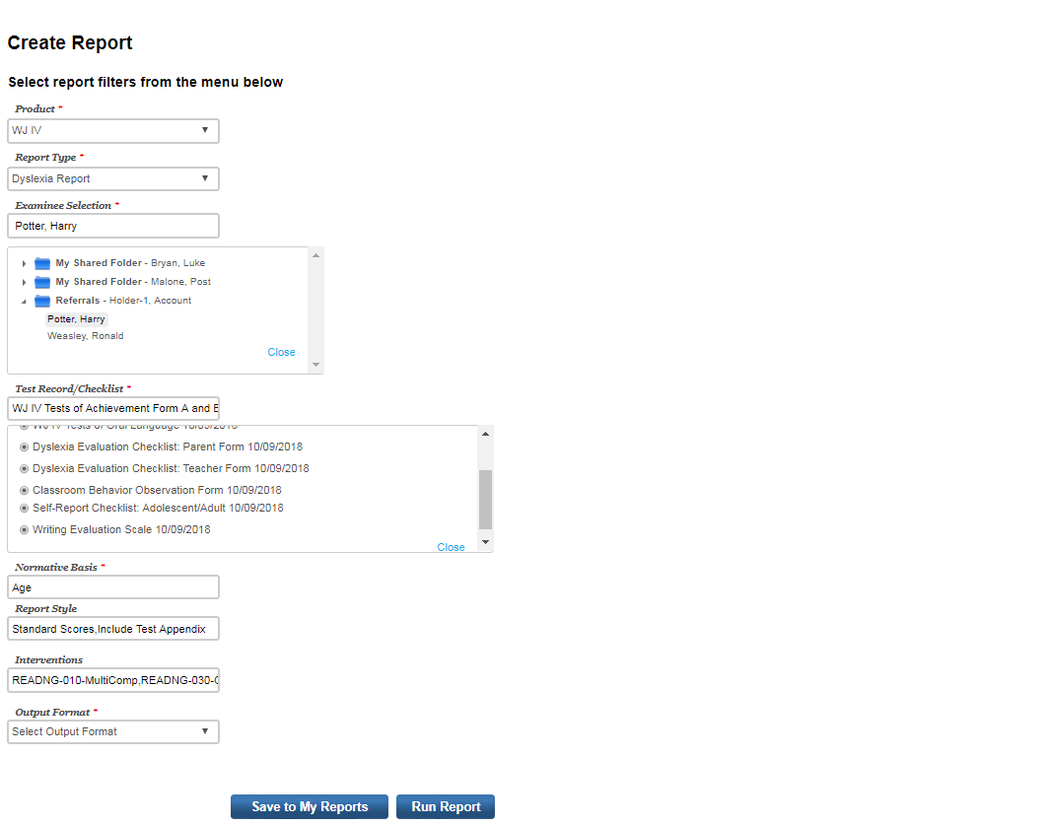
Dyslexia Report
To generate a Dyslexia Report you can navigate to the Create Reports page from the Reports tab on the Dashboard. You will see Dyslexia Report under Report Type Options in the WJIV product if you are entitled to WIIIP.
NEW! Dyslexia Report selection
Notes:
Dyslexia Report is an add-on to WIIIP and can only be accessed.

Slide 69
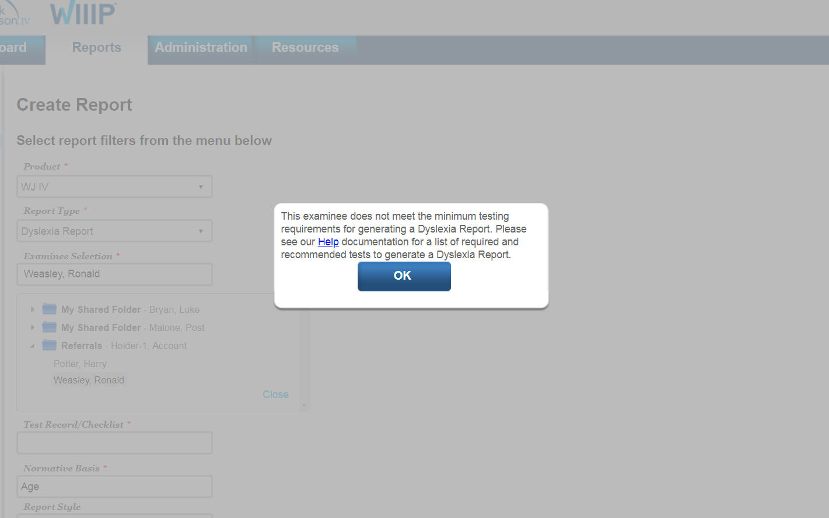
Error Message for Missing Tests/Clusters
*If the selected examinee does not have the required tests and clusters administered they will received the following error message.

Slide 70
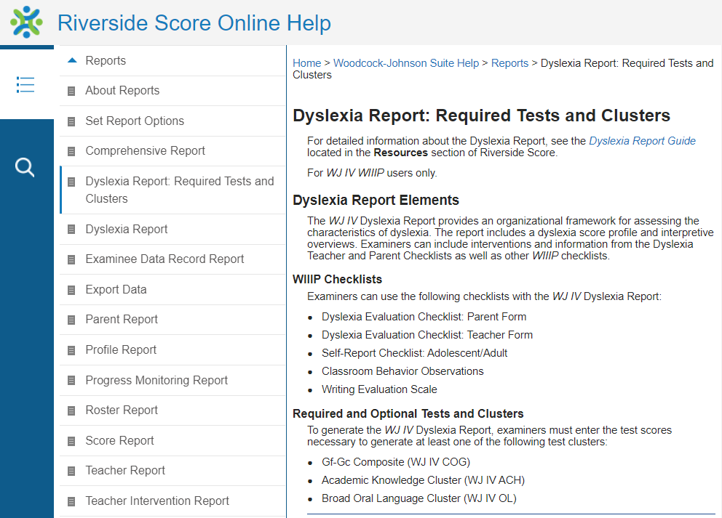
Dyslexia Report Online Help
The hyperlink in the error message will guide you to the following page:
https://s3.amazonaws.com/onlinehelp.riversideinsights.com/Help/testbed/OSR/index.htm#t=Test_Records%2FDyslexia_Report_Required_Tests_and_Clusters.htm

Slide 71
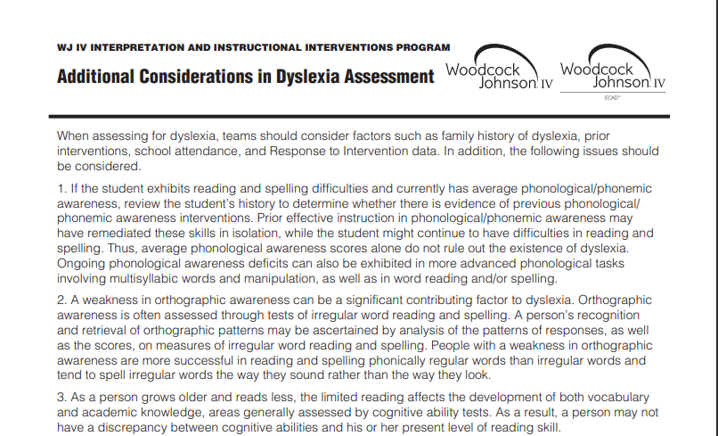
Riverside Score Resources- Additional Considerations in Dyslexia Assessment

Slide 72
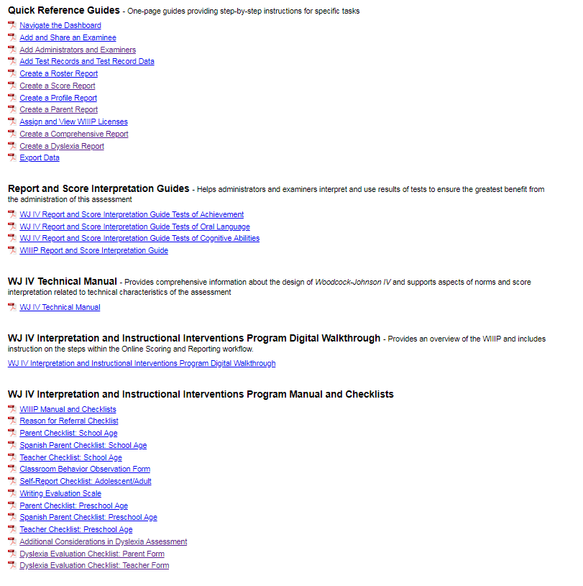
Dyslexia Report Help and Resources
Create Dyslexia Report Quick Reference Guide
Additional Considerations in Dyslexia Assessment
Dyslexia Evaluation Checklist: Parent Form PDF
Dyslexia Evaluation Checklist: Teacher Form PDF

Slide 73
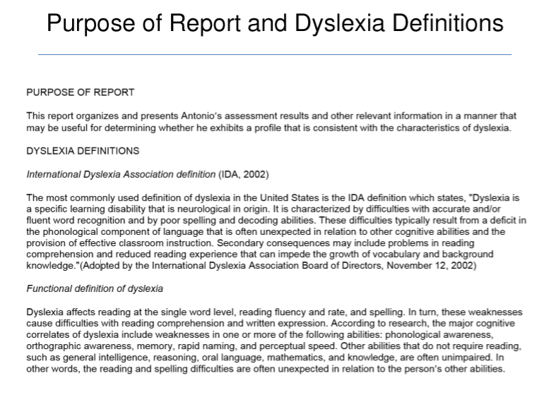
At the Beginning of Every Dyslexia Report

Slide 74
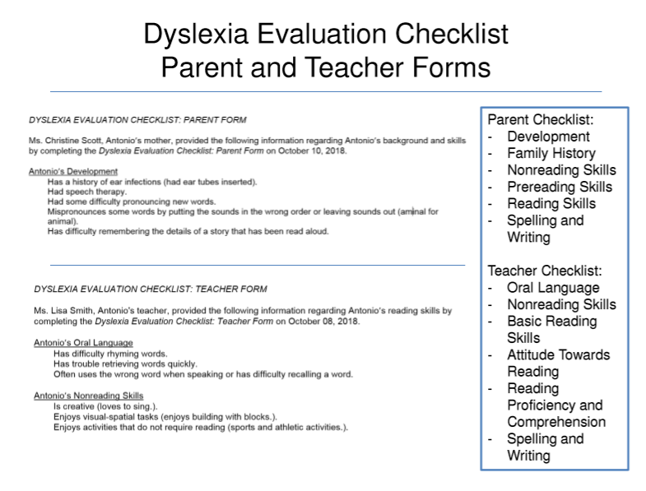
Checklist Information Embedded in Report:

Slide 75
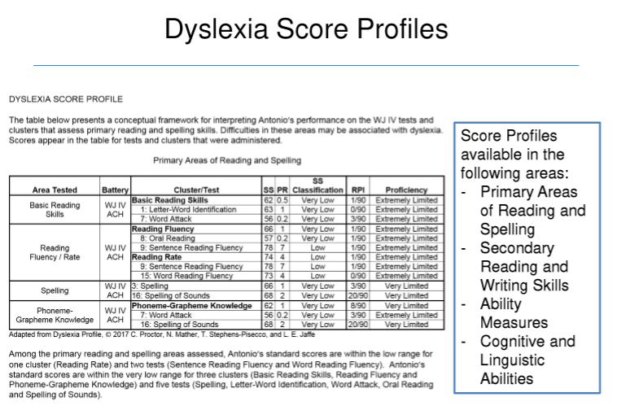
Primary Areas: Reading and Spelling

Slide 76
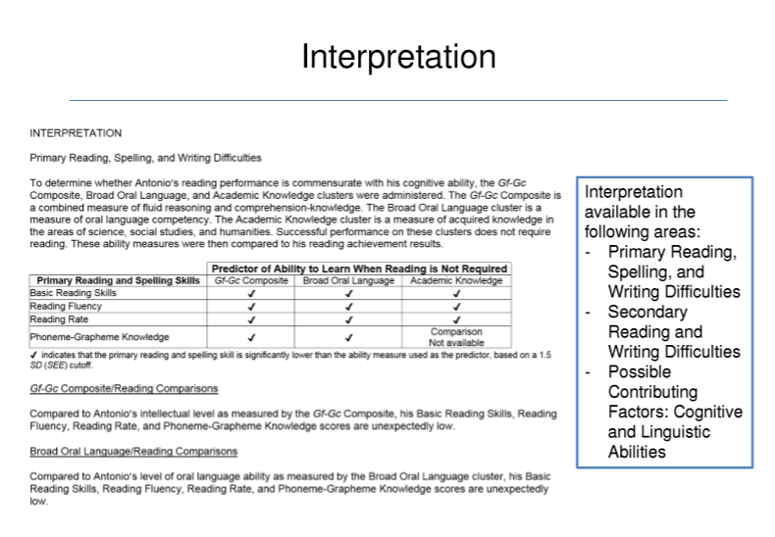
Comparison to Predictors: Gf-Gc, OL, Academic Knowledge

Slide 77
Interpretation Information:
Variations: Procedures that analyze variability in an individual’s performance within the cognitive, oral language or achievement domains to identify a pattern of strengths and weaknesses.
  Uses the average of the other subtests in the “core” to get the predicted score
  Cognitive: Tests 1-7
  Achievement: Tests 1-6
  Oral Language: Tests 1-4
  SCORES and INTERPRETATION CHAPTER
Comparisons: Procedures that analyze if a student’s performance is discrepant from a predictor.
  Standard Deviation

Slide 78
Comparison Methods:
GIA/Achievement; Gf-Gc/Other Ability; Scholastic Aptitude/Achievement
  Requires the WJ Cognitive
Oral Language/Achievement
  Requires WJ Oral Language
Academic Knowledge/Achievement
  Requires WJ Achievement
  *Each considered a predictor in this method

Slide 79
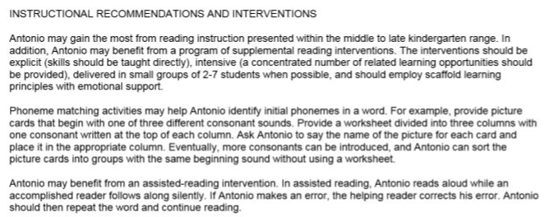
Recommendations and Interventions:

Slide 80
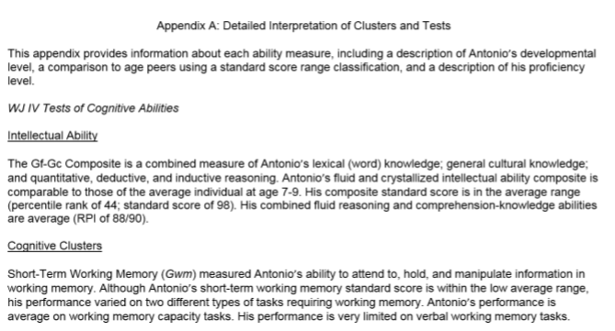
Detailed Interpretation of Clusters and Tests:

Slide 81

Summary

Slide 82
Summary
Key Points
Professional retains control over and responsibility for the report and interventions
WIIIP facilitates the process
  Generates interventions based on examinee’s age and areas of concern (academic, language, and cognitive)
  Generates narrative report and scores so examiner can focus on interpretation
  Generates framework from which a Dyslexia assessment can be conducted

Slide 83
Summary
Key Points
Relevant
  Links WJ IV evaluations to instruction
  Provides evidence-based and formative interventions
  Focuses on the educational needs of the individual
Convenient
  Provides interventions for all WJ IV academic, language, and cognitive areas in one place
  Matches interventions to individual based on needs
  Generates comprehensive report and all scores
  Includes checklists if completed

Slide 84
Summary
Convenient web-based entry
Large number of interventions and accommodations
Streamlined Comprehensive Report
  Test Appendix A provides optional, more detailed interpretation

Slide 85
Availability and Pricing

Slide 86
Availability and Pricing
Available as a license (1 year). Prices below reflect one year initial and one year renewal (which is 10% of the initial license tier fee).
Accessed through Riverside Score
Examples of licensing fees:
  Individual examiner license 626.87 with 10% renewal fee
  2-5 examiners 1250.83 with 10% renewal
  6-9 examiners 2514.28 with 10% renewal
  10-24 examiners 6285.70 with 10% renewal
Other rates available for larger groups of examiners, up to 100+

Slide 87

Questions?

Slide 88
Thank you!
For any other questions about the WIIIP, or any of our other products, please feel free to reach out to our representatives at: inquiry@service.riversideinsights.com

